Slide 1

IGeLU & ELUNA joint
Alma PWG
8th IGeLU Meeting
Session 8
Berlin, 9 September 2013

Slide 2
8th IGeLU Meeting, Berlin 2013
Session 8: Alma PWG Business Meeting
Agenda
Business meeting (15 minutes):
  -- Introduction of current PWG members
  -- PWG guidelines
  -- 2012/13 work
2. Top 5 issues from PWG members (discussion, 45 minutes)
-- Alma design
-- Community zone/ e-resources/Uresolver
-- Analytics
-- External system integration
-- Communications between Ex Libris teams
Improving the partnerships between the Alma community, PWG & Ex Libris (15 minutes)
-- Helping each other
-- Working with Ex Libris
-- What can the PWG do to help the community?

Slide 3
8th IGeLU Meeting, Berlin 2013
Session 8: Alma PWG Business Meeting
Betsy Friesen, University of Minnesota, USA – Coordinator
Helen Loosli, UNILINC, Australia – Deputy Coordinator
Diane Baden, Boston College, USA
Roger Brisson , Boston University,USA
Paolo Buoso, Free University of Bozen-Bolzano, Italy
Scott W. Carlisle, Northeastern University Libraries, USA
Tracey V Clarke, University of Sheffield, UK
Ann Doyle Fath , Getty Research Institute, USA
Lisa Hanson O’Hara, University of Manitoba Libraries, Canada
Ebe Kartus, RMIT University Library, Australia
Megan Lee, Monash University Library, Australia
Bart Peeters, KU Leuven / LIBIS, Belgium
Angela Walker, University Of Salford, UK

Slide 4
8th IGeLU Meeting, Berlin 2013
Session 8: Alma PWG Business Meeting
Alma PWG charge
Organize the Alma Product track at the annual ELUNA and IGeLU meetings
Communicate product information to Alma customers via the Alma mailing list and any other methods available
Maintain content of the Alma portion of ELUNA and IGeLU web pages
Identify need for sub-groups with specific focus and form them when necessary. Sub-groups can include non-PWG members.
Communicate group activities via the Alma (PWG) (Coordinator), to the ELUNA/IGeLU Steering Committees and seek the advice of the Steering Committees on relevant issues as appropriate.
Communicate issues and concerns from the Alma community with Ex Libris product managers via monthly calls with the PWG coordinator

Slide 5
8th IGeLU Meeting, Berlin 2013
Session 8: Alma PWG Business Meeting
Membership
Established by the Steering Committees in August, 2012 from a pool of volunteers from Alma development partner and early adopter institutions.
These members will serve a term of two years. If members leave the group during this time, the PWG will solicit Alma users to fill positions only if the group membership is fewer than ten (10) members and not to exceed fifteen members (15).
After 2014, Group members shall serve staggered two-year term with 50% of the Group’s membership elected each year.

Slide 6
8th IGeLU Meeting, Berlin 2013
Session 8: Alma PWG Business Meeting
PWG work during 2012/2013
Organizational structure
Communication
  Wiki/web
  Alma-L
Alma issue discussions
  ELUNA
  American Library Association meeting
Alma high-level roadmap release with Ex Libris

Slide 7
8th IGeLU Meeting, Berlin 2013
Session 8: Alma PWG Business Meeting
Question 1: The Design of Alma
Would it be possible for us to hear a ‘top-level’
conceptual characterization of Alma in just a few sentences?
Please could the answer include (but not be confined to) the following Alma concepts:
Inventory:
If inventory is central to Alma, what is the relationship between the inventory record, the bibliographic record and the order record?
Material Type :
If the concept of ‘Material Type’ is fundamental to Alma,
a) Why are there different uses for and different lists of material types for different types of records? (the item record and the order record)
b) Why are these lists so restrictive and why can’t customers customise their own lists locally?

Slide 8
8th IGeLU Meeting, Berlin 2013
Session 8: Alma PWG Business Meeting
Question 2: Community Zone/e-resources/UResolver
The community zone so far is a long way from being the huge
database of bibliographic records from all over the world
that customers were promised.
Does Ex Libris have a timeline for improving the content of the
Community Zone and aligning the content more closely with the
resources handled through the UResolver?

Slide 9
8th IGeLU Meeting, Berlin 2013
Session 8: Alma PWG Business Meeting
Question 3: Analytics
Alma Analytics does provide staff with an easy to use interface
for creating, running and sharing reports. However it does not provide users with access to all the data that is required to produce the plethora of reports demanded by library managements.
Could Ex Libris speak about the following Analytics / Reporting inadequacies:
Missing Analytics are required for Holds and Course Reserves data
Print and electronic data seems to be siloed and not available for combined reporting
Key fields like reporting code are missing from certain subject areas
On the fiscal side, most fields like expenditure and encumbrance are available for report selection but allocation has to be formulated. Allocations are key to fiscal reporting and should be easy to select for inclusion in a report
Systems staff requiring real-time (or at least daily) access to all their Alma data (Update: Analytics will refresh daily with the Sept. release)
Systems staff requiring SQL access or equivalent to their Alma data

Slide 10
8th IGeLU Meeting, Berlin 2013
Session 8: Alma PWG Business Meeting
Question 4: Alma’s ability to integrate smoothly with
‘external’ systems.
Integrations with external systems such as Self service machines, entry control, SAP, and the ability to export user records to
other systems, make online payments are difficult.
Often guidance from Ex Libris staff is inconsistent. How can this be improved?

Slide 11
8th IGeLU Meeting, Berlin 2013
Session 8: Alma PWG Business Meeting
Question 5: Communications between Ex Libris Teams
for Implementing Libraries
Dealing with an implementation team, a development team and a
migration team is not always productive.
Library staff frequently discuss complex implementation issues with their development team and then have to repeat it with their implementation
team and then be told to create an SI/Ticket in Pivotal / Salesforce.
Invariably, when these same issues are raised with the migration team they are dismissed and the library’s migration proceeds with little regard to the queries and at the schedule that often only suits the migration team
1. Can a better line of communication be established for implementing libraries?
2. If not all issues reported are high priorities, can the response time for less crucial issued be increased?
3. Frequently implementation issues could be resolved by the libraries themselves. Why can’t they have access to a test environment with real data, with access to their back office to adjust policies etc during their implementation process?

Slide 12
8th IGeLU Meeting, Berlin 2013
Session 8: Alma PWG Business Meeting
Question 5: Communications between Ex Libris Teams
for Implementing Libraries
Dealing with an implementation team, a development team and a
migration team is not always productive.
Library staff frequently discuss complex implementation issues with their development team and then have to repeat it with their implementation
team and then be told to create an SI/Ticket in Pivotal / Salesforce.
Invariably, when these same issues are raised with the migration team they are dismissed and the library’s migration proceeds with little regard to the queries and at the schedule that often only suits the migration team
1. Can a better line of communication be established for implementing libraries?
2. If not all issues reported are high priorities, can the response time for less crucial issued be increased?
3. Frequently implementation issues could be resolved by the libraries themselves. Why can’t they have access to a test environment with real data, with access to their back office to adjust policies etc during their implementation process?

Slide 13
8th IGeLU Meeting, Berlin 2013
Session 8: Alma PWG Business Meeting
2013-2014
We Need Your Help !

Slide 14
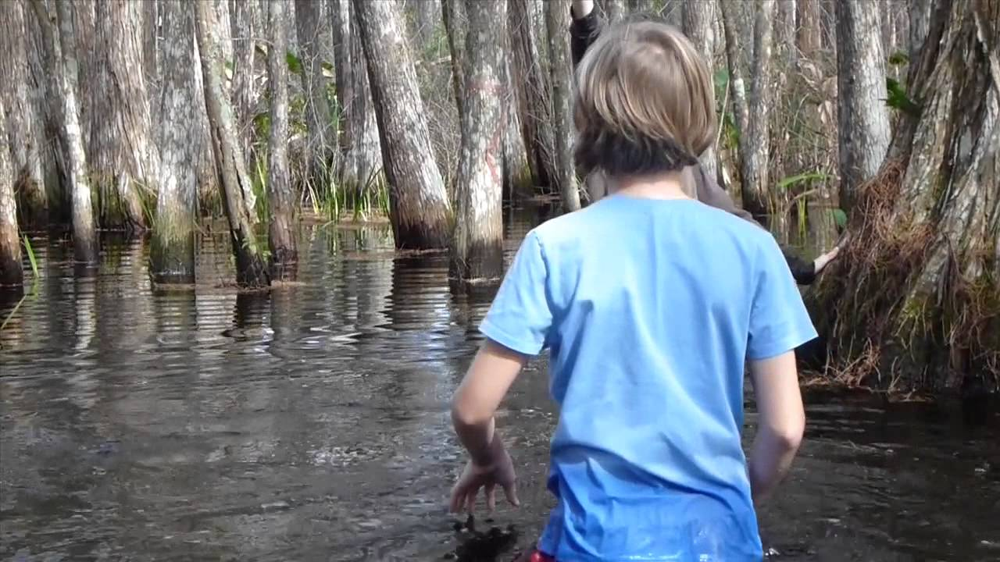
Notes:
Some of us might feel like we’re at the edge of a swamp

Slide 15
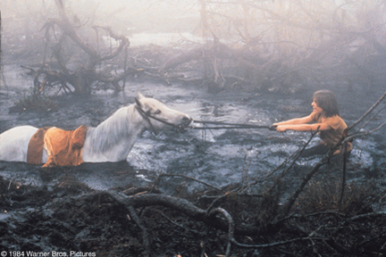
Notes:
Some might feel we’re deep in the swamp

Slide 16

Betsy
Notes:
Project managers may even feel like … and even act like this during implementation

Slide 17
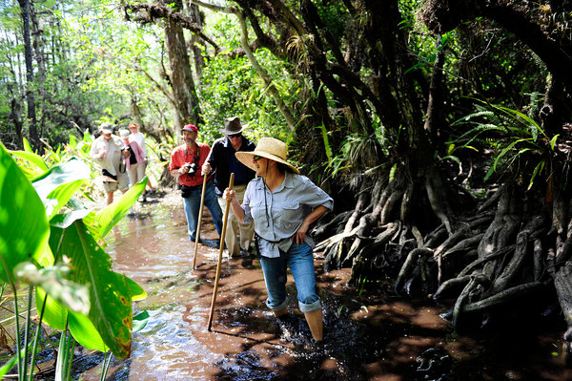
Notes:
But we will come out of the swamp, working locally, with each other, and Ex Libris to make a better product … maybe even smiling like these people

