Slide 1
BIBFRAME Implementation Insights
IGeLU 2025 Conference
September 15, 2025
Xiaoli Li, University of California Davis Library
TJ Kao, University of Pennsylvania Libraries*

Slide 2
Topics
Introduction to BIBFRAME
UC Davis’ BIBFRAME implementation journey
Cataloging workflow using the Sinopia Linked Data Editor
Challenges and lessons learned
Interested in practicing BIBFRAME?
Q&A

Slide 3
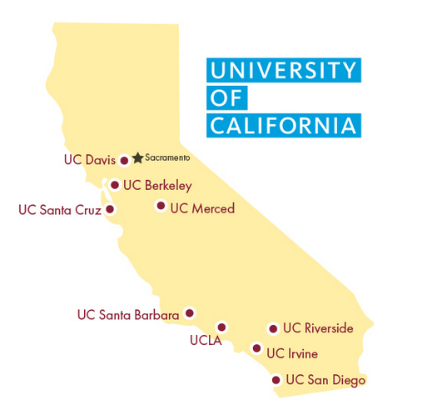

Slide 4
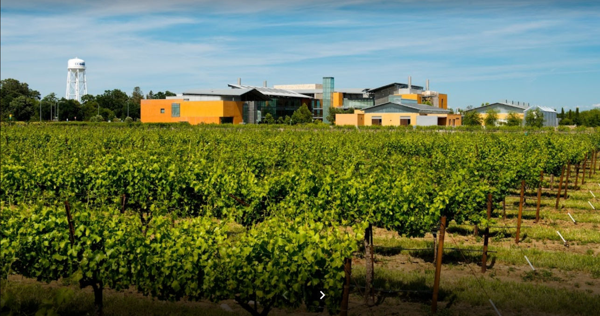

Slide 5

What is BIBFRAME?
Stands for BIBliographic FRAMEwork
Is a linked data initiative developed by the Library of Congress, started in the early 2010s
Designed to replace MARC as the new bibliographic standard
can and will serve as an encoding standard for RDA and other content standards
Leverages the current web technology (semantic web/linked data) and uses RDF modeling practice

Slide 6
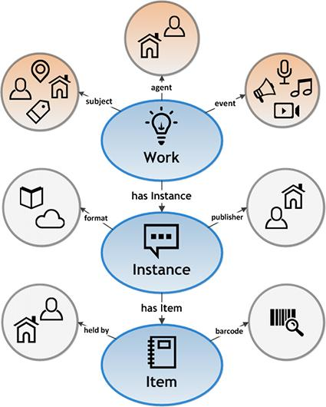
BIBFRAME 2.0 Model and RDA (with Hub)
Hub
RDA Work
RDA Expression
RDA Manifestation
RDA Item

Slide 7
Linked data projects at the UC Davis Library
OCLC Project Passage
PCC Wikidata Pilot
BIBFLOW
2013
2018
2020
2017
2019
2023
PCC ISNI Pilot
LD4P2

Slide 8
BIBFRAME implementation timeline
September 2023
Joined the Ex Libris Linked Data Focus Group
Began experimenting with Sandbox Alma Sinopia (Dev) integration
November 2023
Testing publishing BIBFRAME (BF) data in either BF or MARC 21 format from Alma to OCLC
June 2024
Switched integration from Sandbox Alma to Production Alma
🎉 BIBFRAME in production began!

Slide 9
Sinopia to Alma: linked data cataloging workflow
Log in to Sinopia Dev and select Linked Data Editor
Create the Instance record using “_PCC BF2 Instance (Monograph)”
Create the Work record, if one does not already exist, using “_PCC BF2 Work (Monograph)”
Link the Work and Instance records by inserting the Work URI into the Instance
Export to Alma once both Work and Instance records are complete

Slide 10
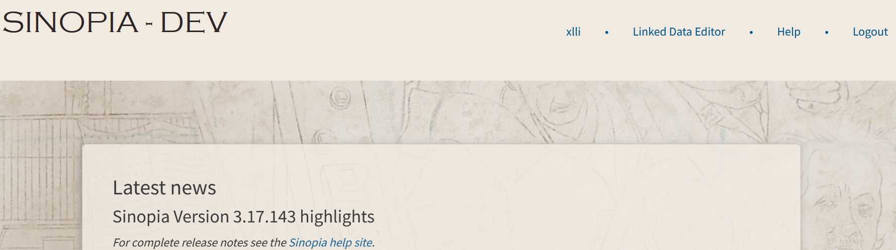
Workflow: Log in to Sinopia Dev and select the Linked Data Editor

Slide 11
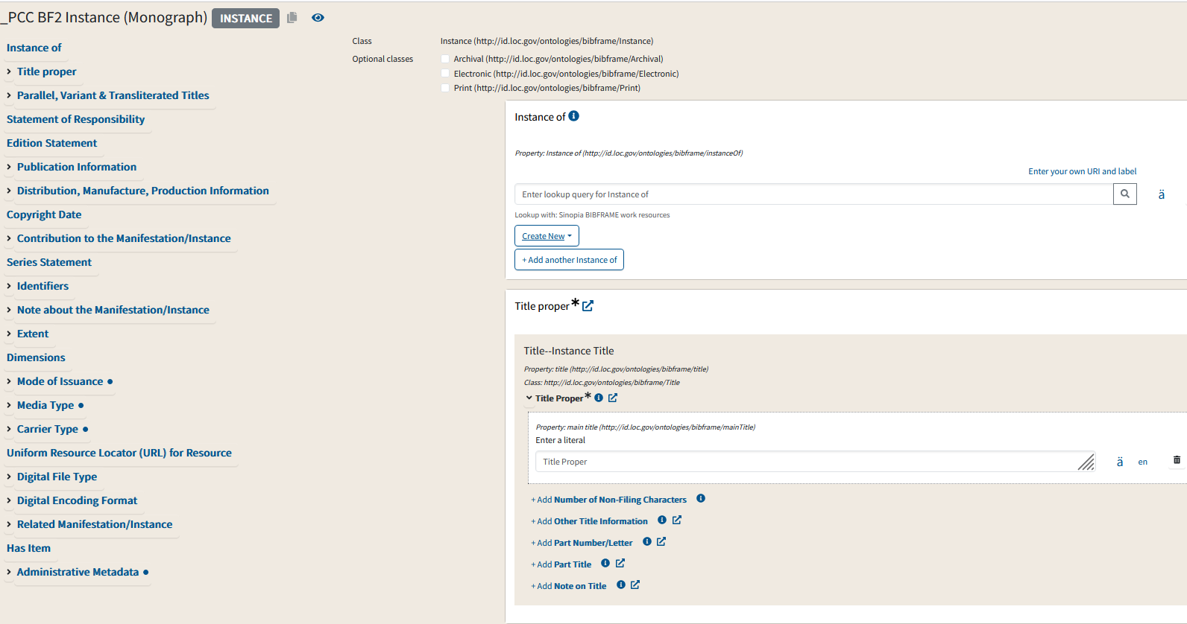
Workflow: Create the Instance record

Slide 12
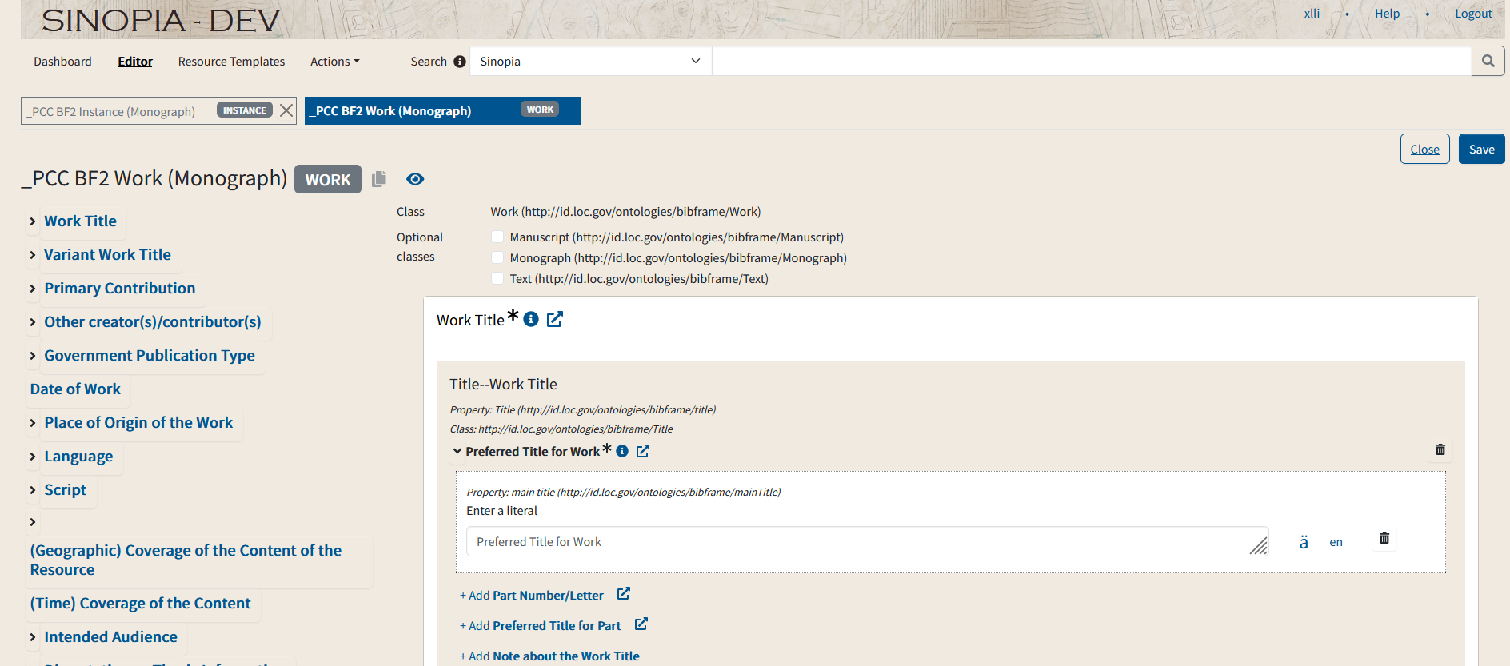
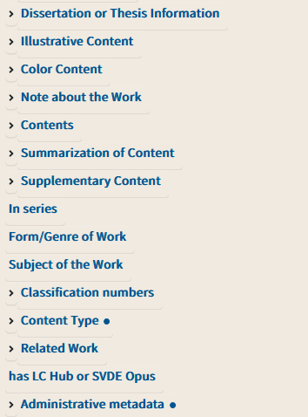
Workflow: Create the Work record

Slide 13
Workflow: Link the Work and Instance records
Insert Work URI here

Slide 14
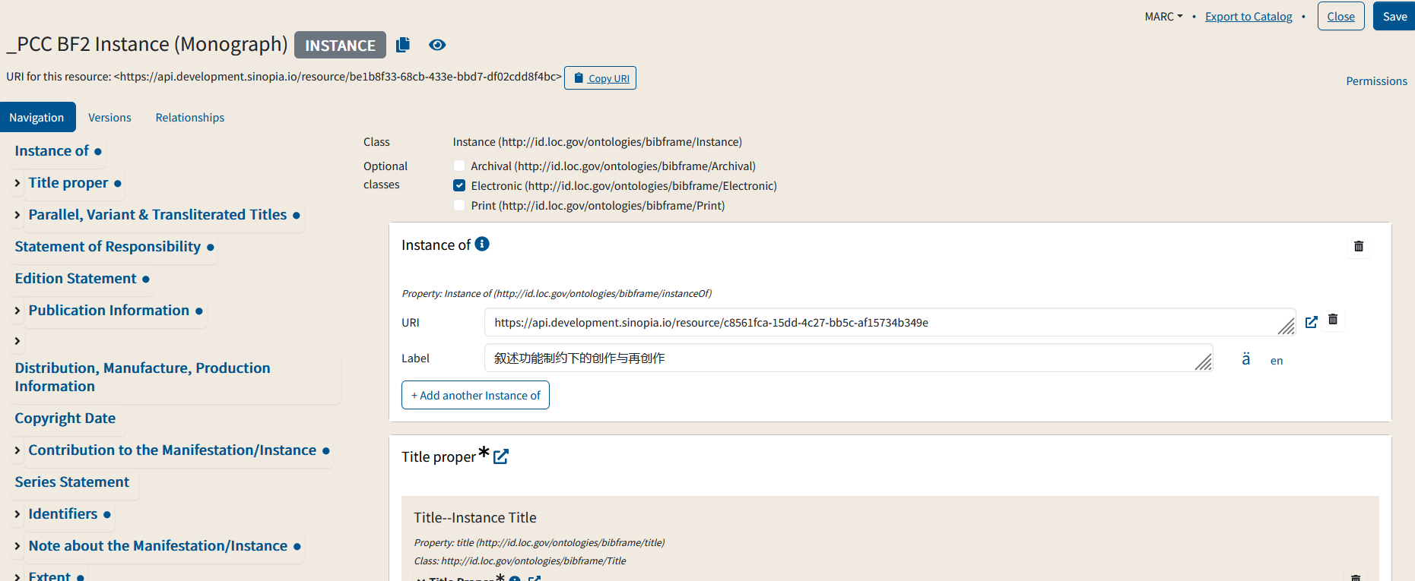
Workflow: Export both Instance and Work records to Alma

Slide 15
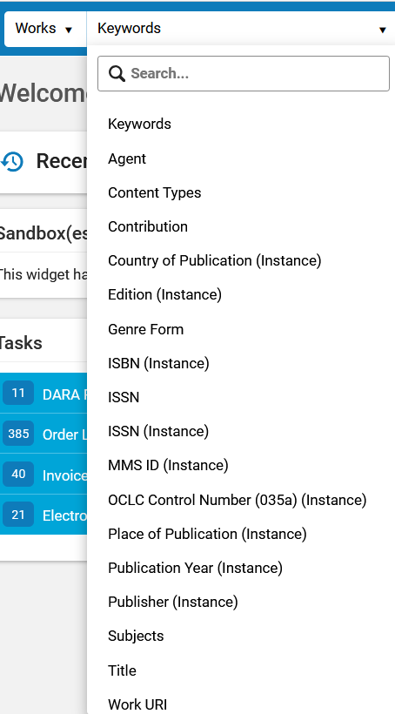
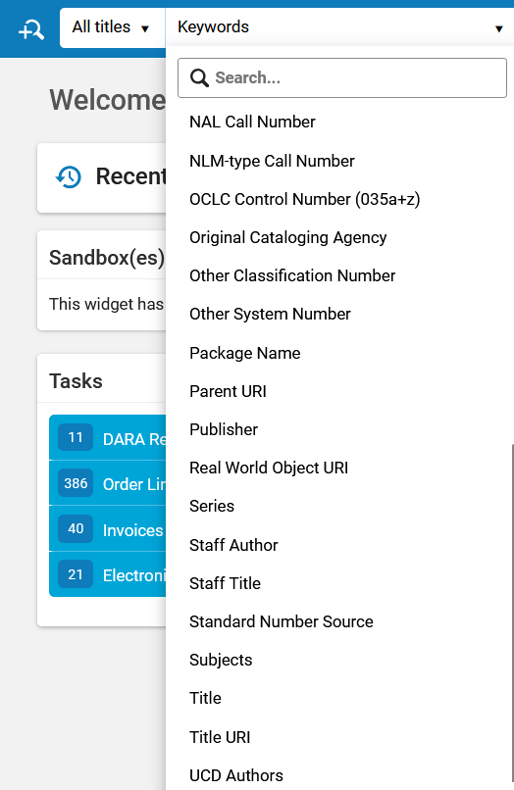
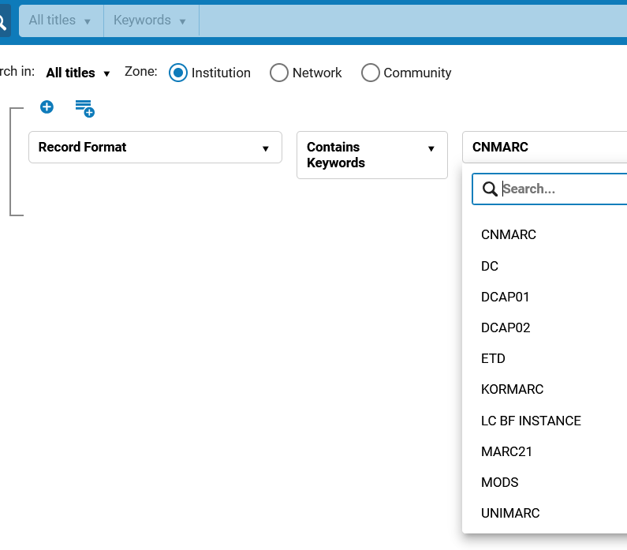
How to search BIBFRAME records in Alma?
New search type
New search fields
Advanced Search: New record format

Slide 16
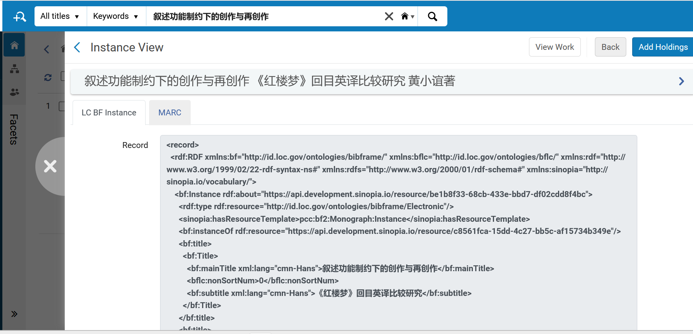
BIBFRAME Instance record display in Alma: example

Slide 17
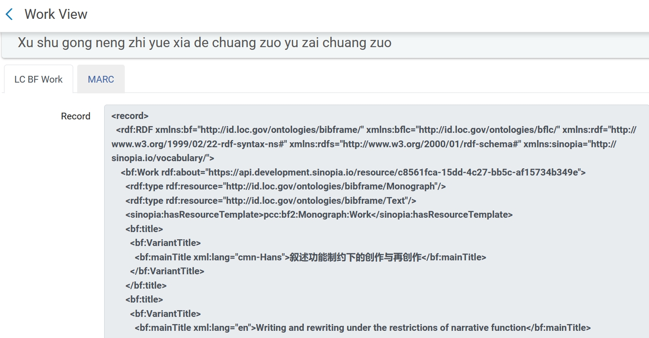
BIBFRAME Work record display in Alma: example

Slide 18
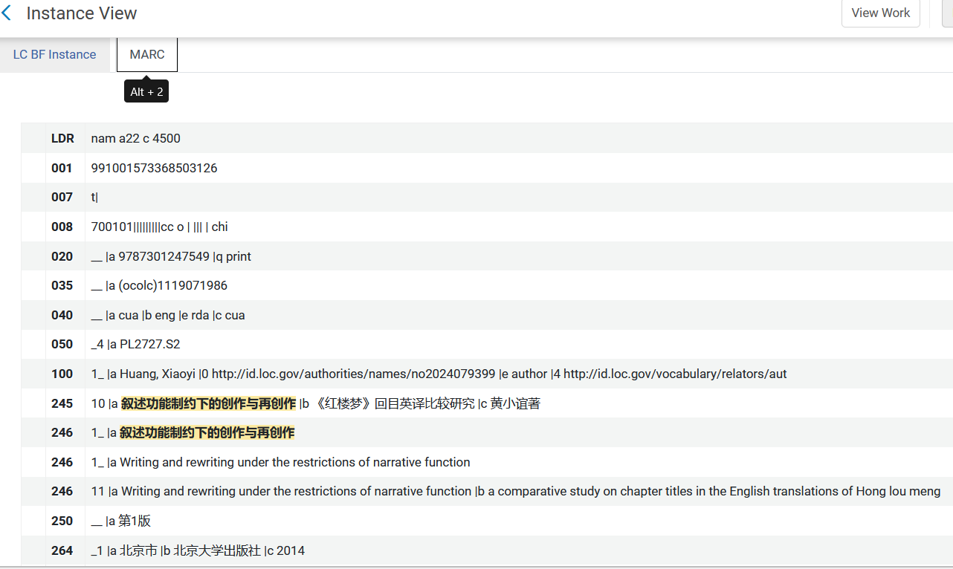
MARC representation of a BIBFRAME Work and Instance: example

Slide 19
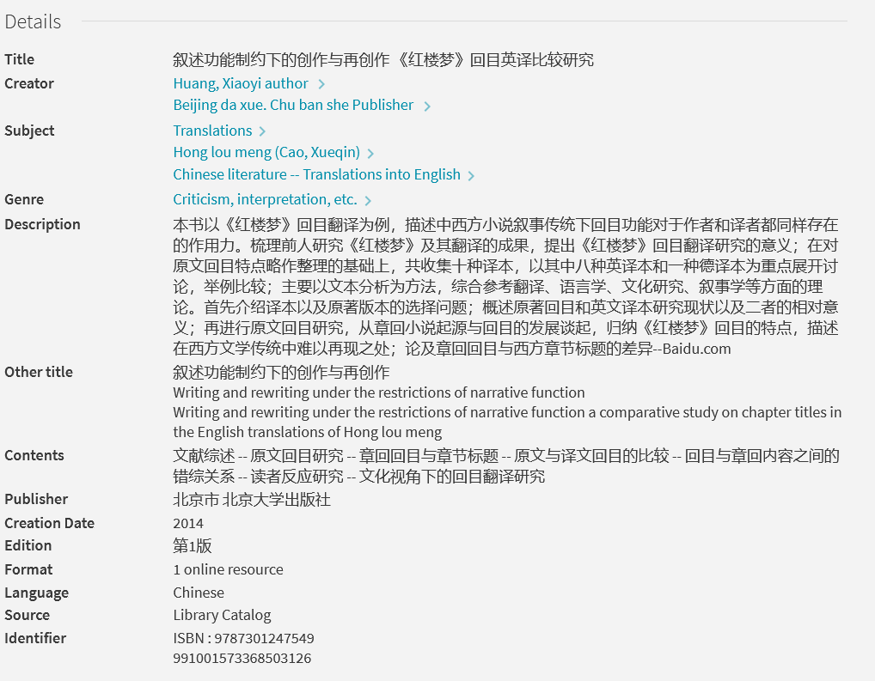
BIBFRAME Work and Instance display in Primo VE: example
https://search.library.ucdavis.edu/permalink/01UCD_INST/13iosf5/alma991001573368503126

Slide 20
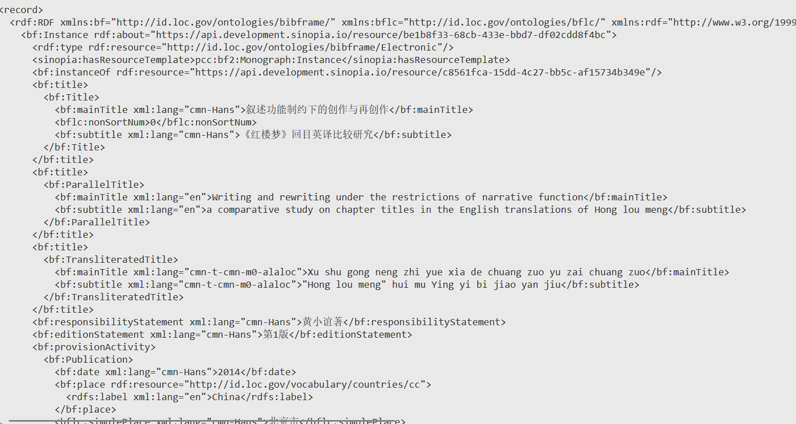
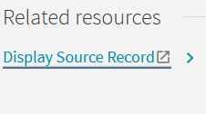

Slide 21
Challenges
Frequent Updates to the BIBFRAME Model and PCC Templates in Sinopia (impacting workflow stability)
Lack of URIs for access points (reducing the potential for semantic interoperability)
No editing capabilities in Alma for BIBFRAME records (adding work complexity)
OCLC is not yet ready to ingest or export BIBFRAME records (limiting data sharing)
Unable to contribute BIBFRAME records to the Network Zone (hindering data reusing within the consortium)

Slide 22
Lessons learned
Encourage staff engagement by embedding linked data goals into:
The library’s strategic plan
Individual staff members’ performance evaluations
Introduce linked data gradually
Provide ongoing training and allow time for staff to build confidence with new concepts and tools
Set realistic expectations
Don’t expect everything to work perfectly from the start—linked data takes time to implement effectively
Start with low-impact collections
Begin with collections where workflow imperfections will have minimal impact on users
For example: we started with 1) Non-UC Davis ProQuest ETDs (local access only); 2) ProQuest Ebook Central Chinese ebooks

Slide 23
Interested in practicing BIBFRAME?
Enable BIBFRAME in your Alma environment
Contact Ex Libris Support
Enable the linked data integration profile
Select a BIBFRAME editor
Option #1: Sinopia Linked Data Editor
Request a development account: https://development.sinopia.io/
Contact the Sinopia Admin (sinopia_admin@stanford.edu) to be added to a user group
Ask Ex Libris Support to configure Sinopia Dev integration with Alma
Option #2: Library of Congress linked data editor - Marva Quartz
Access here: https://bibframe.org/marva/quartz/
Set up an API Key in Alma to enable integration

Slide 24
Resources to help you get started with Sinopia Linked Data Editor
PCC Sinopia Training
PCC Sinopia Cataloging Affinity Group website
Tutorial: How to use Sinopia to create ANY kind of linked data
Sinopia version 3.15 demo

Slide 25
Resources to help you get started with Marva Quartz
Library of Congress Marva Quartz User Manual
API Key set up in Alma
Using Alma API to Import BIBFRAME
Using the Ex Libris API Console: Adding, Updating, and Deleting BIBFRAME records “by the each”
Getting Started with LC BIBFRAME Data in Alma

Slide 26
Thank you! Xiaoli Li: xlli@ucdavis.edu

