Slide 1
Linked Open Data Community of Practice Working Group Updates
Xiaoli Li
Coordinator, LOD CoP Working Group
University of California Davis Library
Sept. 15, 2025

Slide 2
Topics
Part I: Working Group updates
Introduction
What have we accomplished 2024/2025?
Work areas for 2025/2026
Part II: Key findings of the community survey on linked data
Part III: Q&A

Slide 3
Part I: Working Group updates

Slide 4

Introduction - who we are
ELUNA:
Xiaoli Li (University of California, Davis) - Coordinator
Amanda Xu (National Agricultural Library)
Greta Heng (San Diego State University)
Jim Hahn (University of Pennsylvania)
Ken Varnum (University of Michigan)
Lihong Zhu (Washington State University)
Laura Akerman (Emory University)
IGeLU:
Hans Schürmann (Swiss Library Service Platform)
Stefan Schuh (Austrian Library Network and Service Ltd)
Verónica R. Parsiale (International Labour Organization Library)
Liaison to other working groups:
Joanne Rowan (University of Auckland) - Community Zone Management Group*
Catherine Grove (Northwestern University) - Alma
Heather Pretty (Memorial University of Newfoundland) - Alma Authority FG
Corinna Baksik (Harvard Library) - ELUNA Primo
Mark Kluzek (University College London) - IGeLU Primo
Vickie Kline (York College of Pennsylvania) - Summon
Wendy Robertson (University of Iowa) - Esploro
Liaison to Steering Committee:
Tabitha Ochtera (Molloy University) - ELUNA
Wei Xuan (University of Manitoba Libraries) - IGeLU
Ebe Kartus (until April 2025), Kirsten Clark (until June 2025)

Slide 5
Introduction - what we do
Monitor and support Ex Libris linked data development
Promote the implementation of linked data features in Ex Libris products and services
Encourage discussions and information exchange among the user community
Provide training and learning opportunities through town hall meetings and conference presentations, etc.
Solicit linked open data use cases, ideas and examples from the community
Communicate and collaborate with other working groups to develop common strategies
Monitor and report on external developments and projects related to linked data in libraries

Slide 6
What we have accomplished
Work areas for 2024/25
Support education, training, and community meetings
Support the implementation of BIBFRAME
Monitor new linked data features in Ex Libris discovery services
Advocate for supporting official RDA in Alma
Explore the intersection of linked data, knowledge graphs, and AI

Slide 7
Support education
Highlights of the subgroup’s work:
Designed a survey
Organized a community meeting
Topic: Getting Started with LC BIBFRAME Data in Alma
Date: April 22, 2025
Meeting recording: https://youtu.be/ASTLkWXNwPE
Subgroup members: Catherine Grove, Ken Varnum (convener), Xiaoli Li

Slide 8
Support the implementation of BIBFRAME
Highlights of the subgroup’s work:
Contributed to the Town Hall Meeting “Getting Started with LC BIBFRAME Data in Alma”
Developing documentation to support Alma users in the implementation of BIBFRAME
Testing BIBFRAME features in Alma and bringing BIBFRAME related issues to Ex Libris’ attention
Contributing to Ex Libris Linked Data co-development initiatives (e.g. Alma Linked Data Editor)
Subgroup members: Amanda Xu, Greta Heng (convener), Heather Pretty, Stefan Schuh

Slide 9
Monitor new linked data features in discovery
Highlights of the subgroup’s work:
Monitoring new linked data features and issues in discovery interfaces
Working on a cheat sheet to support Alma users in the implementation of Person Entity in Primo VE
Working on a white paper related to linked data in discovery interfaces
Subgroup members: Lihong Zhu (convener), Joanne Rowan, Laura Akerman, Vickie Kline, Ebe Kartus (until April 2025)

Slide 10
Advocate for supporting official RDA in Alma
Highlights of the subgroup’s work:
Two members contributed to the University of Washington MARC to LRM/RDA/RDF mapping project. Release of Phase I is now planned for September 2025
Subgroup members: Ebe Kartus (convener, until April 2025), Laura Akerman, Hans Schürmann, Joanne Rowan

Slide 11
Explore the intersection of LOD, knowledge graphs, & AI
Highlights of the subgroup’s work:
Starting to familiarize ourselves with the topic
Questions for Ex Libris with critical eye toward LOD, knowledge graphs and AI integration in Alma and Primo VE
Presentation of what we've learned at ELUNA 2025
Subgroup members: Laura Akerman (convener), Amanda Xu, Lihong Zhu, Jim Hahn

Slide 12
Work areas for 2025/2026
Proposed work areas for 2025/26:
Support education, training, and community meetings
Support the implementation of BIBFRAME
Monitor new linked data features in Ex Libris discovery services
Advocate for supporting official RDA in Alma
Explore the intersection of linked data, knowledge graphs, and AI
Explore formal partnerships with experts in the field of library linked data and AI

Slide 13
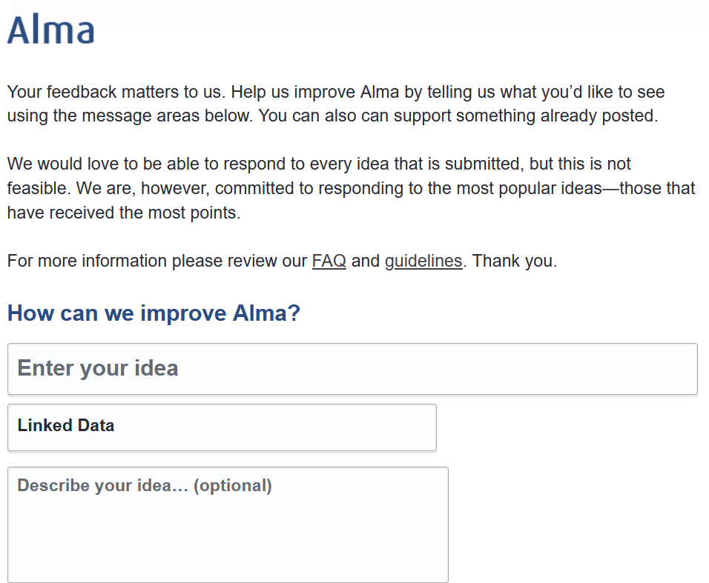
Need your linked data use cases/user stories
Please submit your ideas and/or use cases
Alma Idea Exchange: https://ideas.exlibrisgroup.com/forums/308173-alma
Linked Data User Story Collection Form: https://docs.google.com/forms/d/e/1FAIpQLSekrf8BVU-51xdjJp8lWtYDuL46zGnyEmL7_8hQBv9BvFNaUA/viewform

Slide 14
Part II:
Key findings of the community survey

Slide 15
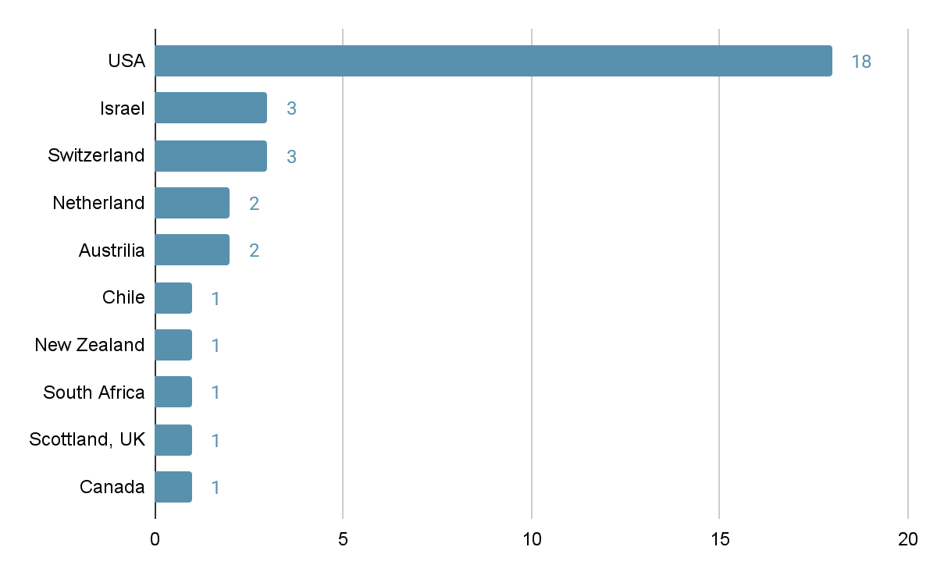
Which country is your institution located in? (n=33)

Slide 16
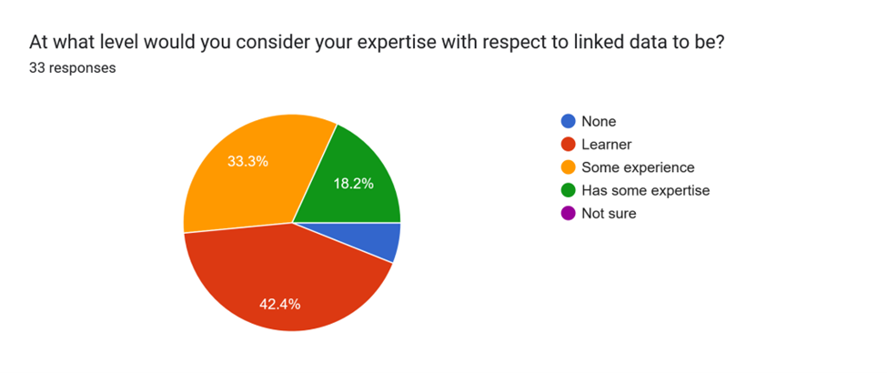
Level of expertise with respect to linked data (n=33)

Slide 17
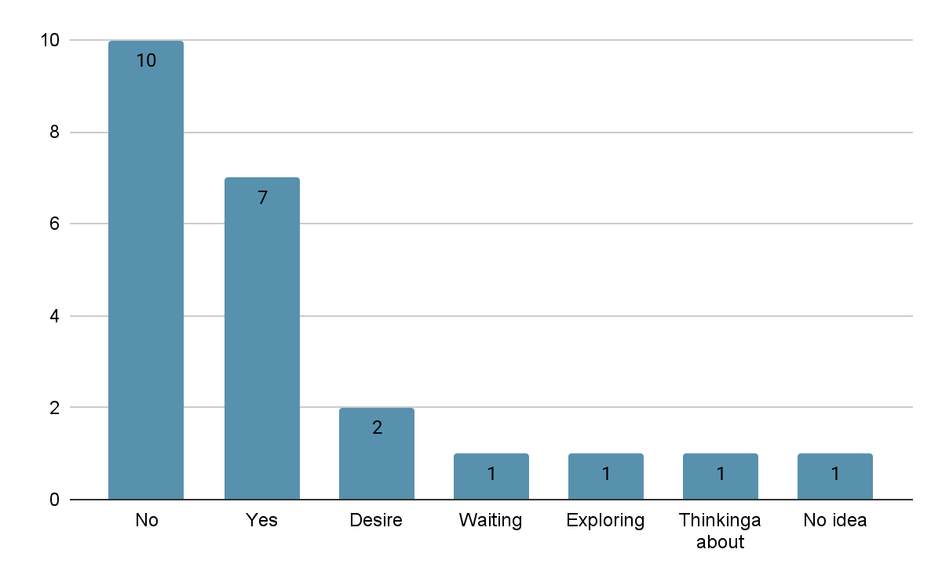
Have plans or desire to transition from MARC to linked data for cataloging? (n=22)

Slide 18
Missing components or barriers for transition from MARC to linked data for cataloging (n=32)
Lack of technical expertise and necessary tools for implementation (e.g., editors, APIs)
Understaffed, lack funding, or have competing priorities
Need for management support and institutional commitment for resources dedicated to linked data initiatives
Perceived lack of immediate benefits or practical applications for users
Concerns about the integration of linked data with existing workflows and systems (e.g., Alma). E.g., "copy cataloging" strategy

Slide 19
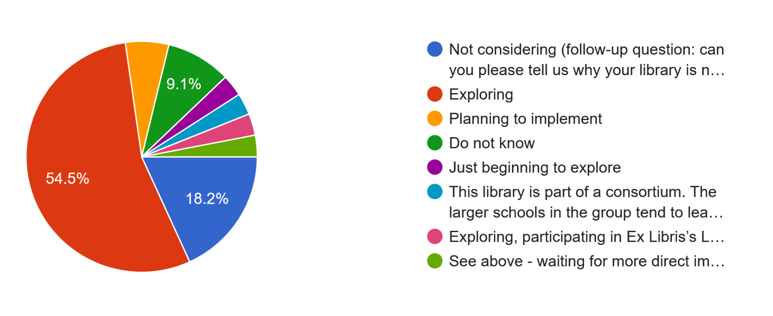
Status on BIBFRAME adoption and implementation (n=33)

Slide 20
Why not using linked data tools and services provided by Ex Libris (n=6)
No plan to transition away from MARC
Current workloads that prioritize ongoing projects
Concerns about infrastructure adequacy
Insufficient management commitment
Existing limitations imposed by union catalogs

Slide 21
Challenges for utilizing Ex Libris linked data features (n=27)
Unclear documentation and language barriers
Insufficient features and unclear functionality
A general need for clearer guidance that considers varying levels of technical knowledge
Skepticism about the tangible benefits of these features
Staffing shortages and lack of time to effectively explore and implement new features
Limited support for workflows

Slide 22
Wish List for Ex Libris's linked data editor (n=22)
Accommodate multiple ontologies, such as BIBFRAME and RDA in RDF
Support a variety of external entities and vocabularies
Enable batch editing of records and visualization of linked data
Support BIBFRAME implementation by separating Work, Instance, and Item entities
Support for collaboration with NACO and SACO to create new linked data entities

Slide 23
Additional linked data features/services most important to your library (n=18)
Support for BIBFRAME and copy cataloging
Entity URI management
SPARQL and query functionality
Integration with external sources
Support for large-scale workflows
User experience enhancements through linked data capabilities

Slide 24
Additional feedback (n=13)
The responses reflect a mix of interest in collaboration, questions about linked data's immediate and practical benefits, and a strong desire for practical guidance and effective implementation.
Respondents thanked the working group for training opportunities!

Slide 25
Stay connected
Web page: https://igelu.org/products-and-initiatives/communities-of-practice/linked-open-data/
Mailing list: https://exlibrisusers.org/postorius/lists/lod.exlibrisusers.org/
Slack channel: https://tinyurl.com/2p8zprvb
YouTube channel: https://www.youtube.com/playlist?list=PLr6LDe01r7vI9mkp_b8yqEOtU_k9TI4VH
Coordinator: Xiaoli Li, xlli@ucdavis.edu
Thank you!

