Slide 1


A new workflow for the acquisition of Accessible Texts
Kevin O’Donovan, Library Acquisitions & Subscriptions Manager,
London School of Economics & Political Science

Slide 2

Marrakesh Treaty (2013)
accessible format copies for people with print disabilities
a visual, physical, or developmental or learning disability
ensuring parity of HE experience for these users

Slide 3
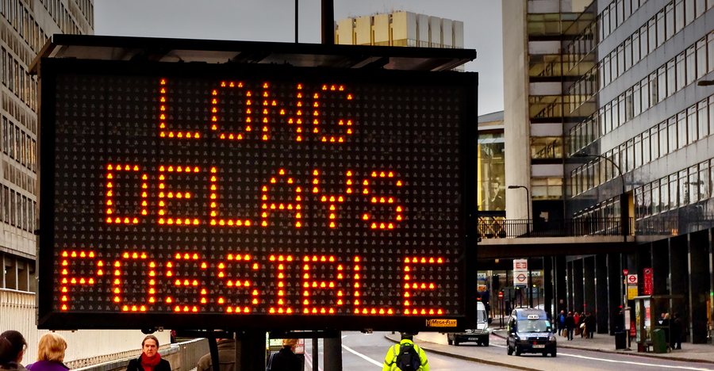
previous workflow reactive not proactive
a mixture of delivery methods, no metadata for easy retrieval
delays with supplying timely content requirements
RNIB Bookshare not integrated with authentication or learning systems

Slide 4

UX research and report fed into solution thinking
readings should be with the course content on institutional systems
no lead time or delays – content there at the point of need
metadata for titles consistent with catalogue and reading list

Slide 5
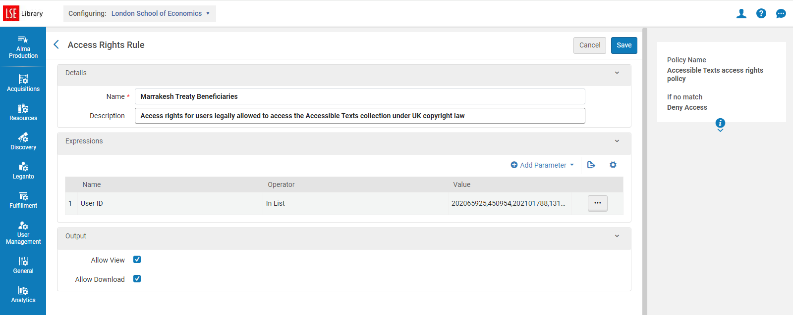
looking for Essential content on Leganto with no electronic version
Alma Digital collection of Accessible Texts – bolt on storage space to Alma
user access rights configuration limiting to only print disabled users
manually administered with no automated feed from registry data

Slide 6
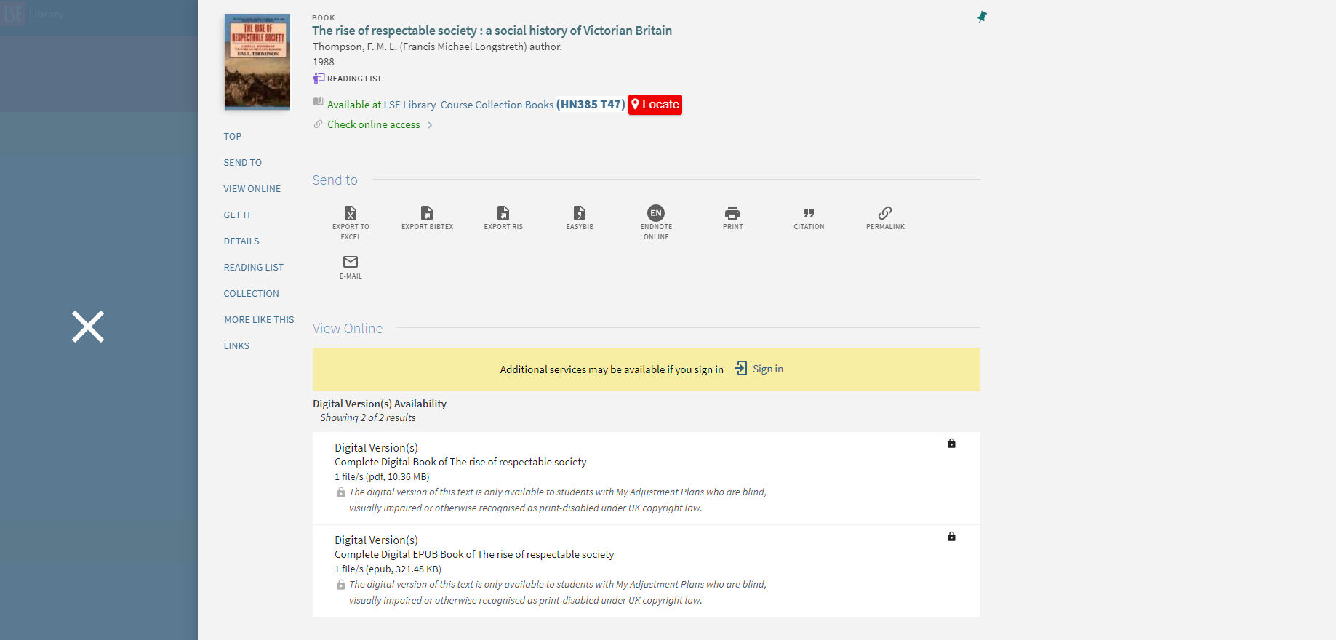
Deeper integration required between Alma Digital and Primo

Slide 7
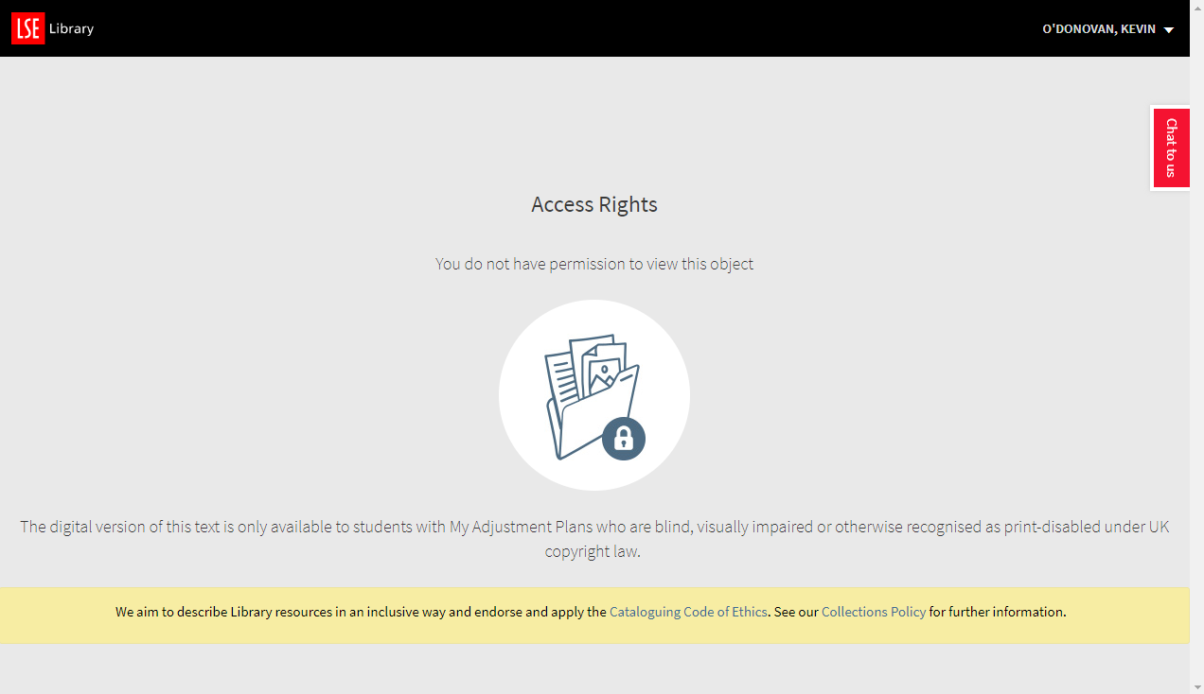
tighter integration required between Alma Digital and Leganto

Slide 8
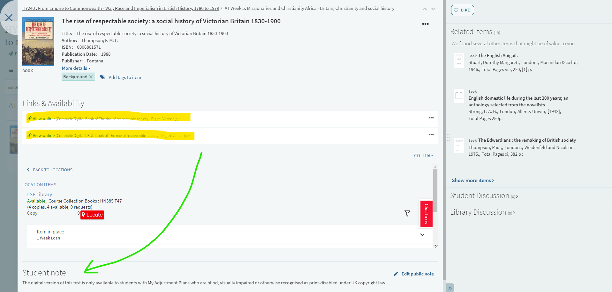
Deeper integration required between Alma Digital and Leganto

Slide 9
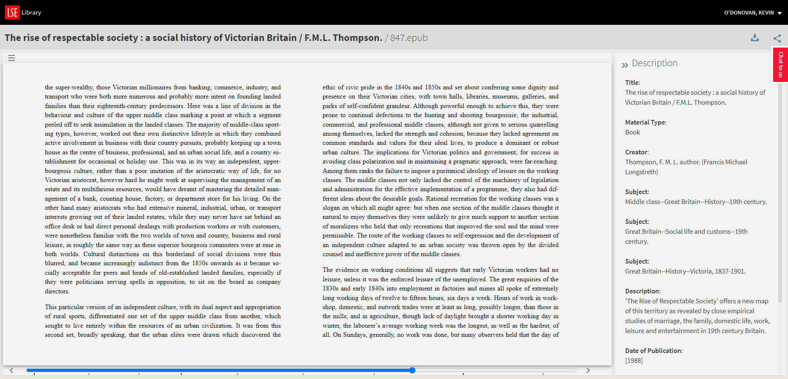
ePub support only enabled recently – very basic, development required

Slide 10
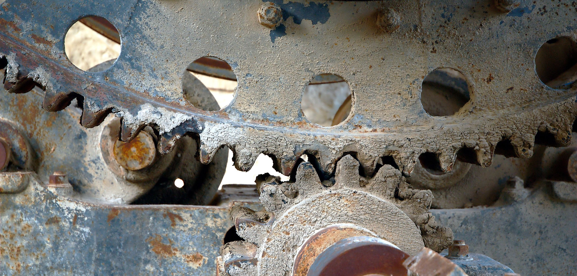
requesting files from publishers still a major pain point in the process
variety of request and supply mechanisms, license agreements
slow response times, lack of responsibility, some just no response at all

Slide 11
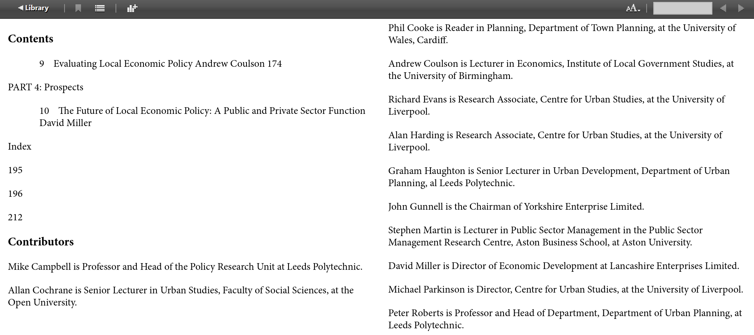
Avoiding in-house scanning where possible – native files are best
Scanning equipment available but work is repetitive and long
PDF to ePub conversion work with Abbyy FR, variable results (see above)
AI tool would be ideal for this task!

Slide 12
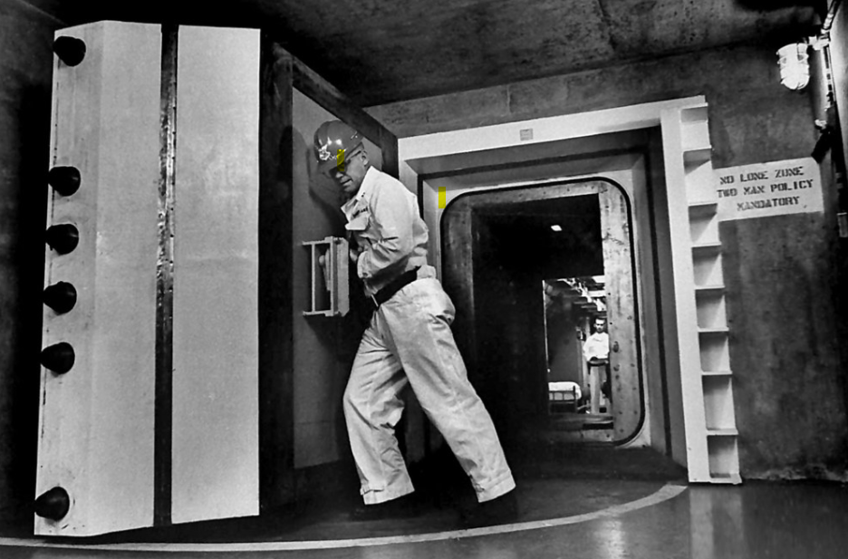
RNIB Bookshare already has content, just locked away
harmonised publisher permissions / request form for institutions
new license agreement between HEIs, publishers and the RNIB?
Clarivate solution? Relationships with publishers. Willing to pay annual fee

Slide 13
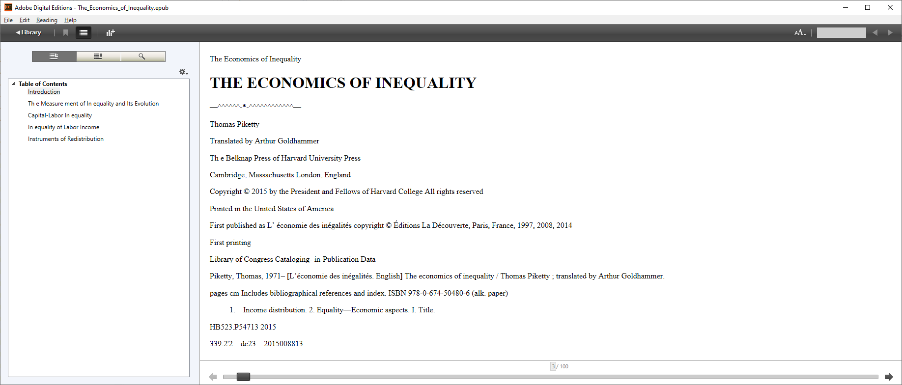
Conversion to ePub from PDF in Abbyy rarely satisfactory
Much better if the publishers supply an ePub made from original digital files
AI tool for this please!

Slide 14


Slide 15
Image acknowledgements
Non-commercial reuse under Creative Commons licenses
01 flame https://www.pexels.com/photo/man-wearing-welding-helmet-welding-metal-near-gray-brick-wall-1474993/
02 treaty: https://www.wipo.int/marrakesh_treaty/en/
03 delays: https://www.flickr.com/photos/omarparada/8516269783
04 jigsaw: https://pxhere.com/en/photo/1567143
05 stuck gears: https://commons.wikimedia.org/wiki/File:Abandoned_concrete_factory_mechanism.jpg
06 large door: https://www.flickr.com/photos/x-ray_delta_one/12428590374
07 laughing: https://pxhere.com/en/photo/1434197
08 answers: https://www.pexels.com/photo/advise-answers-arrow-assistance-208464/

