Slide 1

Ask not what the Enhancement Processes can do for you – ask what you can do for the Enhancement Processes!

Slide 2
Agenda – Part 1: Answers to Legitimate Questions
Who am I to tell you what to do for the Enhancement Processes?
What are these „Enhancement Processes“ I am referring to?
What‘s wrong about these Enhancement Processes?

Slide 3
Agenda – Part 2: Examples and Recommendations
What we customers can do for the Enhancement Processes …
What product managers can do for the Enhancement Processes …

Slide 4
Who am I to tell you what to do for the Enhancement Processes?

Slide 5
Where do I come from?
Some basic facts about the Bayerische Staatsbibliothek (BSB):
located in Munich, Germany
founded as the court library of the house of Wittelsbach in 1558
evolved to the largest academic universal library in Germany today
central regional and repository library of the Free State of Bavaria
> 221,000 active patrons
~ 64,000 with library cards issued by BSB
~ 157,000 with library cards issued by University Library of Munich
> 900 staff members (644 FTEs + project staff)
for more details cf. https://www.bsb-muenchen.de/en/about-us/portrait/

Slide 6
Who am I?
Some basic facts about myself:
degree in Mathematics (1998)
PhD in Computational Representation Theory of Finite Simple Groups (2001)
took a job in librarianship because it was an opportunity to gain at least three years of professional experience outside of academia (2003)
ultimately sticked to it because managing library IT offers so many varied and exciting challenges ☺
left Headquarters of Bibliotheksverbund Bayern (BVB) in 2021 to take over as CIO of BSB
started learning at least 11 different programming languages in the course of my life (from BASIC to Python) - the only one I really sort of mastered is Perl
⇒ not a software developer but have quite an idea of software development

Slide 7
What is my experience with Clarivate products?
Team Lead of BVB SFX Consortia Administrators (2003-2021) and member of BVB‘s MetaLib, DigiTool, and Rosetta Teams (2003-2013)
SFX Software Enhancements Coordinator on the IGeLU SFX PWG (2008-2014)
Head of BVB Library Network Services, the department operating the Aleph-based BVB/KOBV Union Catalog (2013-2021)
Customer Project Manager of Alma/Primo VE Implementation at BSB
Customer Project Manager of Alma/Primo VE Implementation at the ten regional State Libraries of Bavaria („rSB“; authorities subordinate to the BSB)
current roles:
Certified Alma and Primo VE Administrator
Head of BSB/rSB Joint WG coordinating the operation of Alma/Primo VE
Coordinator of the BSB Alma CERV Enhancement Votings

Slide 8
What are these „Enhancement Processes“ I am referring to?

Slide 9
Community Enhancement Requests and Voting
If you have ever worked with NERS (New Enhancement Request System), just think of CERV as the new Normal, er… NERS.
Requesting and voting takes place on two separate platforms:
Aha! Enhancements Portal for submitting requests
open 24/7
open to everbody who registers an account
ElectionBuddy for voting on reviewed and deduplicated requests
open only during voting cycles
only 1 person per ELUNA/IGeLU member institution invited to vote
Voting cycles on software enhancements often include a round 2 of voting on the top-ranked requests from round 1 assigned with a certain number of development points by Clarivate reflecting their estimated efforts for implementation.

Slide 10
The two greatest things about CERV
Clarivate has committed to implement the N top-voted requests equivalent to a certain amount of „development points“ per voting cycle – except those that are technically unfeasible or incompatible with the product architecture!
There are volunteer colleagues who do the hard work of reviewing all the submitted requests and, if necessary, deduplicating them before they make it onto the ElectionBuddy ballot!
A big THANK YOU and a huge round of applause to the members of the various PRODUCT WORKING GROUPS!

Slide 11
IdeaExchange
https://ideas.exlibrisgroup.com/
as well as CERV open 24/7 to everybody who registers an account
different from CERV:
there are no voting cycles, i.e. you can also vote 24/7
every account has a certain total number of votes per idea category (i.e. the several products, or „Content“)
you can only cast up to 3 votes on one and the same idea
votes will be returned to you automatically if an idea you voted for is closed (for whatever reason)
you can also withdraw your votes from ideas at any time in order to get them back for other ideas that seem better or more important to you

Slide 12
What‘s wrong about these Enhancement Processes?

Slide 13
IdeaExchange is a nice process BUT …
… at least as far as I know there is
no guarantee that your idea is ever read at all by a product manager
no transparency rg. the thresholds on the number of votes or the number of comments an idea needs to become interesting for product management
no one responsible to check ideas for feasibility or to deduplicate them
And at the end of the day it‘s completely up to Clarivate whether to implement an idea or to reject it for reasons that are more or less clear.

Slide 14
CERV is a nicer process BUT …
also costs a lot more efforts by volunteers to keep it that nice
also costs an enormous effort by member institutions to hold an informed vote on the requests on the ballot (in 2025: 238 for Alma, 89 for Primo) within the one month scheduled for round 1
look at the percentage of votes cast on requests that qualified for round 2 in the 2025 voting cycles for Alma and Primo:
Alma: 18 requests qualified and received only 36,66 % of 68,608 votes
Primo: 20 requests qualified and received 56,57 % of 66,790 votes
in 2025 Clarivate not only assigned development points to but also trimmed down the content of several of the requests before they were put to a vote in round 2 ☹

Slide 15
What can we all do
in order to improve
the situation?

Slide 16
What we customers can do for the Enhancement Processes …

Slide 17
Make your enhancement requests / ideas sparkle!
Suggestion:
If you haven‘t read this excellent guide by Ann Kucera (Central Michigan University) and Anne Pepitone (University of Washington) yet, then do so and take every piece of advice it contains to heart.
Reasoning:
It helps you to write enhancement requests / ideas more colleagues will instantly understand by just reading them once.
This will increase the chance for them to cast votes on your request / idea.
For CERV requests it significantly reduces the amount of work by the reviewers on the PWGs for asking back questions in order to clarify what you really were trying to request.

Slide 18
It really works, I tested it myself!
Example: “Plugin Thresholds“ for General E-Services (my own idea, June 2024)
“For SFX a ‘plugin threshold’ is known as an almost arbitrary complex condition (evaluated by any sort of locally developed script code returning 1=true or 0=false) on the contextual relevancy of a certain service. The Alma link resolver should not stand behind and be able to employ any third party web service for the evaluation of conditions too complex to be stated by means of its out-of-the-box types of thresholds.”
Mistakes:
100% geek talk; not understandable even if you happened to find it because you searched IdeaExchange for one of the terms contained in it
describes no concrete use case
targetted at Alma product management instead of other customers
⇒ got 5 votes so far (I‘ve already withdrawn my own three)

Slide 19
Sparkling version
Allow for Almost Arbitrary Conditions in General Electronic Services (May 2025)
“Currently for a general electronic service we can only create conditions based on metadata already contained in the given BIB record. Please provide a way to let the link resolver check any condition which is computable within a reasonable short amount of time!
Example Use Case: Our library network offers a web service taking any given ISBN, ISSN or Union Catalog ID and returning 'true' if there is a BIB record for the corresponding resource in the union catalog and at least one of the network's libraries has an item of this resource available for ILL. Otherwise the web service returns 'false'. If we were able to let the Alma link resolver check a given ISBN, ISSN or Union Catalog ID against that web service we could offer an ILL service if and only if there is a pretty good chance that there is an item available via ILL.
[…, link to the same request on the CERV portal: AENH-I-36524]”
⇒ got 57 votes so far (including my own three)

Slide 20
Submit less enhancement requests / ideas!
What else can we do?
Suggestion 1:
Make sure you don‘t submit a duplicate.
Reasoning:
[Come on - it isn‘t really necessary to justify this to librarians, is it?]

Slide 21
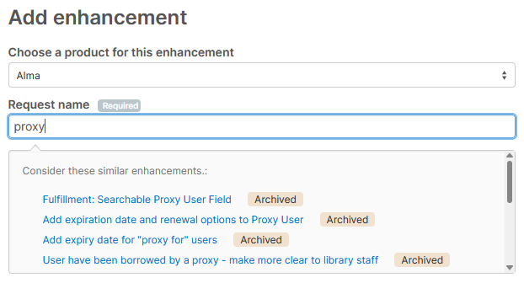
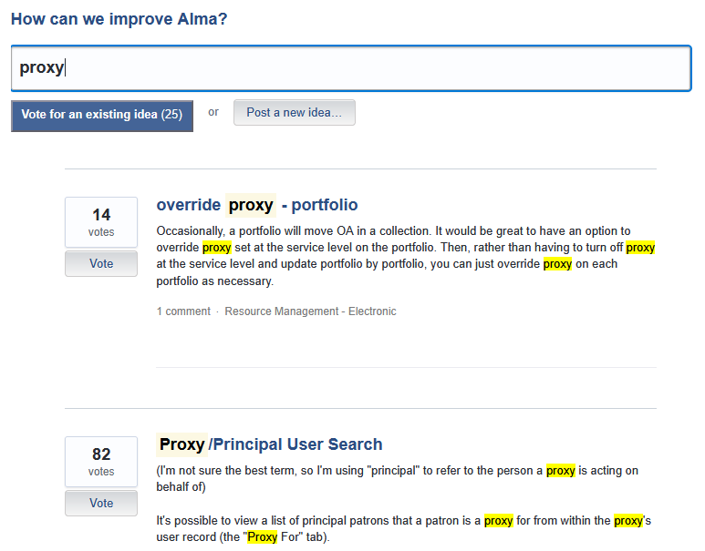
Search before submission?
Not necessary: Both the CERV portal and IdeaExchange suggest similar already submitted requests / ideas while you are typing the name of yours!
IdeaExchange is just significantly slower in generating the suggestions – so you might just not have noticed this feature, yet ☺

Slide 22
Submit less enhancement requests / ideas!
Suggestion 2:
At the latest before you submit your enhancement request / idea take a moment to ask yourself if this can still be thought „broader“.
Reasoning:
If your request/idea is not thought broad enough it prompts others to submit similar other requests/ideas (in order to sort of complete yours).
If your request/idea is not thought broad enough you risk to lose potential votes because it is too specific for others to support it.
Or it forces voters to split their votes on several items on the ballot instead of putting the whole amount on one single, more comprehensive request/idea.

Slide 23
Almost always a way to think even broader …
Example 1: Enable case-insensitivity for indication rules (AENH-I-36450)
“Indication rules in Alma are case sensitive by design. Case sensitivity is appropriate for ensuring exact matching and the prevention of inadvertent data problems. However, there are use cases in which case insensitivity within indication rules would be more appropriate. [… 8 lines more …]“
Example 2: Regular expressions in indication rules (AENH-I-36291)
“Make it possible to use regular expressions within indication rules in ALMA.“
My thoughts:
I understand all too well why Example 1 has been submitted altough the broader Example 2 had already existed (“What are regular expressions?“).
Why not regular expressions in all kinds of rules that could make use of a powerful tool for pattern matching as well? (normalization and merge rules)

Slide 24
Yet another „Please add X to the export“ …
Generic example:
“The EXCEL export of list <INSERT_YOU_FAVOURITE_LIST> currently contains the fields A, B, C, and D. Please, add field X to the EXCEL export as well.“
“The EXCEL export of list <INSERT_YOU_FAVOURITE_LIST> currently contains the fields A, B, C, D, and X. Please, add field Y to the EXCEL export as well.“
“The EXCEL export of list <INSERT_YOU_FAVOURITE_LIST> currently contains the fields A, B, C, D, X, and Y. Please, add field Z to the EXCEL export as well.“
:
My thoughts:
Why don‘t make EXCEL exports completely configurable in terms of what fields of the listed objects get exported?
Why doesn't product management get tired of these suggestions and, thus, just makes exports completely configurable?

Slide 25
What product managers can do for the Enhancement Processes …

Slide 26
In case we don‘t think broad enough … PMs should!
Suggestion (to PMs):
Instead of sticking to the wording of a request/idea eligible for implementation take a moment to ask yourself if this can still be thought „broader“.
Reasoning:
If you don‘t you might let development implement only „half the way“ of what was reasonable.
That leads to another and another and another enhancement request for the same feature and, thus, slows down product enhancement at large.
By sticking to the wording of a request/idea like to that of a specification you pass on responsibility for product consistency and efficient use of development resources to the submitters of requests and ideas.

Slide 27
To expand the meaning or to clarify the name?
Example: last activity date (shared by Hege Raklev in Nov 2017)
“User profile - Last active date
We would like to have a field in the user profile that shows patron’s last active date, i.e. loan, request or return. This field will be useful when deciding which user profiles to purge.“
My thoughts:
You want to purge a user who logs into Primo every month but hasn‘t found anything to request and loan for two years?
You want to purge every user who is interested only in the information resources you have available online?
Even if that should have been the intention of the idea, why hasn‘t product management decided not to call that field “last_patron_activity_date“?

Slide 28
„This is intended design.“ – Really?
Suggestion (to PMs):
Don‘t let customers vote on whether to fix a design bug or not. If you don‘t believe the customer that the root cause of an issue is a bug in design then, please, at least believe the Product Working Groups.
Reasoning:
Bugs in design are just another sort of bugs.
So it‘s not an enhancement to fix them, it‘s a mere need.
Not fixing bugs in design may save you development resources in the short term, but in the long run it will make your product worse.

Slide 29
Same idea (from 2016!) already accepted in 2023
Example: Improve Alma Job Reports for Failed Records (AENH-I-36357 from 2025)
“Currently, Alma job reports do not identify which records have failed when a job is run against them (such as publishing to OCLC). It would be very helpful to have lists of the specific records involved, so that their errors can be fixed and the jobs re-run successfully.”
My thoughts:
Logfiles without any hint on for which records and why the job failed are completely useless.
Making completely useless logfiles useful is a necessity, not an opportunity for possible improvement.
The requester probably submitted a case for this bug but has been told that completely useless logfiles were „intended design“ and, thus, …
BTW, Clarivate, mind what you tell us about your designers!

Slide 30
Might be intended design but impairs productivity
Examples:
Fulfillment Unit - moving loan rule up and down a list by drag & drop instead of clicking a series of arrow buttons (AENH-I-36444)
“The workflow for adding or revising fields within the Full Record Details would be quicker, more efficient, and less likely to cause errors if it were possible to reorder by drag and drop […] than the current ‘move up/down’ by a single row at a time. Some configuration tables in Alma support drag and drop (Display Logic Rules) or the ability to place ‘at/before’ the top, bottom, or any item in the list (Create and Manage Collections).” (PENH-I-28370)
Improve reorder functionality for all [Wow – YOU thought broadly, dude!] ordered configuration tables (AENH-I-36451)
My thought:
Why have you made all these colleagues submit essentially one and the same enhancement request, Clarivate - instead of fixing your design?

Slide 31
An FAQ: Isn‘t this basic functionality?
Some more examples:
Winner of the Alma CERV Enhancement Voting 2025: Add NOT operator to advanced search (AENH-I-36492)
Enhanced Export Physical items CSV, TSV, XLSX (AENH-I-36281): “[…] The CSV file is inconsistent: fields are sometimes surrounded by quotation marks, sometimes by French quotation marks (guillemets), sometimes by quotation marks and French quotation marks (guillemets), and sometimes by nothing at all. […]” ⇒ Clarivate, you definitely want to read RFC 4180 !
Not my thought, but spoken from my heart:
“I am a fan of the CERV/NERS process, but the reality is that it takes time and serves established products better than new products that need a more agile feedback/development loop. A request like displaying all filters by default is basic functionality and should not need to go through this process […]” -- Paul R. Butler (Dartmouth Libraries) on Primo-L, 3 Sep 2025 14:55:33 +0000

Slide 32
Can you afford letting brilliant ideas die unvoted?
Suggestion (to PMs):
Treat IdeaExchange like what it is – a huge box of gifts. And, as we all know, the most inconspicuous gifts are often the best.
Reasoning:
If lots of great but similar ideas hang around on IdeaExchange as duplicates drawing votes from each other it takes a much longer time until one of them catches your attention. That cannot be in your interest.
Brilliant minds are rare. And even rarer are those of them who can sell their ideas well. So there’s a good chance for the most brilliant ideas to die on IdeaExchange if you only watch out for the ones with the most votes.

Slide 33
Thanks for listening! Now I‘m eager to hear/read your thoughts. kratzer@bsb-muenchen.de
Credits to Andrea Zech (FU Berlin) for pointing me to both "Enhancements: Make 'em Sparkle" and Paul R. Butlers posting on Primo-L!

