Slide 1
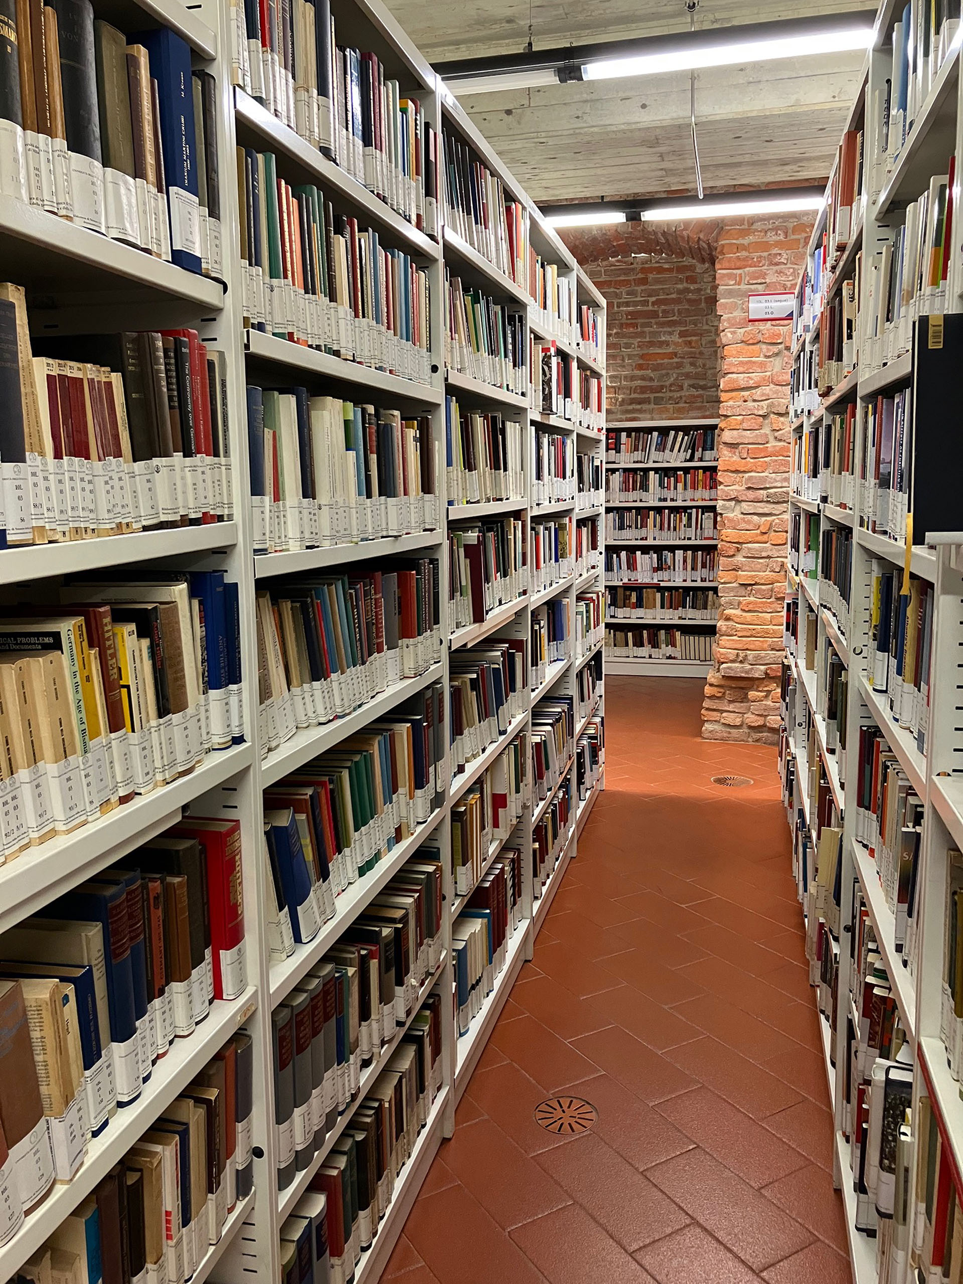



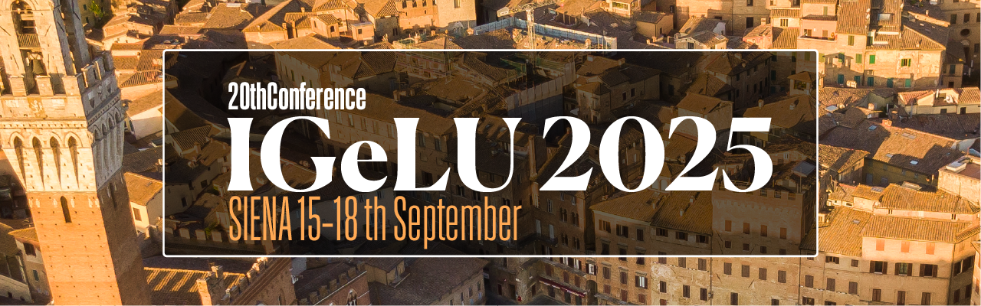
Integrating Theses Management in Alma/Primo VE: Challenges, Benefits, and Best Practices
A case study
from the University of Milan
Paola Foscaro and Leonardo Bassanini

Slide 2
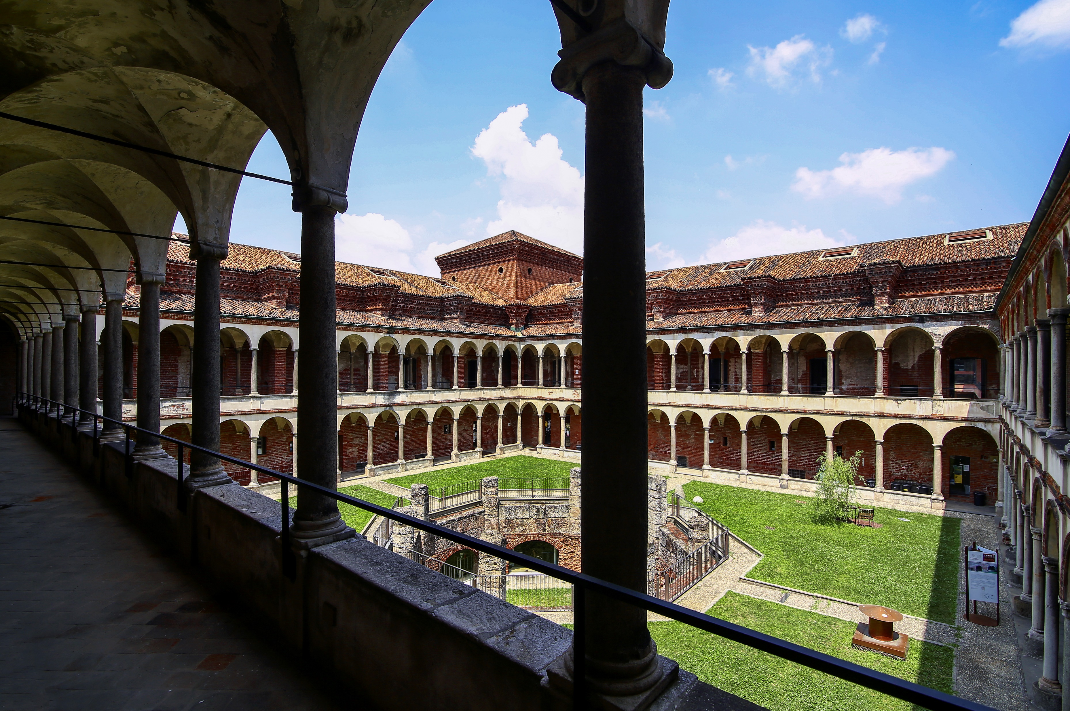
Presentation Overview
Thesis Archive Collection and his History
Service Improvement Needs
Migrating from the Old DB to Alma
Showcasing the Results

Slide 3
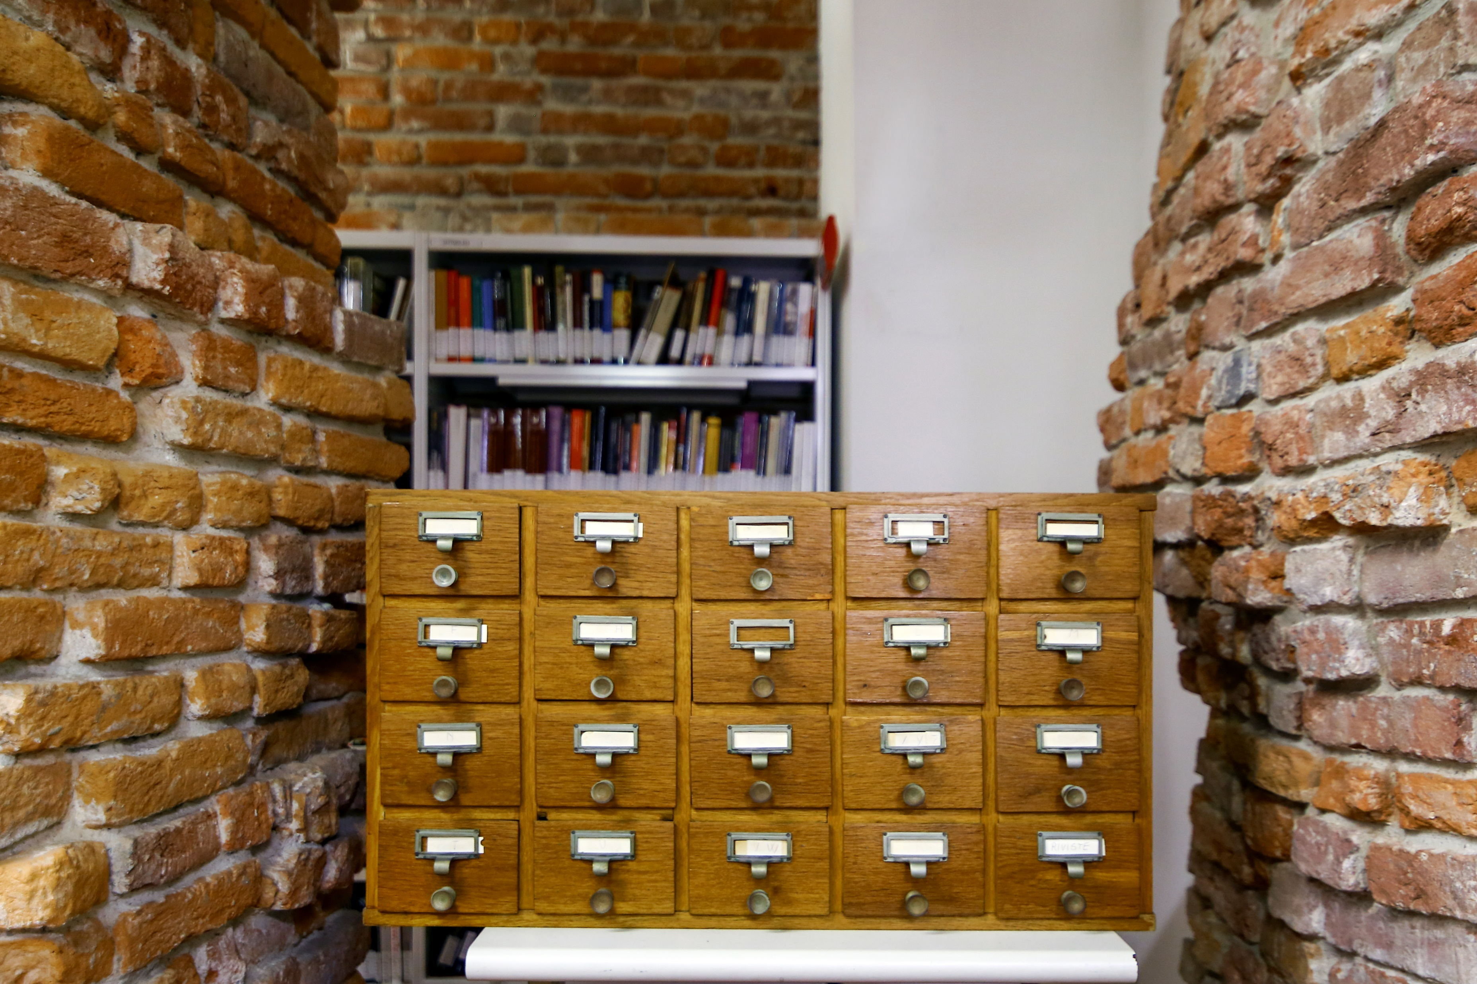
The University of Milan Theses Archive
The Theses Archive preserves:
Master's theses
Theses from graduated schools
PhD dissertations
(from 1990/91 to 31/12/2010)
Documents date from the university's foundation
in 1924 to present day

Slide 4
Historical Development
1
Before 1997
Catalogue
Free access
1997: Anti-Plagiarism Initiative
2
Local archive with severely restricted access:
Internal use only
2014/2015: University
Evaluation Unit
3
Only PhD theses included in OPAC
Critical assessment highlighting:
Requiring triple authorisation
(author, faculty dean, supervisor)
Need for online accessibility of thesis catalogue
Recommendations for improving access procedures

Slide 5
Proposals for a New Thesis Procedure
Author-Centric
Approach
Legal Basis
Rights Allocation
In line with Italian copyright law (1941): creators automatically become authors upon creating the work
Students as thesis authors have full ownership rights, while supervisors and co-supervisors have not
Proposal to require
only the author's authorisation for in house use
This change represented a significant shift from the previous multi-authorisation model to a simpler, author-centred approach aligned with existing copyright legislation.

Slide 6
August 2023: Theses Archive Guidelines
Dual Nature of Theses
Copyright Considerations
Administrative Document
The archive aims to enhance the value of preserved documents while respecting the author's wishes
Certifies completion of student’s
academic career
Managed by Student Services Office
Authors retain both moral and
economic utilisation rights
Academic Scientific Document
Plagiarism verification is the author's responsibility, not the archive's
Intellectual resource with research value
Managed by the Theses Archive as a bibliographic resource

Slide 7



Comparative Analysis: Italian Mega-Universities
Università degli Studi
di Firenze
Alma Mater Studiorum – Università di Bologna
Università Bocconi
Hybrid storage: print format in university libraries and digital format in online Thesis Catalogue. Pre-1976 "historical" theses accessible via Primo or paper catalogues.
Institutional repository "AMS Tesi di Laurea" for digital theses with Primo integration. Print/microfiche managed by individual libraries.
Master's theses fully integrated into Primo with dual-format availability (print and digital), representing a similar approach to Milan's implementation strategy.

Slide 8

International Benchmarking
University of Birmingham
PhD and postgraduate dissertations integrated in Primo with comprehensive digital access infrastructure
Harvard University
Multi-format PhD dissertations (print, microfiche, digitised) through Primo with advanced filtering capabilities

Slide 9
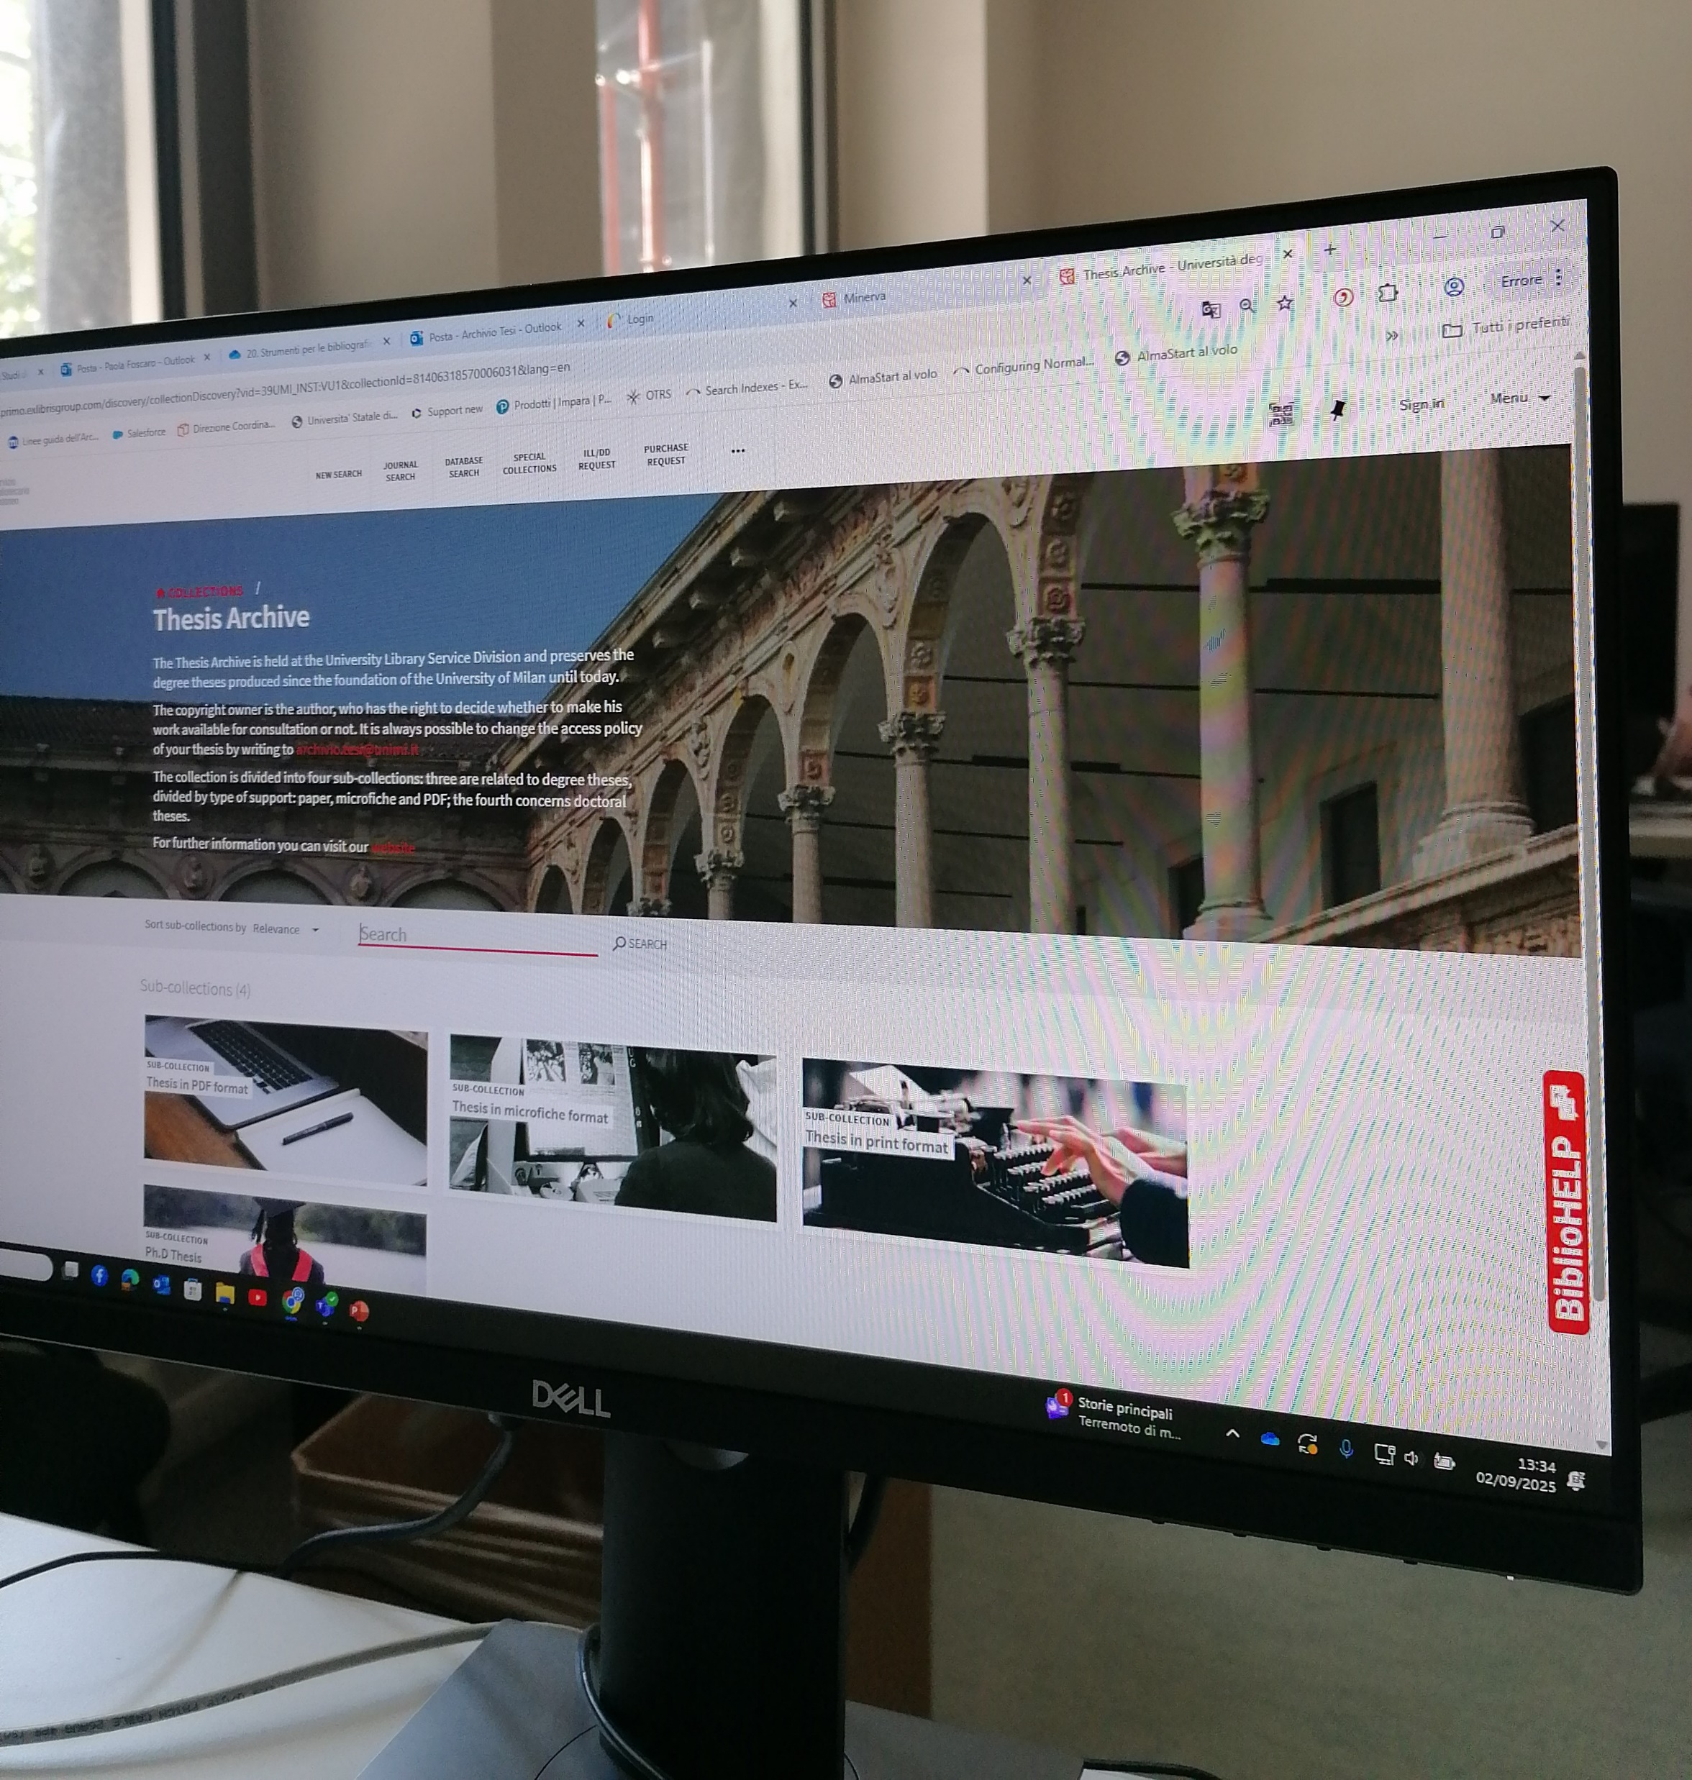
Migration to Alma
Integration with Alma
Migration of the existing archive to the new Alma management system, following verification of PDF handling and authorisation processes
Catalogue Access
Free access to the catalogue (descriptive, administrative and
management metadata) for all users
Thesis Access
Access to full text limited to those explicitly authorised by the author

Slide 10






Author-Defined Access Permissions
Embargoed
Access permitted after specified time period
Accessible
Full access granted immediately
Not Accessible
Access permanently restricted
Important: Document download is not permitted for digital theses,
even when online reading is authorised

Slide 11
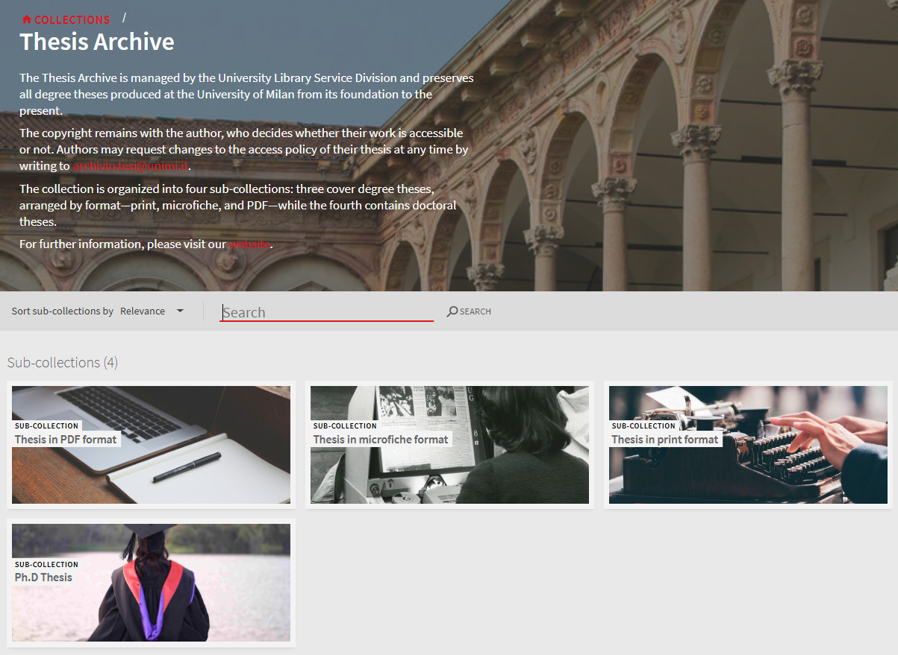
Notes:
Good morning, my name is Leonardo Bassanini (coordinator of the Italian AlmaD working group), and in the next ten minutes I will present the main configurations in Alma that allow us to make the entire thesis collection accessible to users.In Alma we created the Top Level Thesis Archive collection, along with four sub-collections, one for each format: digital, print, microfiche, and one specifically for Ph.D. theses.On this slide, we can see the result in Primo VE, where the resources are grouped together and accessible both from the Collection Discovery section and from the New Search.

Slide 12
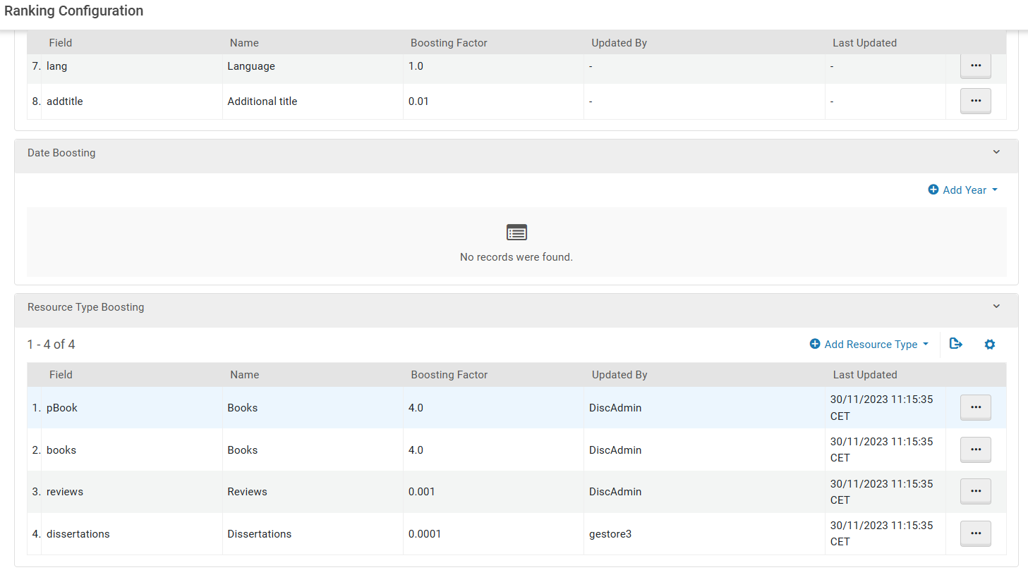
Notes:
In order not to “clutter” the search results page with theses, we adjusted the ranking configuration, assigning a lower relevance value to dissertations.

Slide 13
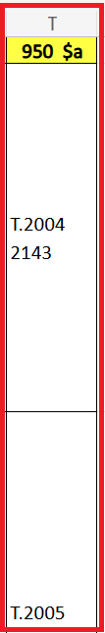
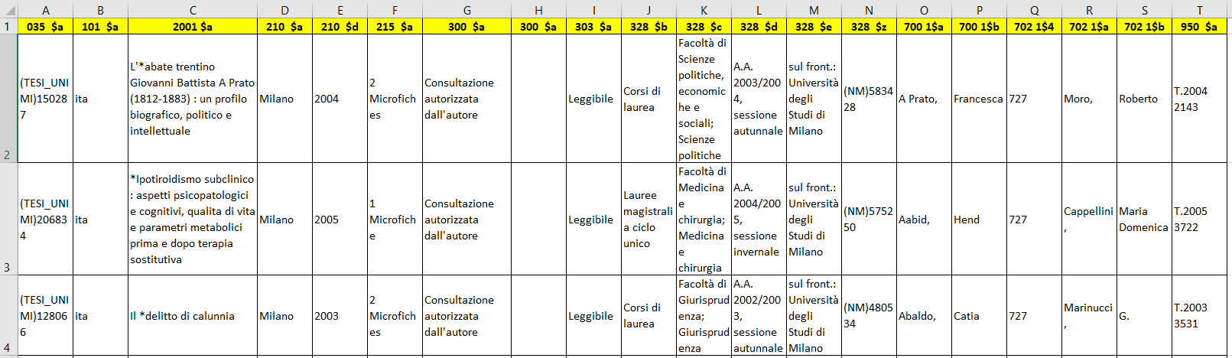
Export Physical Titles
Notes:
We started by extracting the thesis from the old custom database, and we organized them by type and by level of accessibility. What you see here is a template with the metadata for the physical theses.
In this structure the UNIMARC 035 field contains the primary identifier coming from the old system. Then, of course, we have the series of fields with the usual bibliographic details: title, author, year of publication, and so on.
The 950 field, on the other hand, is what we use to create the holding—and this allows us to link the circulation rules.

Slide 14
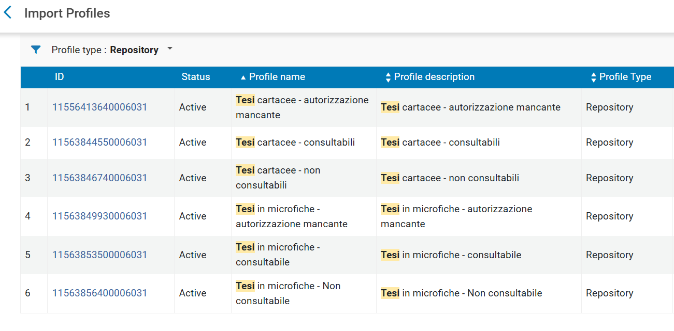
Import Physical Title
Notes:
For each type of thesis (print and microfiche) and accessibility (Open, Restricted, and by author’s permission ), we created 6 different import profiles. These allow us to generate the records in Alma—together with the holdings and the items—so that we can properly manage their circulation.

Slide 15
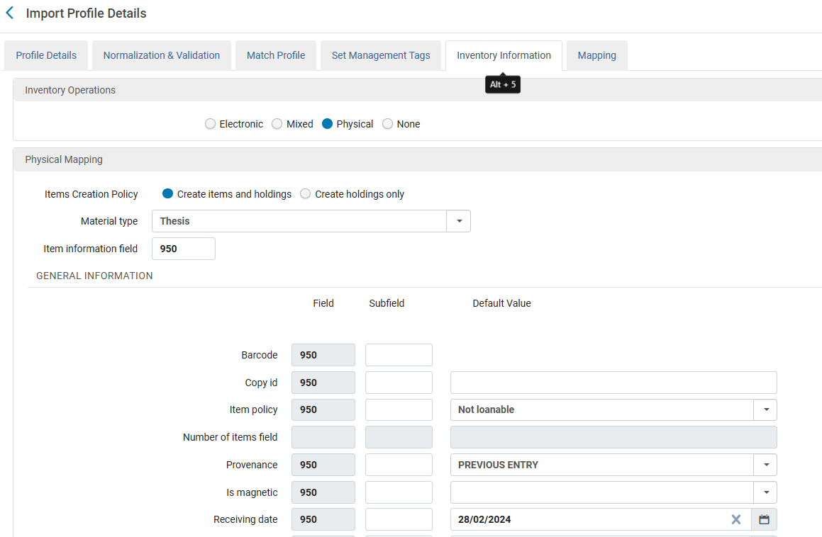
Notes:
Now, let’s look in more detail at one of the Import Profiles. I’d like to show you at least the Inventory Information tab, because this is where we can define some of the key aspects related to the item.

Slide 16
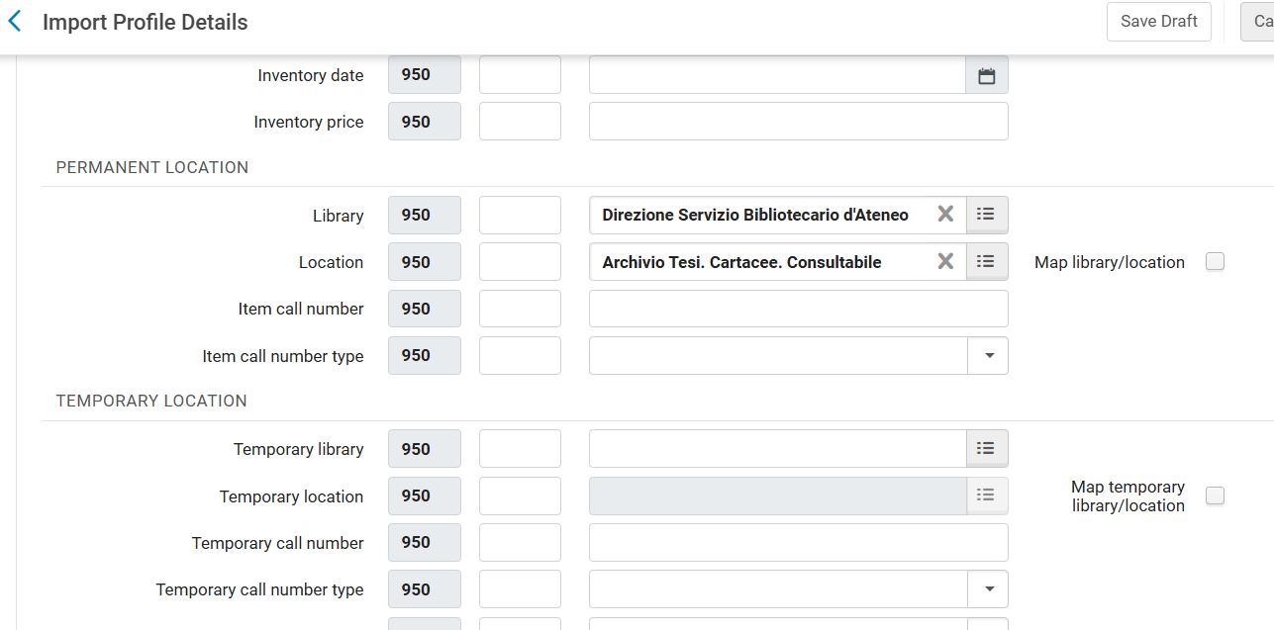
Notes:
to the location, and therefore to the circulation policies that are applied.

Slide 17
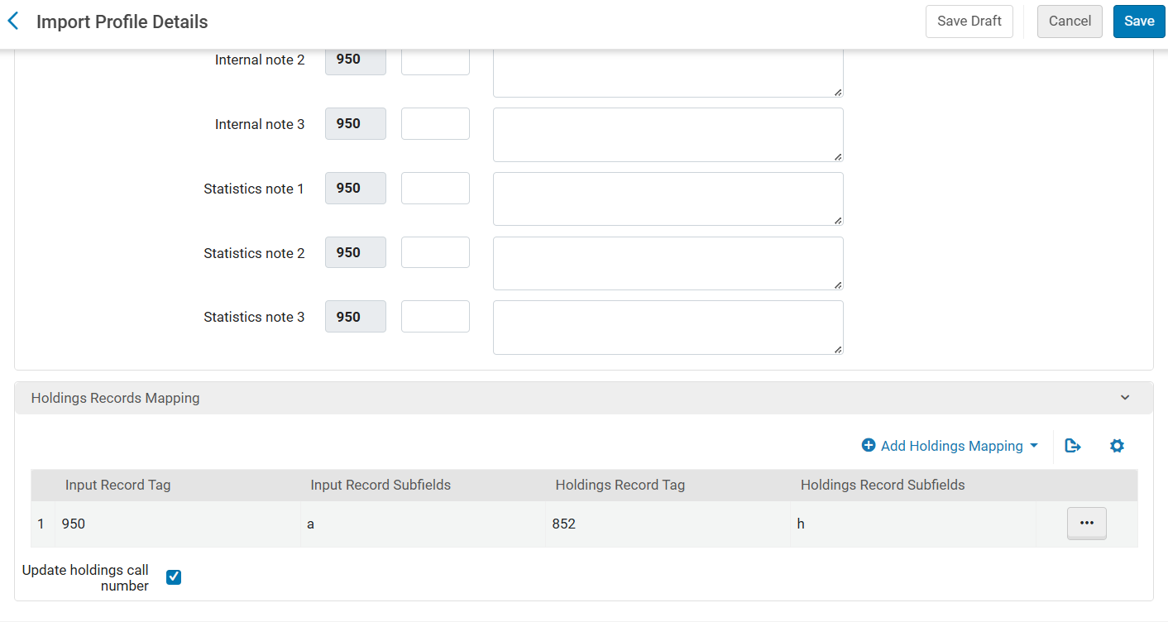
Notes:
to the composition of the holding record. This is done by mapping the content of the UNIMARC 950 field to the 852 field in MARC21.
By running these six Import Profiles, we imported to its respective location around 300,000 theses into Alma.

Slide 18
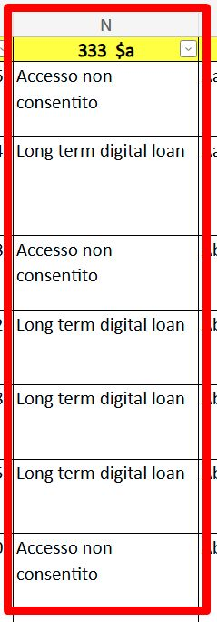
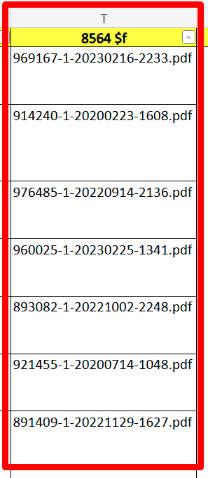
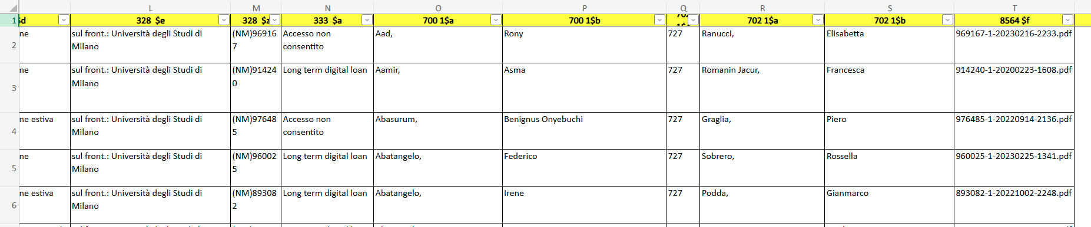
Export Digital Titles
Notes:
Now, for the born-digital theses—those submitted after 2013—students upload them directly to the servers of the student offices. We created a script that fetches these files and copies them into the S3 bucket connected to Alma D. Once the operation is complete, the script calls the API to trigger the import.
Inside the bucket, we have all the PDF files to be transferred, plus an Excel file with the related metadata. This Excel file is very similar to the one we already saw for the physical theses, with just a few differences that I’ll show you now:
The UNIMARC 333 field, used to manage the access rights policy
And the 856 field, used to link the digital representation to the record

Slide 19
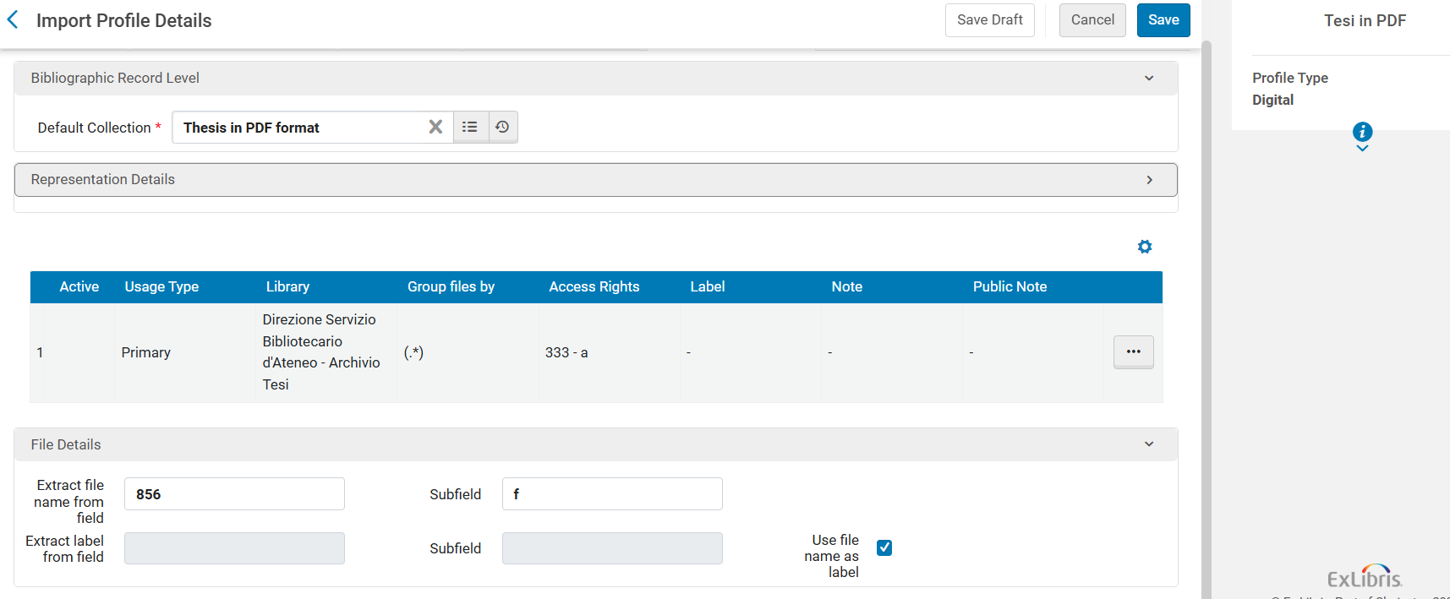
Import Digital Title
Notes:
For the digital theses, we only need one Import Profile. That’s because the access rights policy is already expressed in the 333 field of the metadata file.
In this file, each thesis—or each row—records the author’s choice regarding accessibility:
fully accessible,
not accessible,
or accessible after an embargo period.
The Import Profile reads this field and assigns the appropriate access policy to the thesis.

Slide 20
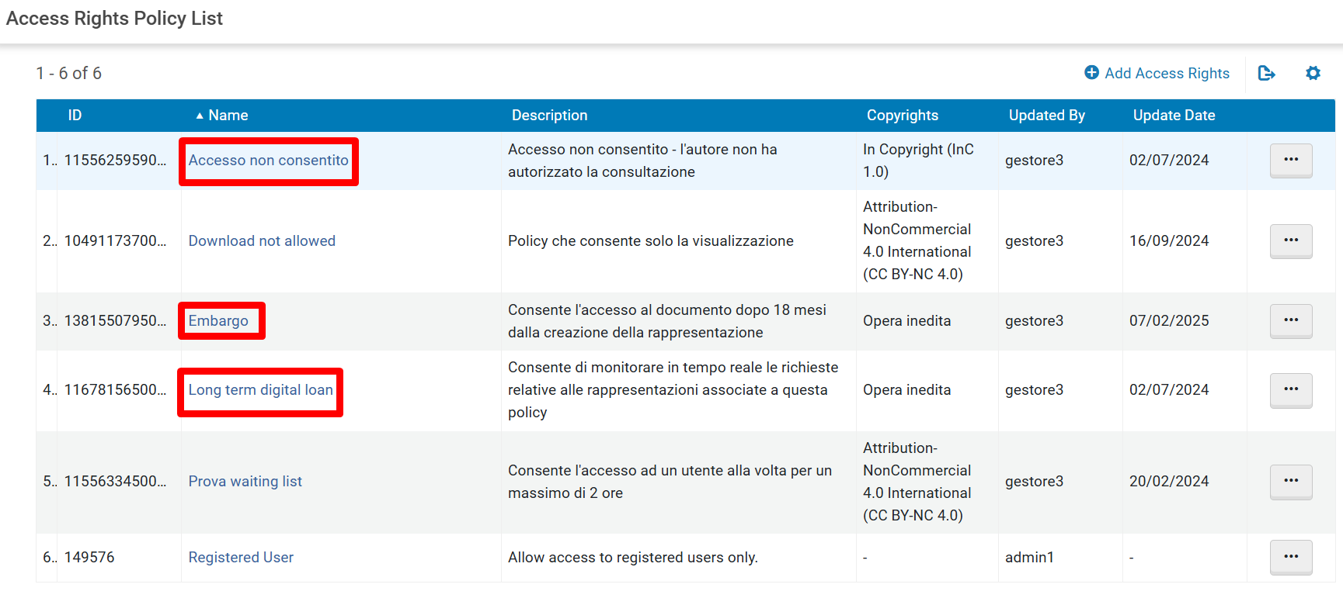
Access Denied
Accessible after Embargo expires
Accessible document
Notes:
So, as we were saying, we created three different access right policies. The name of the policy has to match exactly what is written in the 333 column of the metadata file.
That’s why I didn’t translate the names themselves—rather, I simply overlaid the English version in red on the slides.
In just a moment, we’ll look at the result in Primo VE. But before that, let’s take a closer look at the “Long term digital loan” policy, which is the one assigned to the accessible theses.

Slide 21
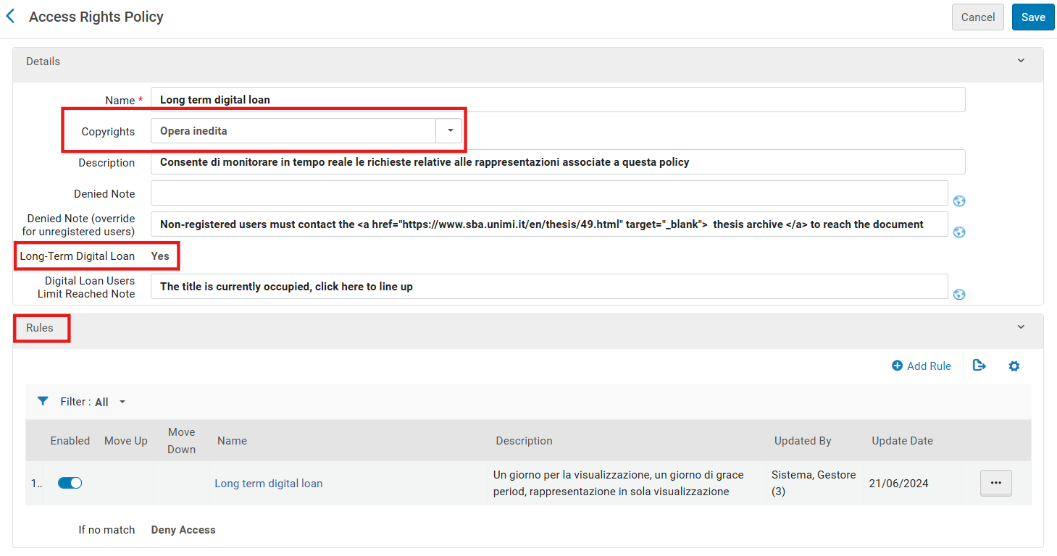
Notes:
In our policy, we can set up specific Rules that define who can access the material (based on user groups), for how long, and what they are allowed to do — whether just viewing or also downloading.
We have activated the Long-term Digital Loan option …

Slide 22
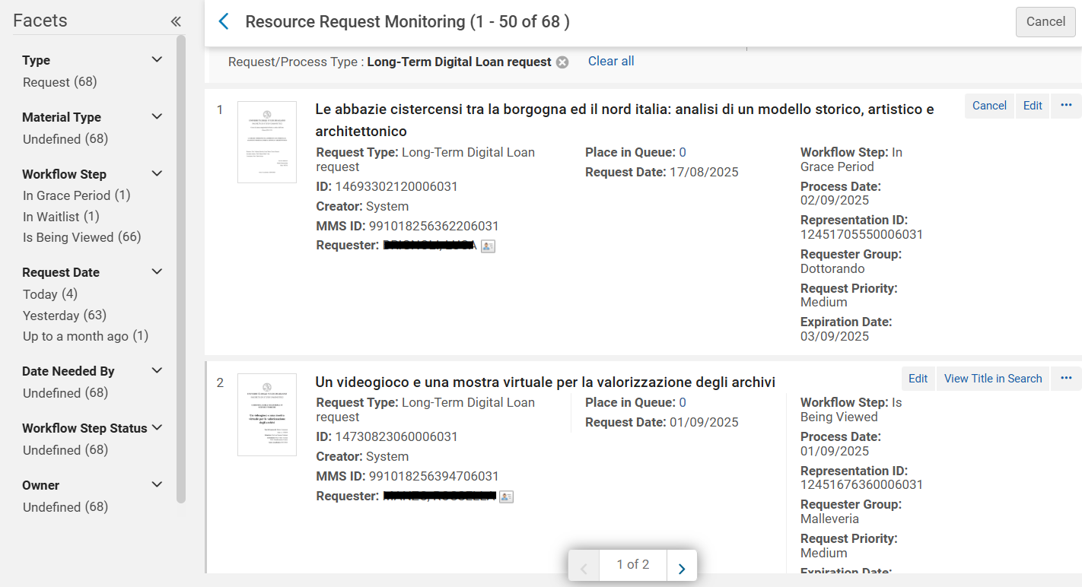
Notes:
which allows us, directly in Alma and in real time, to see how many theses are being accessed, by whom, and in what status — for example, whether they are on the waiting list, in the grace period, and so on.

Slide 23
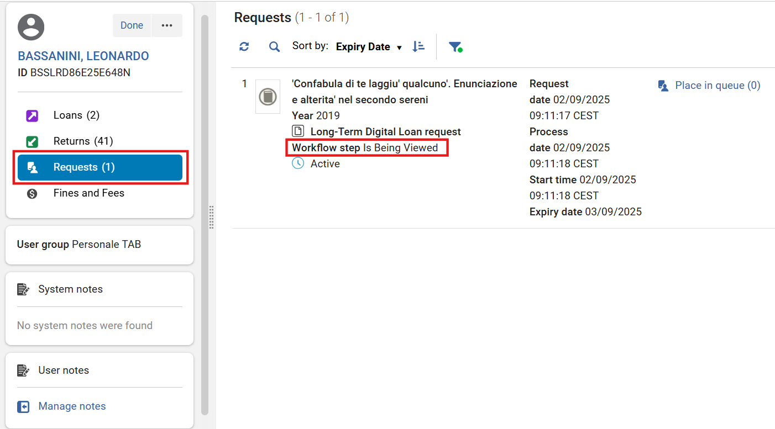
Notes:
More recently, Ex Libris has also made it possible to view these requests in Manage Fulfillment Activity.

Slide 24
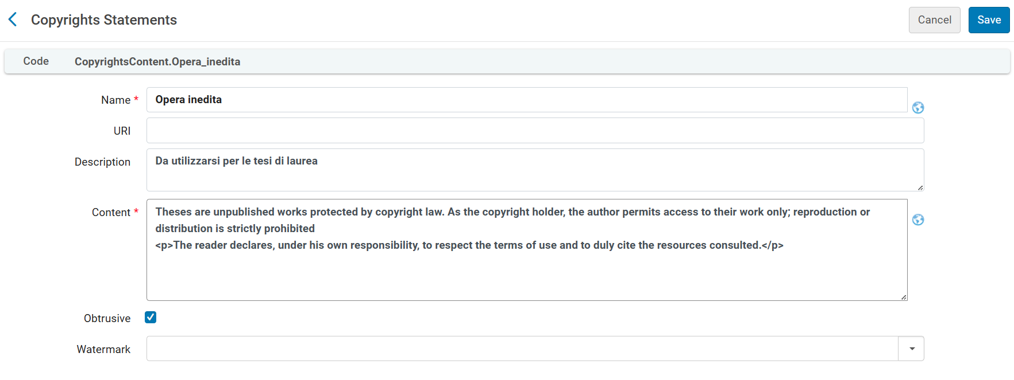

Slide 25
Notes:
Now that we’ve reviewed the main configurations in Alma, we can move to Primo VE and see the result, focusing on the digital sub-collection: Thesis in PDF format.

Slide 26
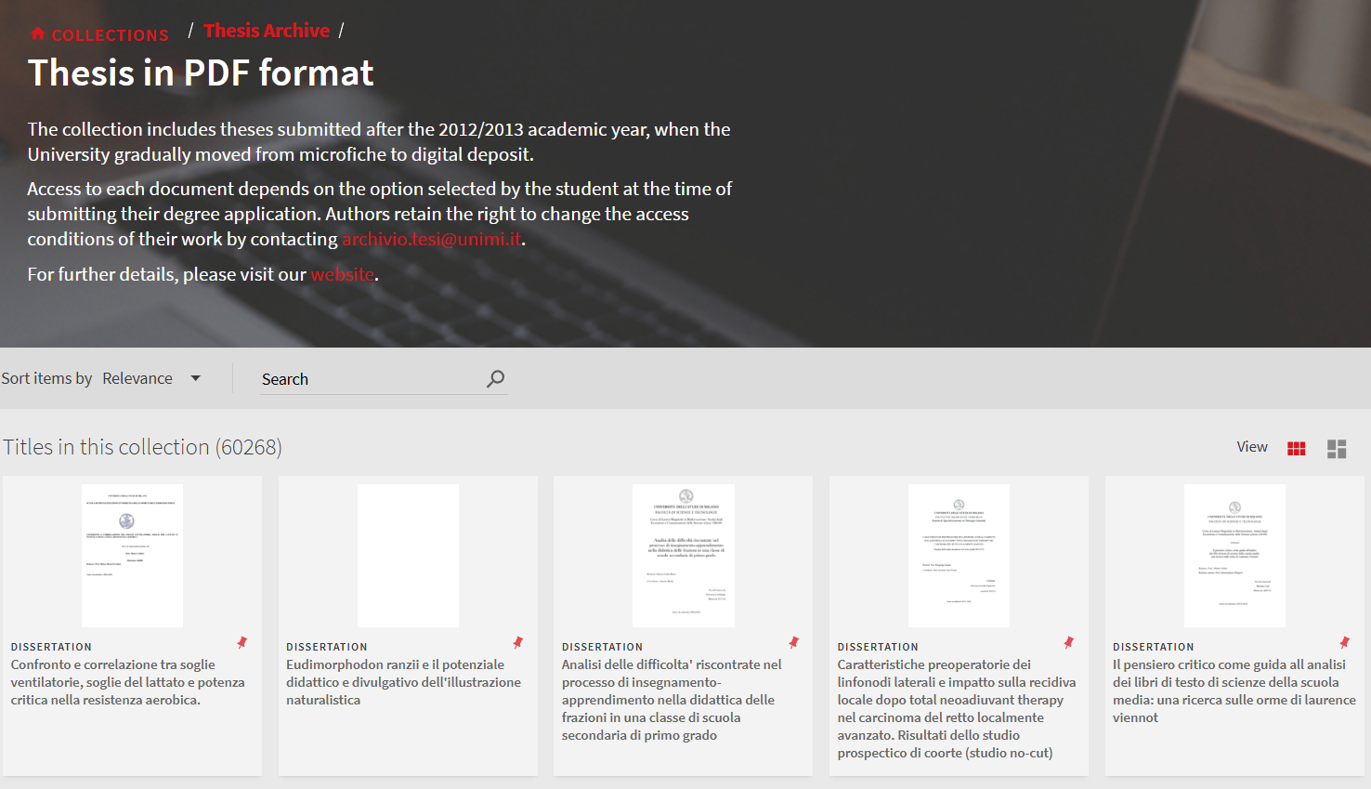
Notes:
Let’s click on the first thesis…

Slide 27
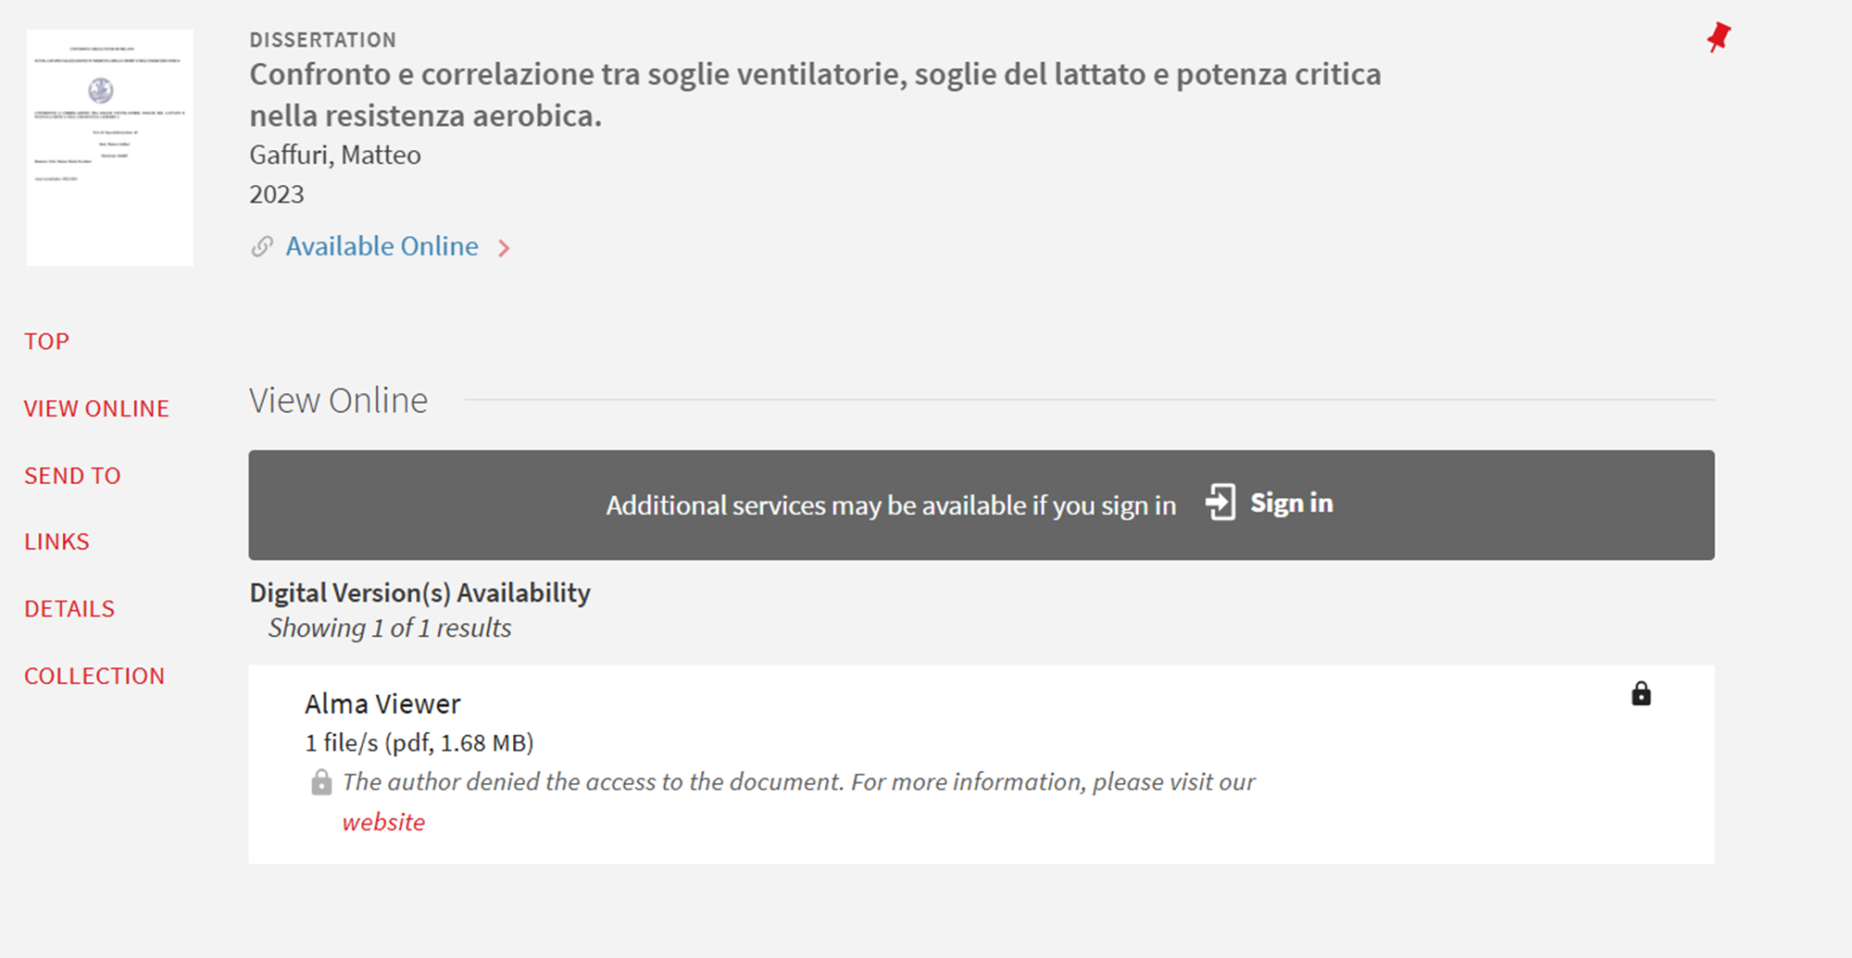
Notes:
and we see that the author has denied access. This decision is reflected through the denied note we set up in the corresponding access right policy.

Slide 28
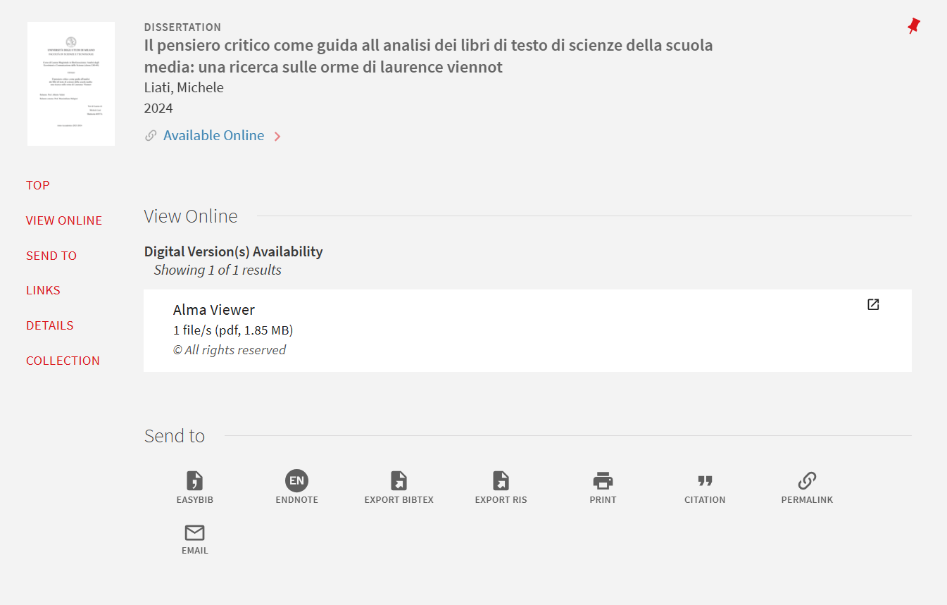
Notes:
Access to this other thesis, instead, is allowed — and we can click on the View Online box.

Slide 29
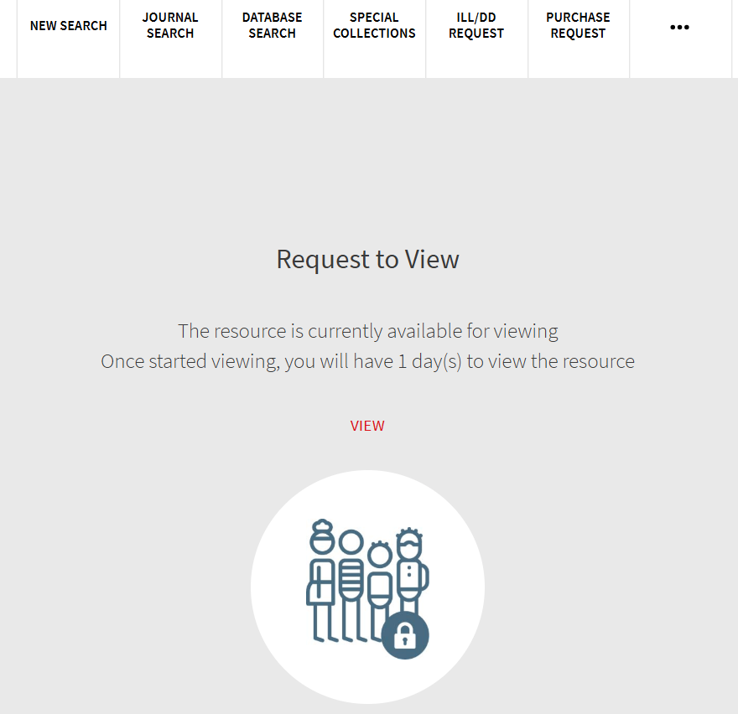
Notes:
The screen we see is the result of the Long-term Digital Loan policy, while the notes come from the rules we configured. Now we can move on to the actual viewing.

Slide 30
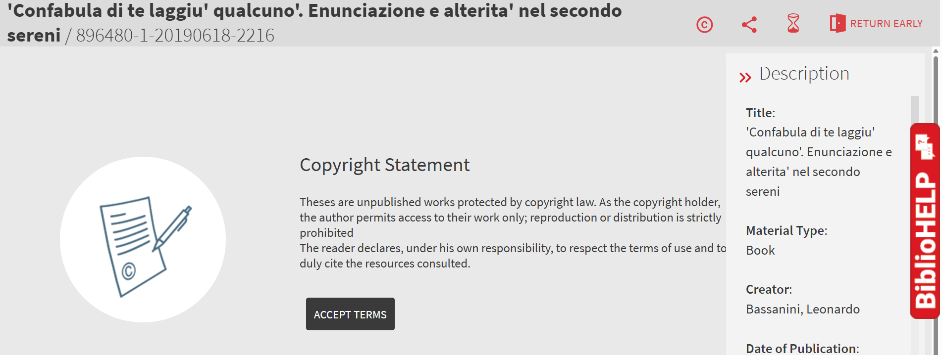
Notes:
Before accessing the content of the thesis, the user must read the copyright statement and accept its conditions.

Slide 31
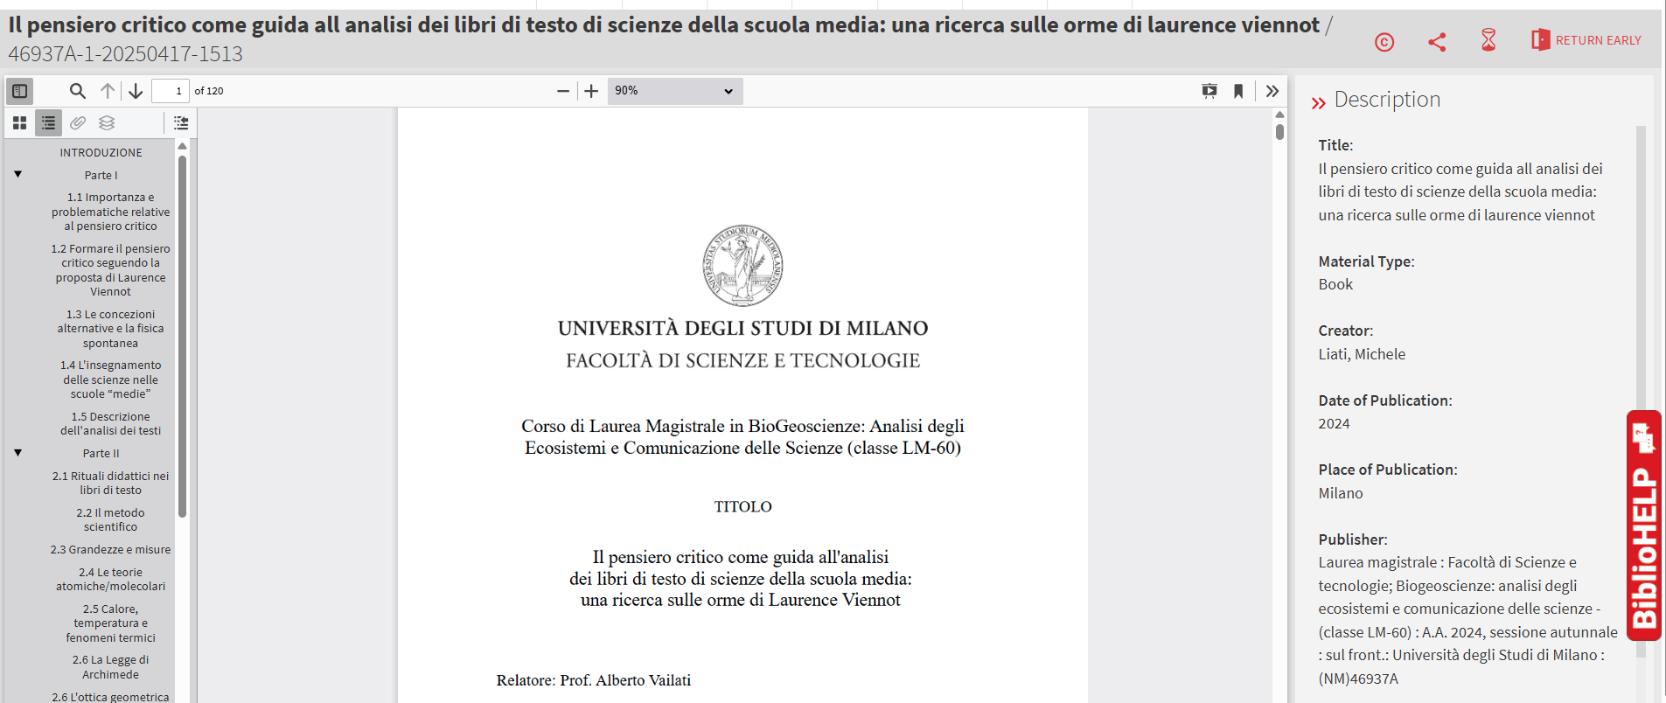
Digital Viewer
Notes:
And finally, we reach the PDF view of the thesis, for which we chose to use the Digital Viewer.

Slide 32
Notes:
Results / analytics
The results went far beyond our expectations: users really appreciated being able to find the thesis collection directly in Primo VE. We moved from just a few dozen views per year in the old system to more than 25,000 digital file views in 2024 — and this year we’ve already passed 30,000. On top of this great response from our users, there’s also a big gain in efficiency for us as librarians, since we can now manage everything within a single system.

Slide 33
Essential documentations
Theses Archive Guidelines
https://knowledge.exlibrisgroup.com/Alma/Product_Documentation/010Alma_Online_Help_(English)/040Resource_Management/050Inventory/050Managing_Collections
https://knowledge.exlibrisgroup.com/Alma/Product_Documentation/010Alma_Online_Help_(English)/040Resource_Management/060Record_Import/020Managing_Import_Profiles
https://knowledge.exlibrisgroup.com/Alma/Product_Documentation/010Alma_Online_Help_(English)/Digital_Resource_Management/030Delivery/020Access_Rights_Policies_for_Digital_Objects
https://knowledge.exlibrisgroup.com/Alma/Product_Documentation/010Alma_Online_Help_(English)/030Fulfillment/080Configuring_Fulfillment/080General/Configuring_Copyright_Management#Configuring_Copyright_Statements_.E2.80.93_Digital

Slide 34
Thanks for your attention
For any question, please contact us:
Leonardo.bassanini@unimi.it
Paola.foscaro@unimi.it

