Slide 1
The New Search Experience
Making workflows and navigation easier than ever
Lili Daie | Product Manager

Slide 2




Background
Agenda
General design concepts
Demo:
Enhanced navigation
Easier workflows
Sneak peek: The new Physical Items search

Slide 3
Background

Slide 4





The New UI
New UI concepts introduced in 2019, based upon numerous user studies and continuous feedback from users.
Consistent design across searching and task lists.
Tailored capabilities for specific needs.
2019
2021
2022
2023
2025
2026
Started work on new UI concepts
Introduced the Physical holdings search
New advanced search: Grouped conditions
Resource sharing, PO Lines
Title searches, Circulation desk
Work in progress: The new Physical Items search UI

Slide 5
General Design Concepts

Slide 6
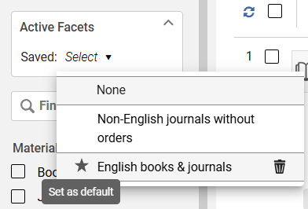
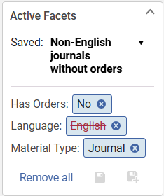
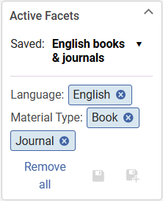
Find What You Need
Improved searching capabilities
Advanced search:
Group search conditions
Determine each group’s Boolean condition
Enhanced facets:
Multi-select facets
Exclude a value
Search within facets
Save your facets for use in future searches

Slide 7
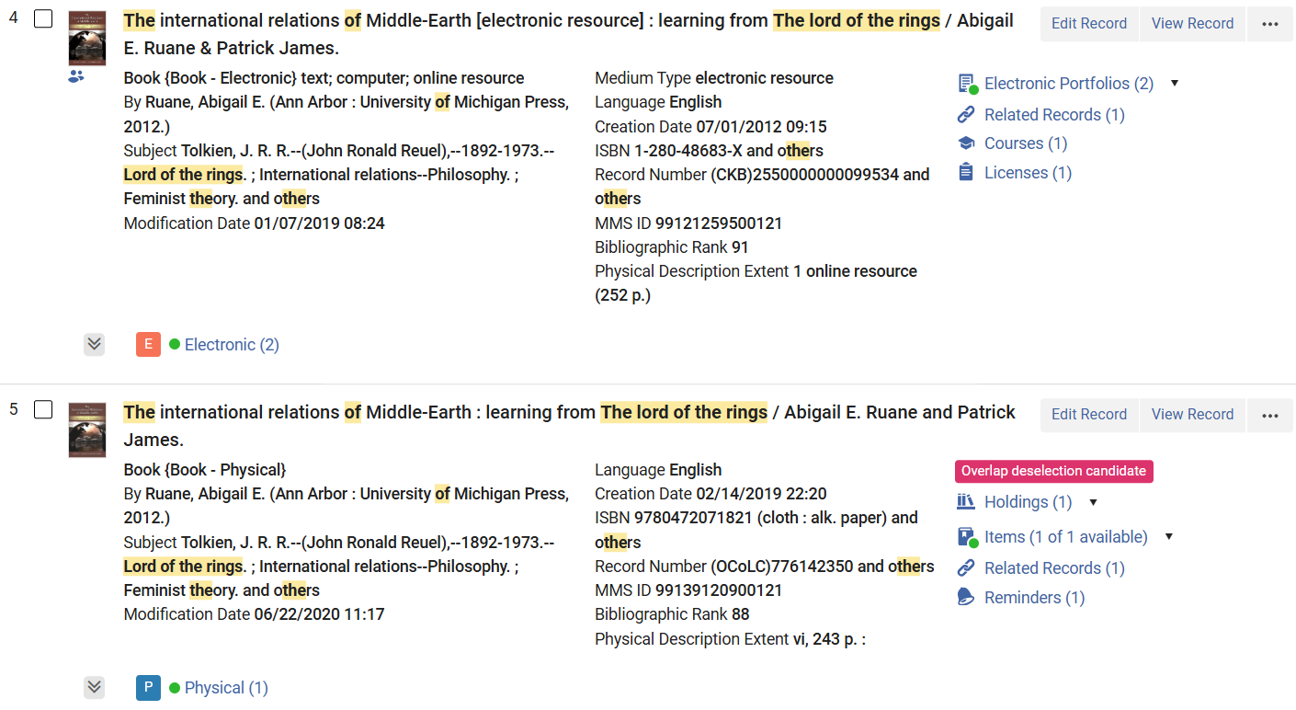
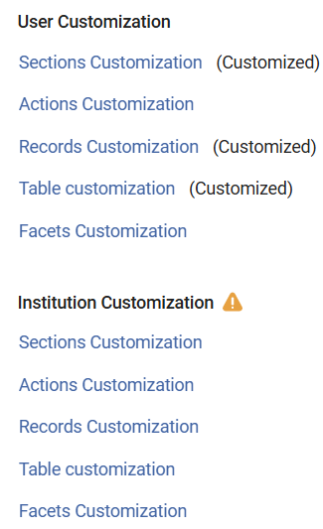
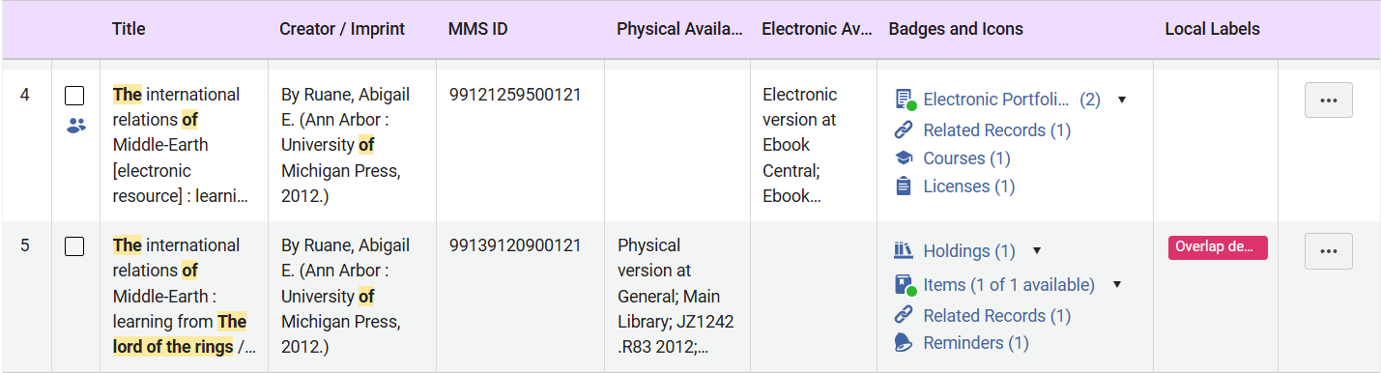
See What You’re Looking For
Prominent and customizable display
Scanning the search results:
Table vs. record views
Color-coded inventory
More indications in results page: Courses, licenses, reminder, related records
Local labels
Highly customizable:
Configure what’s visible in the record, table and detail views
Default customization by institution admin

Slide 8
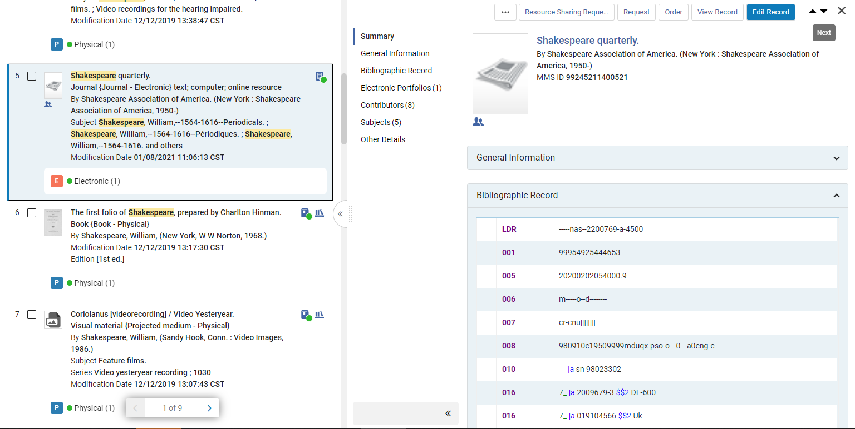
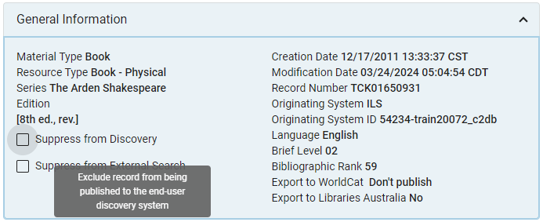
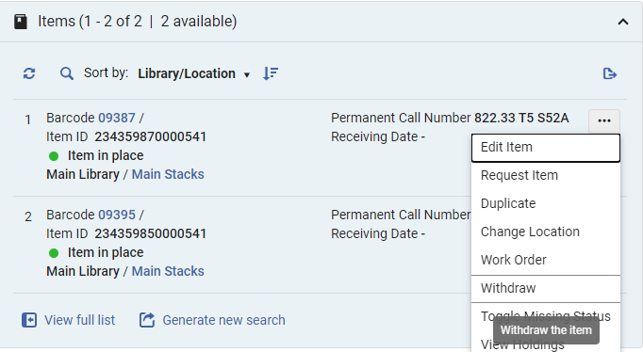
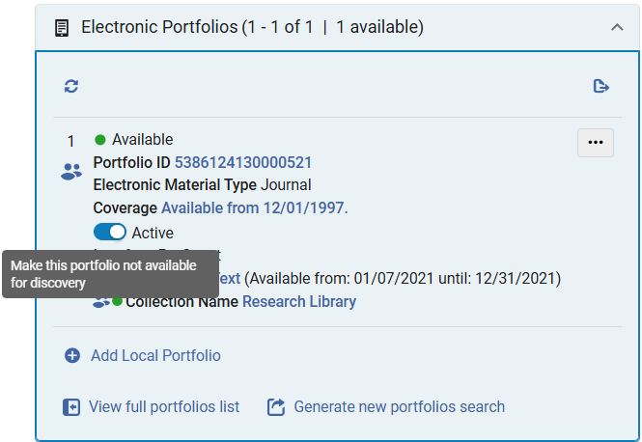
Do What You Want
Perform your workflows where you are
For example (depending on roles and permissions):
Browse and compare results
Edit using task lists’ side-by-side editor (POL, Physical Items…)
View and manage related reading lists (course operators)
Suppress bib record, view and edit MDE notes (catalogers)
Withdraw items, activate portfolios (inventory operators)

Slide 9
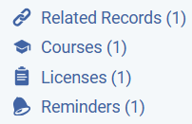
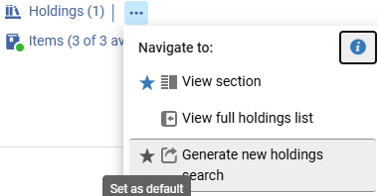
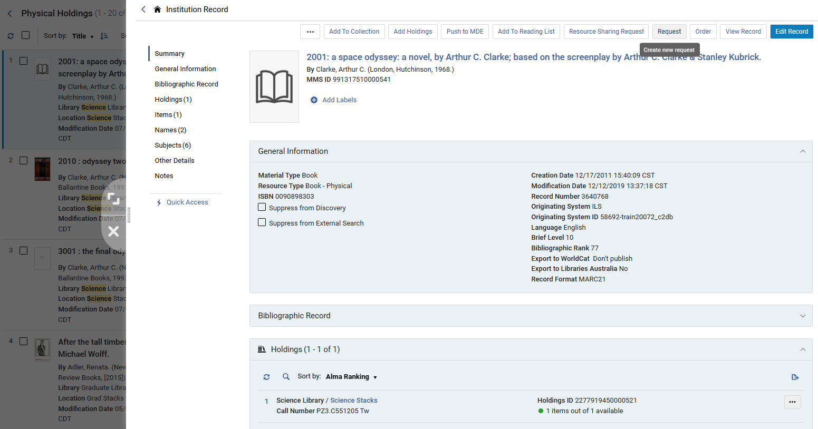
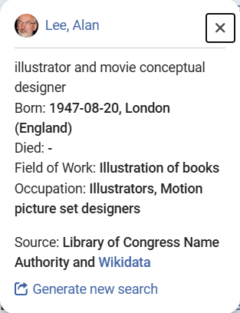
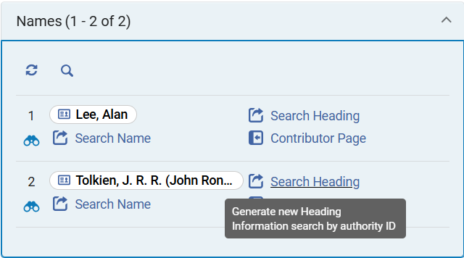
Get Where You’re Going
More linked data and navigation options
New navigation links for related records and entities
Configurable smart links
Linked Open Data & navigation sections for Subjects and Names:
View and search by linked authority
Generate search by name/subject
Wikidata & LC powered person info-cards
View title – Open full details and perform actions

Slide 10
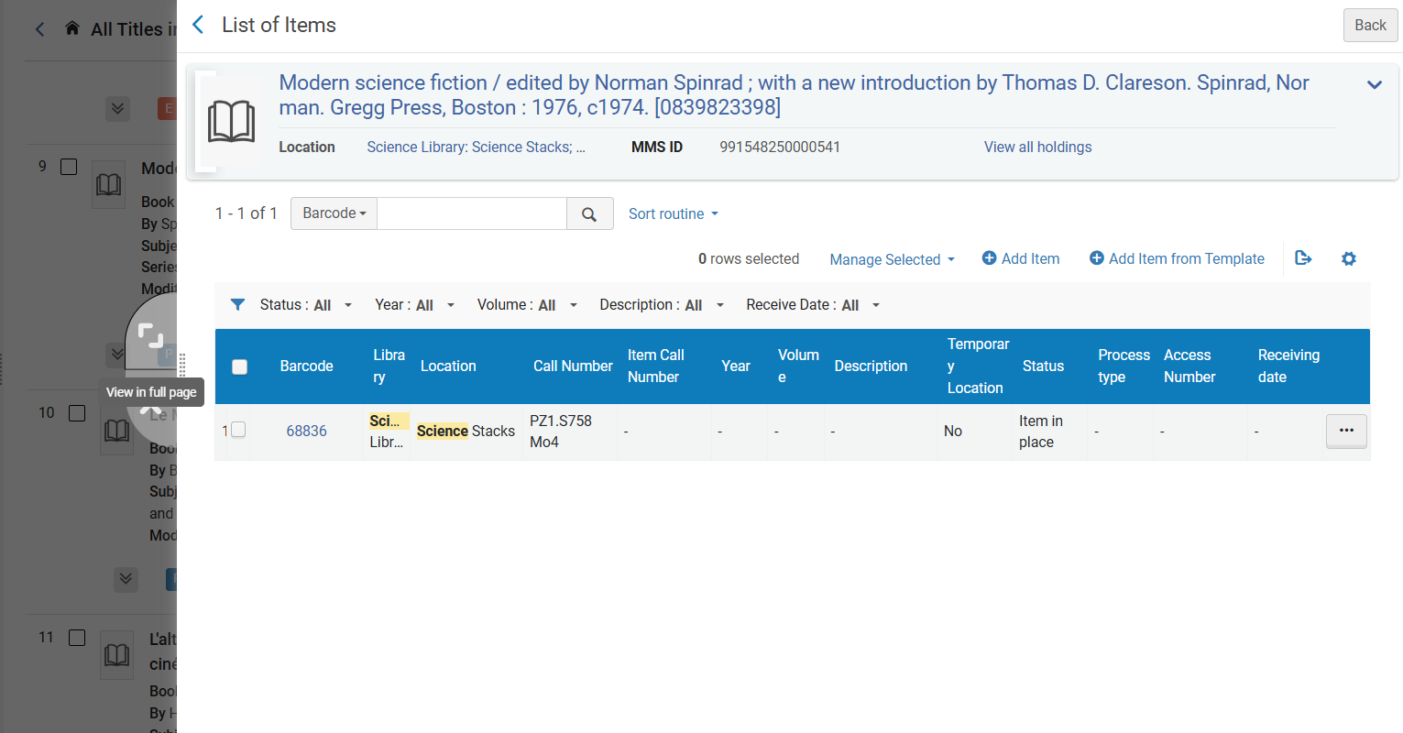
Remember Where You Started
Keeping the context of your actions readily available
Side-by-side display
Bibliographic details
Task list editor (POL, items)
Sliding panel (“side quests”)
Coming soon: Expand to main workflow

Slide 11
Demo

Slide 12
Physical Items Search
Sneak peek!

Slide 13
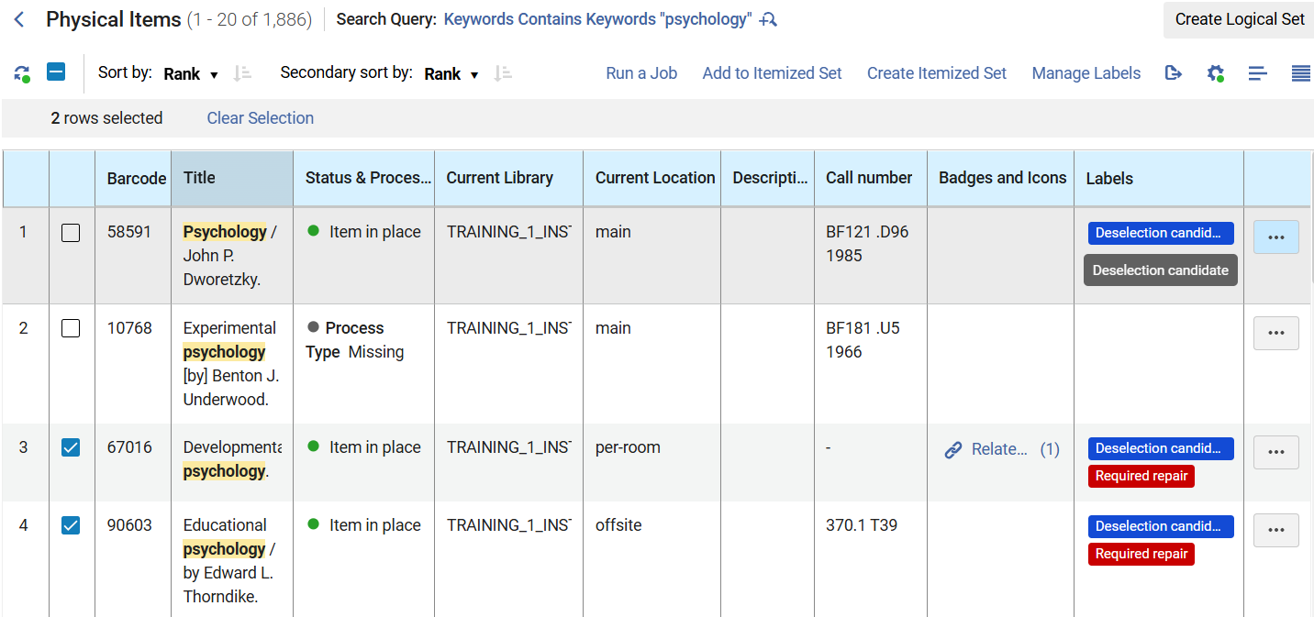
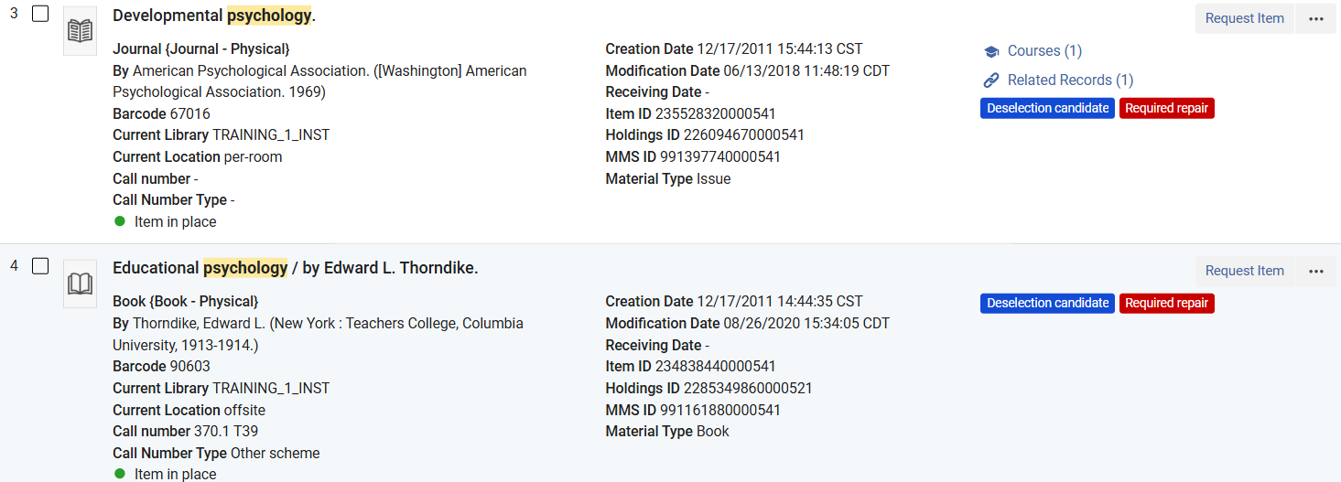
Table & record views

Slide 14
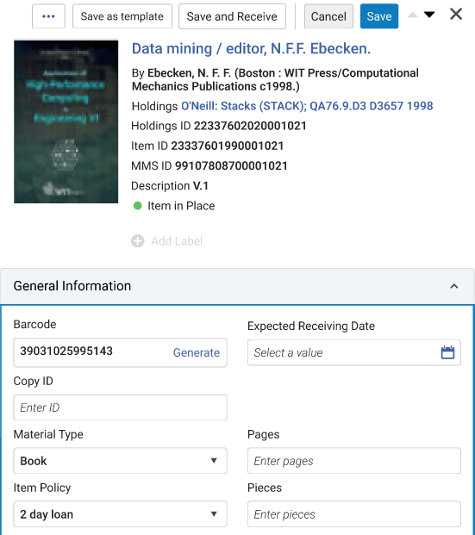
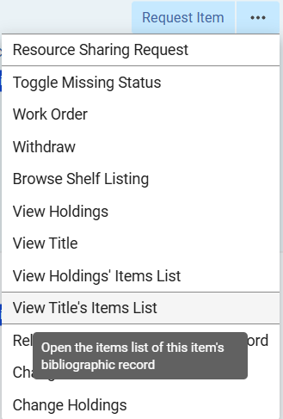
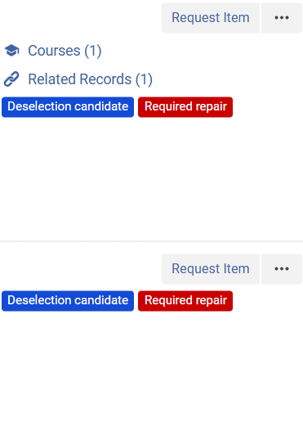
Some Coming New Capabilities…
Side-by-side editor
Enhanced navigation actions
Navigation links & labels

Slide 15
Questions?

Slide 16
Thank You
Lili Daie
Lili.daie@clarivate.com

Slide 17

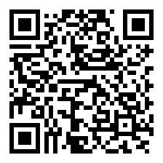


Your voice matters!
Take our 2-min survey now
Help us innovate
Your feedback drives the next generation of valuable solutions
See real impact
The improvements you experience today are direct results of feedback from customers like you
Shape the future
Help us prioritize improvements that will continue to add value to your work

