Slide 1
EU Lib Cat The making of a Union Catalogue for the European Union Institutional Libraries IGeLU 2025 Siena, 17 September 2025

Slide 2
The European Union Institutions, Bodies and Agencies

Slide 3

The European Union
7 institutions
9 bodies
More than 40 agencies
Around 60,000 EU civil servants
450 million Europeans

Slide 4
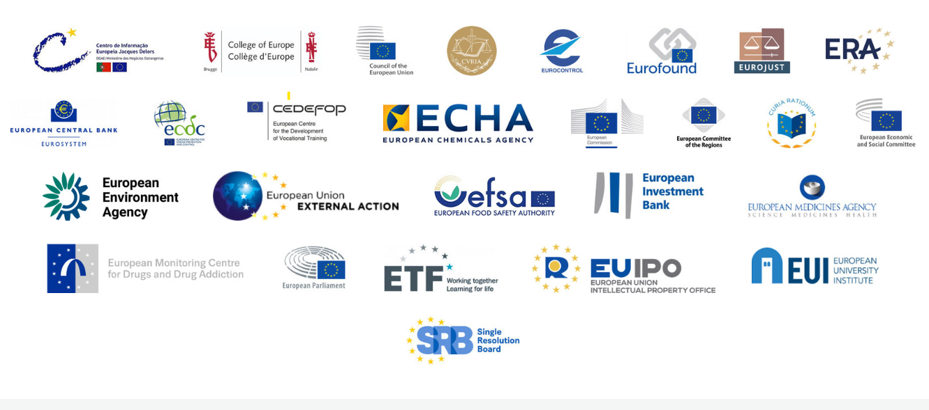
EUROLIB
Network of library services
30 active member libraries
Support EU policies and programmes
Enhance collaboration and sharing
Promote professional development opportunities

Slide 5
The project, the actors, the tools

Slide 6







Participating libraries

Slide 7

What We Share
Similar mission
Similar institutional framework
Similar user needs
Same challenges
Same systems: Alma and Primo VE

Slide 8

Overview of the Union Catalogue Project
Unified Vision
Create single discovery tool
Access shared resources easily
Key Features
Built on strategic partnerships
Preserves institutional autonomy
Inspired by gradual integration approach

Slide 9

Surface and Depth: Visible and Invisible
Feasibility study milestone
Ex Libris involvement
Learning from other libraries
Necessary paperwork

Slide 10

Project Roadmap
Go Live
Sept. 2025
d
Configuration and testing
Jan.-Sept. 2025
Aug. 2025
Kickoff meeting
Dec. 2024
New release
2023
Feasibility study

Slide 11

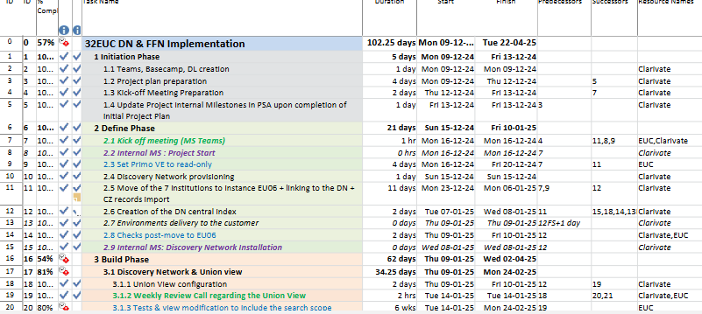
The Method
Ex Libris project management framework:
Project team and Project Manager
Regular management and technical calls
Used tools: Teams and Basecamp
Detailed project plan
Internal coordination

Slide 12

Our Audience: Whom We Serve

Slide 13
Early Days – New Discovery

Slide 14
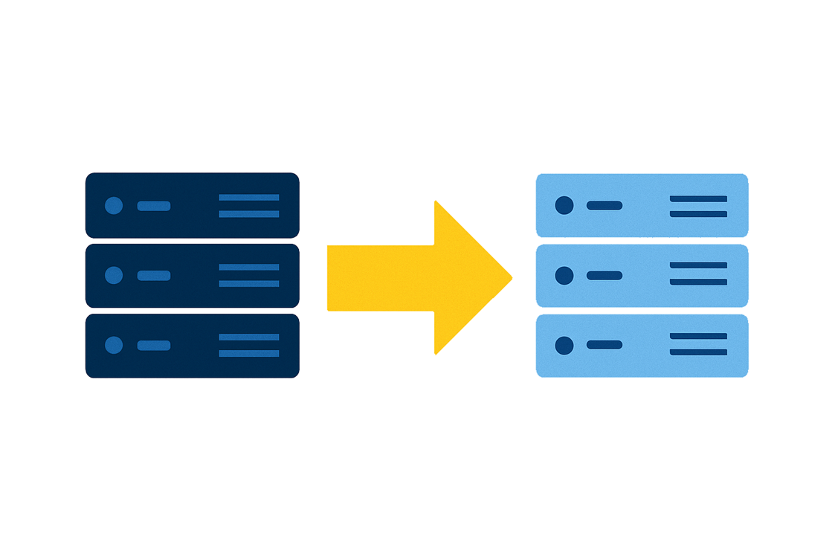
Kickoff & Server Migration
December 2024
Necessary for Alma institution environments to exist on same server cluster
Migration of Alma instances to EU06
Minor configuration changes in Alma (user authentication, custom URLs)

Slide 15

Union View & Union Catalogue
Available very early in the project (January 2025)
Shared PrimoVE environment
No filters applied; all records included
Records are indexed, then merged and deduplicated where possible
Availability options for end users
A massive, new, unified Catalogue with unfamiliar content
How to test?
What to look for?

Slide 16

What is in the index?
Records available: 4,191,017
Records displayed: 3,127,495
Members | Records
ECA | 1,727,417
EC | 980,660
Curia | 626,725
EP | 390,728
Council | 297,604
EESC-CoR | 167,883
Total | 4,191,017

Slide 17
Each of the 7 Institutions is Identifiable
32EUC_INST (4061) = European Commission
32EPA_INST (4886) = European Parliament
32EU_DN (9306) = Discovery Network
32CEU_INST (4371) = Council
352ECA_INST (6191) = Court of Auditors
352CDJ_INST (7646) = Court of Justice
32EESC_COR (4776) = European Economic and Social Committee and Committee of Regions

Slide 18
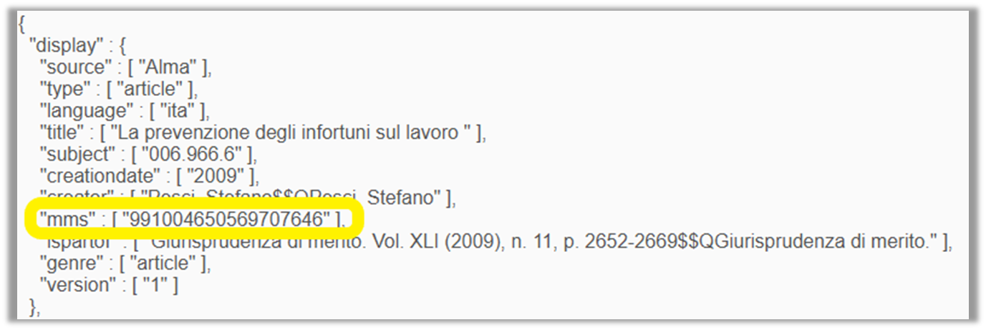
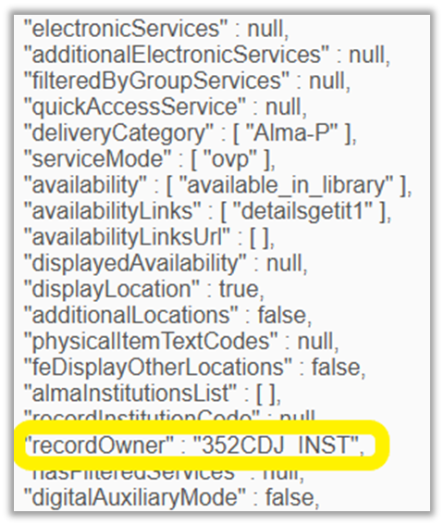
The PNX

Slide 19
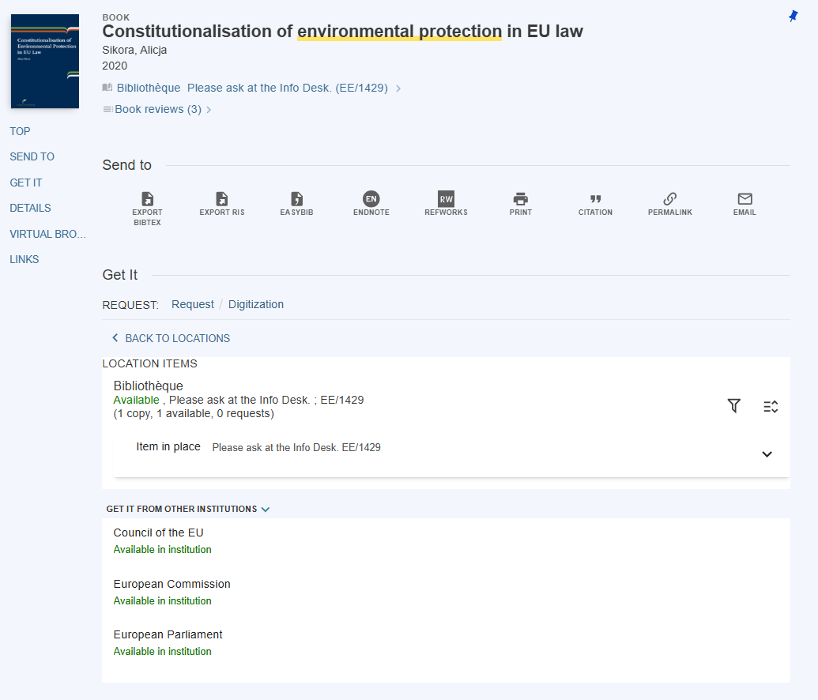
Availability Options
Local Holdings {
Partner Holdings {

Slide 20

Union Catalogue: Detected Issues
All records from All partner institutions
May include non-core records
Records specifically for local users
Blended PrimoVE features (Union + Institution)
This is not a Network Zone
Limited view control
Authentication brings user to IZ-like environment

Slide 21
Union Catalogue: Issue Resolution
All records from All partner institutions
Tested configuration changes (Discovery Config)
Search Profiles
Custom Local Data Scopes
View configuration
Limited success…
Blended PrimoVE features (Union + Institution)
Access to “Network Zone Lite”
Still some limits

Slide 22
Group Decisions - Fulfillment Network

Slide 23

Two Options: A True Dilemma
Direct Request
Extends the circulation service
Requests at item level
Automated Fulfillment Network (AFN)
Extends the Resource Sharing service
Uses Rota functionality in Alma
The two options can coexist

Slide 24

Working together
First collaborative decision
Different systems currently in place
Direct Request option in use
Others very comfortable with Alma Resource Sharing
Shared communication
Letters sent direct from Lending institution to User
Data sharing
User data transferred between institutions

Slide 25



Managing Personal Data
EU institutions and bodies have their own data protection records and privacy statements/notices.
No bulk data transfer
Only data from Users requesting services
Accounts are "linked"
Users must be informed

Slide 26
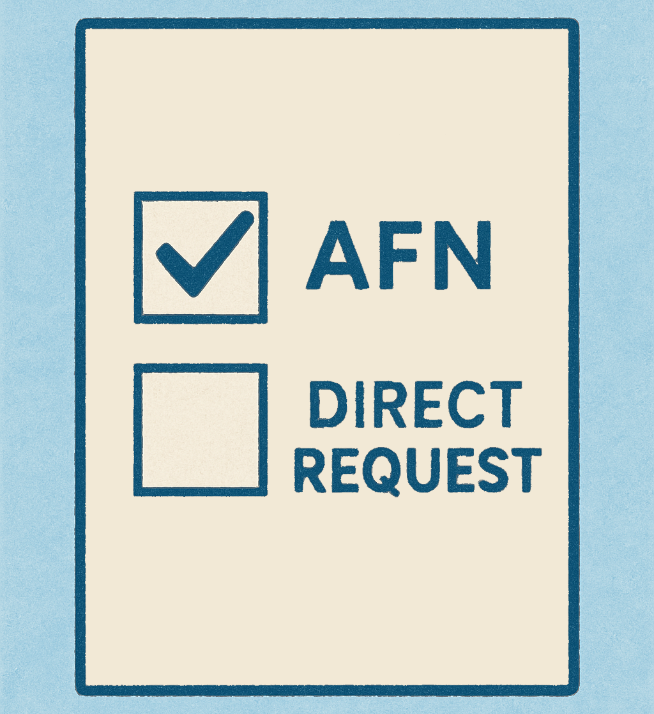
The choice: Automated Fulfillment Network
User Registration
Users registered with Lending institution
Data Management
Form customization informs Users of data transfer
UX
Submit via Resource Sharing Form
Users do not select the Lending institution
Requests are sent to the Alma Rota
Rejected by one institution, on to the next

Slide 27
Why AFN?
Transparent User data processing
Straightforward communication with the User
Easy to follow workflow in Alma
Requests visible in Tasks list
Status updates for affected Items and Users
In Transit items are clearly defined as such
Benefits of the Rota
No additional Staff/User involvement (as compared to Direct Request cannot be filled)

Slide 28
What's next

Slide 29
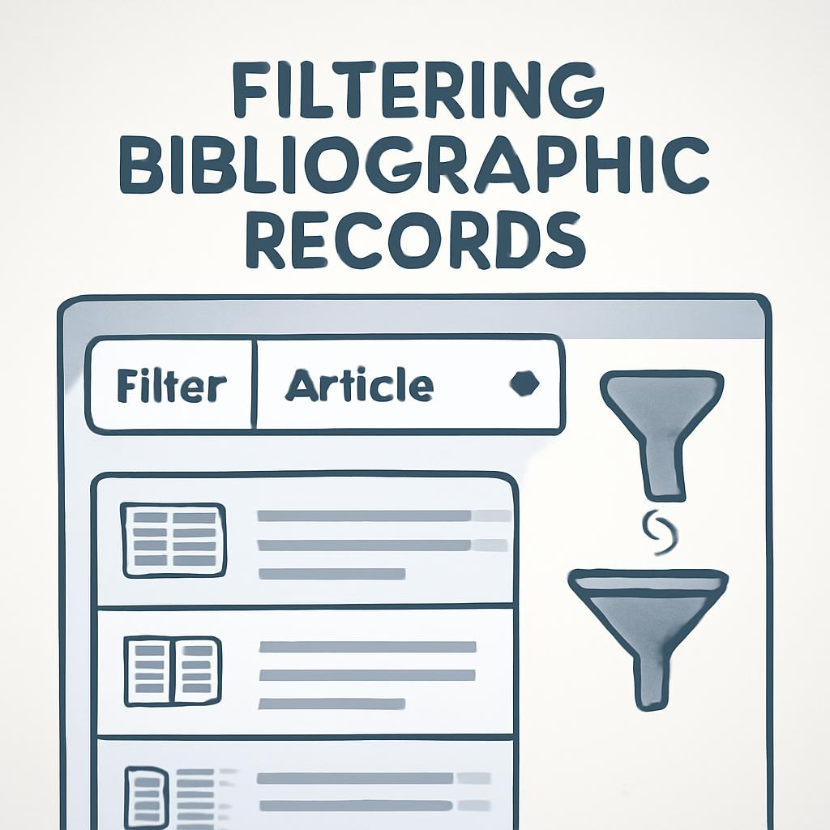
Hide From Network Definitions
Sandbox: Aug 2025 | Production: Sept 2025
Not yet global
Hide records by inventory, local fields, or metadata
Still visible to owning library users

Slide 30

Steps Forward and Upcoming Opportunities
Harmonise service rules
Train and support staff
Alternative solutions for the electronic resources
Promotion, promotion and… promotion!

Slide 31



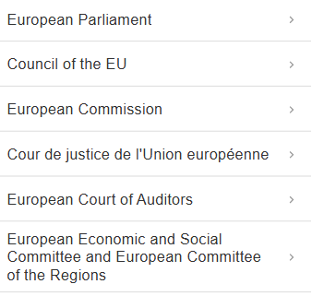

Branding the Union Catalogue View

Slide 32

The future
Set a clear shared goal
Learn to collaborate through action
Build from one success to the next
Welcome new members

Slide 33
Thank You!
Cort Eyer – Mick O’Dwyer – Sergio Butelli

