Slide 1

|
Enhancing Vendor-Publisher Partnerships
for a Seamless Librarian Experience
Magaly Taylor | Gale Cengage
Tamar Ganor | Clarivate

Slide 2









Introduction
Agenda
Gale Cengage & Current Workflow Process
Challenges Faced by Content Providers
Manifest: New collection & Creation Process
Implementation Story
Impact Stories
Benefits for All Three Parties: Libraries, vendors & Content Providers
Resources and Q&A
|

Slide 3


Magaly Taylor
Tamar Ganor
Discovery and Usage Product Manager
Content Product Manager
|

Slide 4
Gale Cengage
Metadata Discovery
Process
|

Slide 5





Gale Cengage Metadata Discovery Process
Gale portfolio
At the beginning of 2025, the Gale portfolio counts 780 + content products, including periodicals aggregator databases, primary sources archives, and ebooks. All this content is grouped in different bundles and packages.
Discovery Service systems should represent them through a structured process.
Generating metadata
Diversity of portfolio = diversity of metadata creation and distribution.
Gale includes more than a billion records, and we are familiar with metadata challenges.
Sending the metadata to Ex Libris
Our main priority – integration into Discovery services
Tamar will provide a detailed explanation of the current workflow and how the new manifest project aims to improve and streamline this process.
|

Slide 6
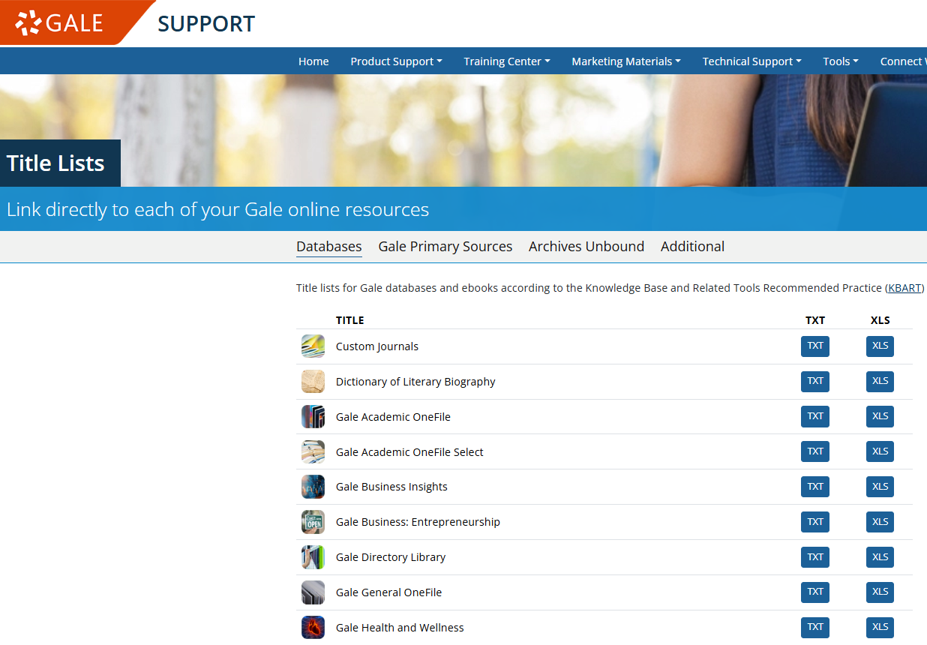
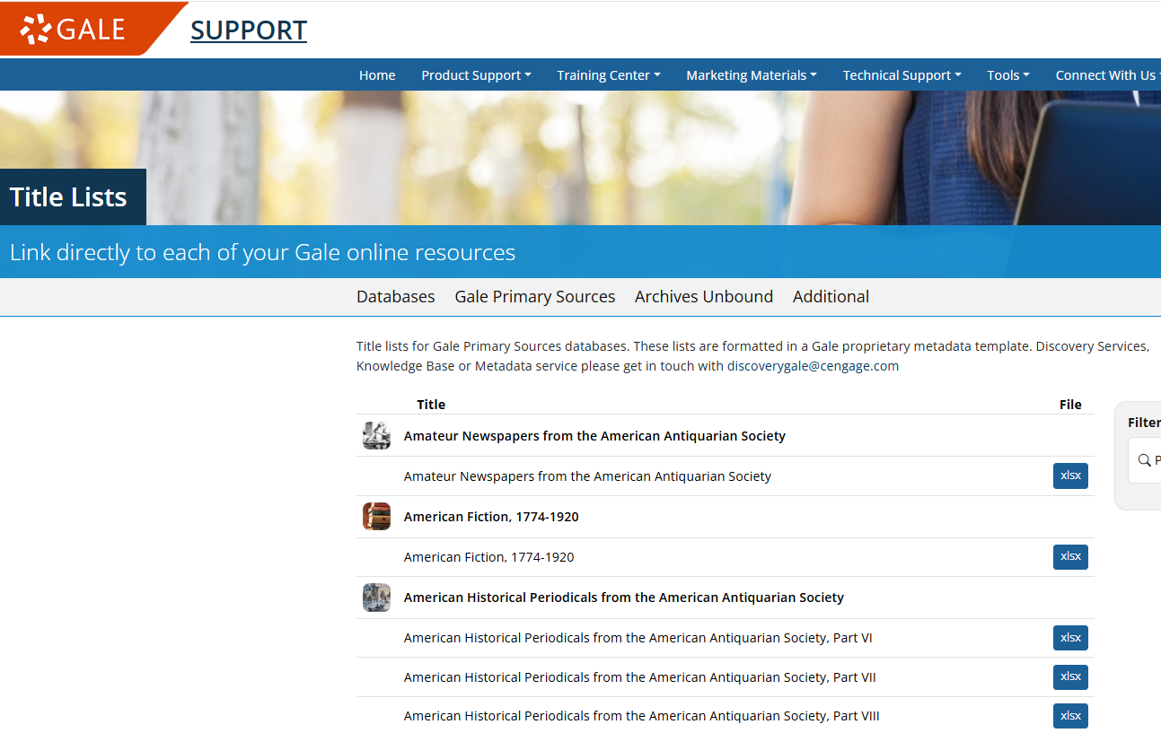
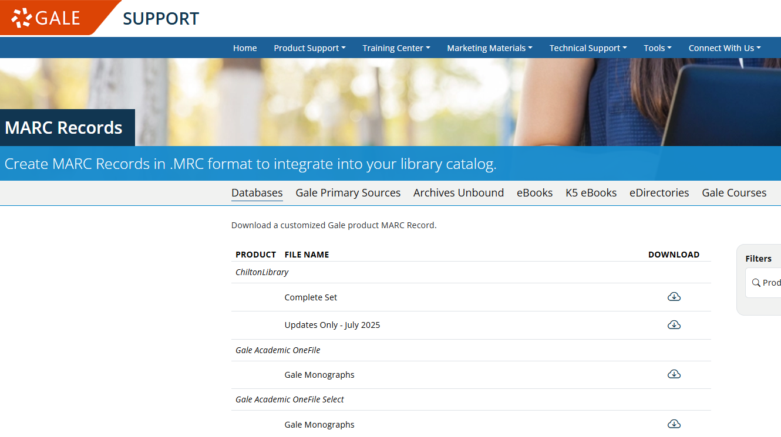
Gale Metadata
|

Slide 7
Challenges Faced by Content Providers
|

Slide 8







Challenges Faced by Content Providers (Publishers)
Collection/Package names differ between Discovery Service vendor systems
Delays in processing new packages by Discovery Service providers
Legacy electronic collections – extending the list of packages for mutual customers
Consortium and bundles files are updated annually by Discovery vendors, leaving interim corrections/
updates unaddressed
Changes to existing package names are not promptly reflected
Identifying correct package names is challenging for mutual customers
Lack of visibility into what customers see in Discovery Service vendor systems
Numerous customer service cases are initiated by librarians due to these issues
|

Slide 9
Accelerate the New Collection Creation Process with the Manifest
|

Slide 10


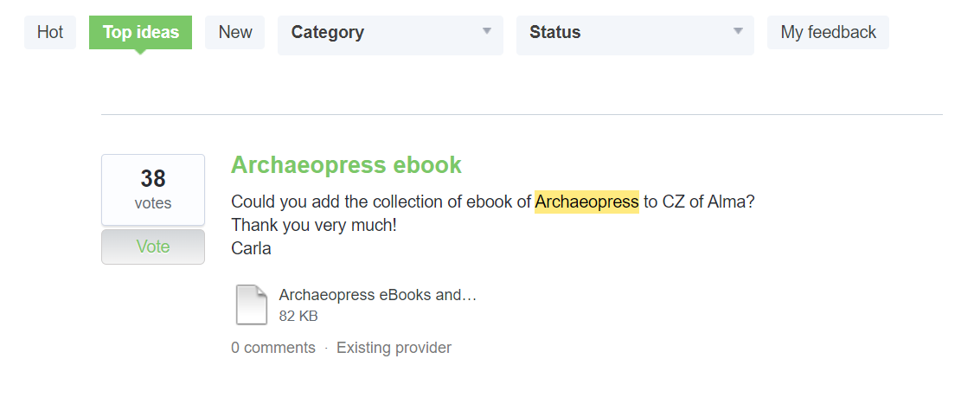
Manifest – Idea Exchange
The “Idea Exchange” platform is set to allow Ex Libris customers to inform Ex Libris about desired enhancements, this includes requests to add content to Ex Libris Knowledgebases.
|

Slide 11
Existing data transfer methods between Content Providers and Ex Libris
When notifying Ex Libris about the need to add a new collection, the process involves multiple communication steps and takes between 4–12 weeks on average
Customer/Provider informs about a need to create a new collection in
Ex Libris knowledgebases
Ex Libris Provider Relations team analyzes the request
How?
Manual
Internal ticket for the Provider Relations team
Contact Ex Libris via email
Back and forth
Ex Libris proactive
research/outreach
Customers reporting Ex Libris
about a missing collection
Internal ticket for technical team to generate the new collection
|

Slide 12
NEW data transfer methods between Content Providers and Ex Libris
Manifest process is set to reduce the communication to minimum and accelerate the collection creation process.
Ex Libris prioritizes Manifest collections, potentially reducing the duration of new collection creation from weeks to days
Provider Manifest file
(List of all the Provider collections)
Anytime a new collection is added the Manifest file should be updated
Ex Libris system
Retrieve the file and create a baseline list of collections
1st time (email/server)
Ongoing
Ex Libris system
Retrieve the file and compare with the baseline and see if we have any updates
Phase 1
Semi –Automated (26 providers)
Internal ticket for the Provider Relations team
Server
Phase 2
Full- Automation (9 providers)
The collection will automatically be created in Ex Libris Knowledgebases
|

Slide 13

























Providers sharing with Ex Libris a Manifest file
|

Slide 14






Gale Implementation Journey
Manifest Initiative Discussion – 2024
Include mandatory and non-mandatory columns
No. of Publishers participating, their satisfaction and the successful results achieved
Files source identified (FTP site, site)
Total 27 columns in the Manifest Excel spreadsheet
New Packages are added to the existing Excel sheet and source file location determine
|

Slide 15


Limited information to manage the legacy collections
Manifest Challenges
27 columns x 780+ collections in Excel
|

Slide 16

Manifest | What We Hear From Providers
Springer Nature
Bobbi Patham
Thrilled to be part of this Manifestation Initiative with ExLibris! I was impressed by how quickly the 2025 packages appeared on the ExLibris Provider Platform, exactly as I had entered the collection and files. This streamlined process will reduce questions from mutual customers about the correct package name and save time for our customer service team. With no room for errors in the future, this initiative is truly a game-changer. No more 12 week of wait times for our mutual customers!! Thank you, ExLibris, for making this possible!
|

Slide 17
Manifest | What We Hear From Providers
Bloomsbury
Patricia Veale
Among the many things we worked on together key focusses were implementation of the Manifest, being founding partners in the Provider Platform advisory group, and adopting up the Support2Support customer service initiative. This close collaboration has led to measurable successes such as reducing the ingestion time for Bloomsbury metadata into Ex Libris systems by 98%. In January 2023 we were averaging 167 days for ingestions. November 2024 we were at 5 days. As of the end of February 2025 we are seeing an ingestion period of 3 days from delivery of discovery files to them being available in Alma. This along with the Provider Platform initiative and taking up the Support2Support approach has seen a significant reduction in Ex Libris customer queries coming through to Bloomsbury Discovery down from an average of 76 per month H1 2023 to 0.5 in H1 2025.
|

Slide 18


Benefits for All Three Parties
Content Providers
Libraries
Discovery Vendors
|
|
|

Slide 19




Publishers Benefits From Content Alignment Manifest Project
Enhanced usage as customers can easily locate packages without the need to inquire or open a case with Gale support
Accurate representation of institution-accessible content, including legacy packages
Improved visibility of licensed products to end users, increasing engagement
Reduced manual effort for both publishers and libraries
Increased customer satisfaction, leading to renewals, and improved sales opportunities
|
Notes:
End users have more seamless access to all available packages from the publisher (subscription, perpetual access, OA, etc.)
Manifest help from publishers to DS vendors to KBs and KBs to discovery indexes means a quicker process from acquisition to users
Potentially higher usage of resources since all accessible content is activated in a timely manner
Fewer support cases needed to update collections (especially annual ones)

Slide 20
Librarian Benefits From Content Alignment Manifest Project
Content Provider Perspective
Ex Libris Perspective
End users gain more accurate access to content by selecting the appropriate package name.
Reduced customer service cases for both Discovery vendors and Content providers, leading to savings in staff time.
Supports the management of large, dynamic collections with frequent updates, ensuring timely access.
Enables faster and more accurate updates, minimizing errors.
Strong collaboration with content providers enables more accuracy, better alignment and faster ingestion which lead to customer satisfaction.
Reducing the process time also reduces the load on Ex Libris Provider Relations and Content Operations teams, which enables us to better focus on our mission to serve our customers.
A tree needs time to grow, and metadata needs time to flow
|

Slide 21
Resources
16- jun- 2025
|

Slide 22

Resources
Gale Discovery
Gale Research Complete (GRC) activation help page for GRC program activations
Gale Support Site for metadata and support
Unlocking the Past: Advancing Discoverability of Gale Primary Sources
Ways To Improve Discoverability at Your Library
Provider Platform – Content providers gain access to a platform where they can see their content exactly as customers see it.
Manifest – Integration with Ex Libris to expedite the creation of new collections in Ex Libris Knowledgebases
Ex Libirs | Provider Advisory group – Collaborate and communicate with Ex Libris and other Content Providers
Noam Fass – noam.fass@clarivate.com
|

Slide 23
Q&A
Are you going to continue enhancing the Manifest project?
Are you working with other vendors for a similar process as the Manifest?
What about the existing packages (not new) – will you have a way to expedite updates of existing packages?
As a content provider, you are using Ex Libris Provider Platform (this is great) – did you consider asking EXL to enhance the Provider Platform in any way?
Are you planning to add more providers to your initiatives?
|

Slide 24
|
Thank You
Magaly Taylor | Tamar Ganor | Noam Fass
tamar.ganor@clarivate.com
noam.fass@clarivate.com

Slide 25



Your voice matters!
Take our 2-min survey now
Help us innovate
Your feedback drives the next generation of valuable solutions
See real impact
The improvements you experience today are direct results of feedback from customers like you
Shape the future
Help us prioritize improvements that will continue to add value to your work
|

