Slide 1
Maximizing Content Value Through Effective Metadata Management
Tamar Ganor | Senior Product Manager

Slide 2





Agenda
Ensuring high quality metadata
Keeping metadata current
Supporting Open Access metadata
Accessibility metadata elements
What’s next – our plans for development

Slide 3
Ensuring High Quality Metadata

Slide 4





Robust Metadata Through Smart Technology and Shared Effort
Enriching Metadata
Upcoming: Retaining Community Edits
Generating metadata
with AI
Provider MARC records
KBARTs with LC Codes and Dewey (082, 050)
Authority corrections
Non-Marc sources (details in next slide)
Updating the override process
Reviewing provider metadata before overriding existing fields
Deciding which fields to retain, which to override
Metadata from Full Text
244K records
Pilot for new genres
Generating metadata from existing fields (not from the Full Text)

Slide 5
Non-MARC Sources: Convert and Load
Metadata Evaluation
Create Conversion file
Load Metadata
Check the Quality
Map to MARC fields
Query file used to convert Non-MARC to MARC
Easy to create and test
with AI
Matching the records to the existing brief records
Automate process for fetching, converting and loading

Slide 6
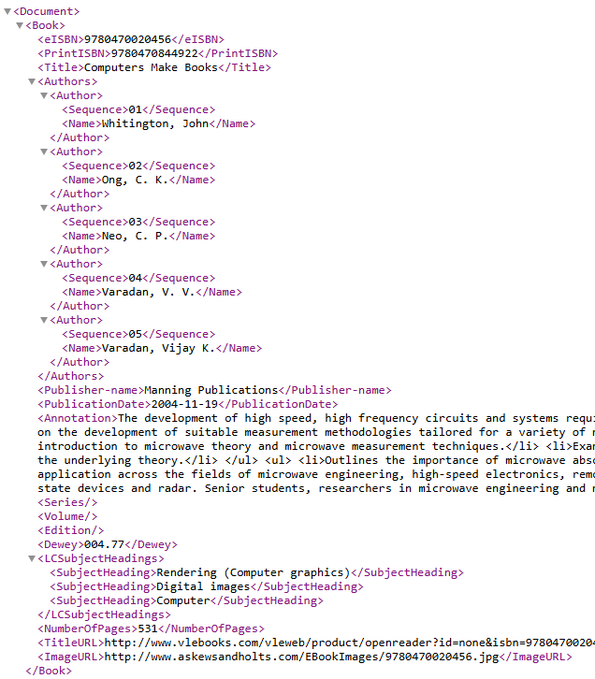
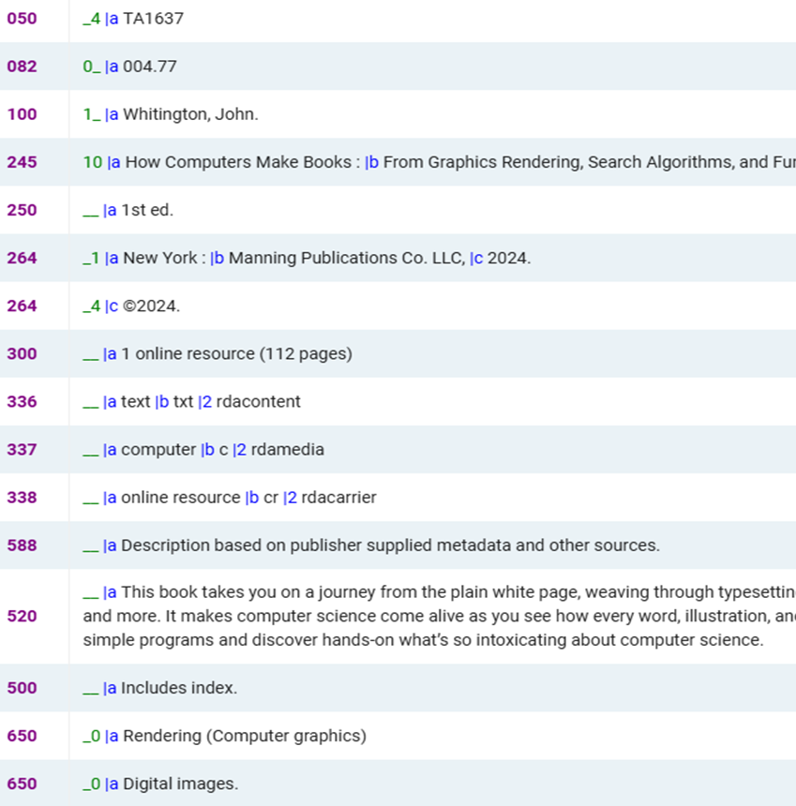
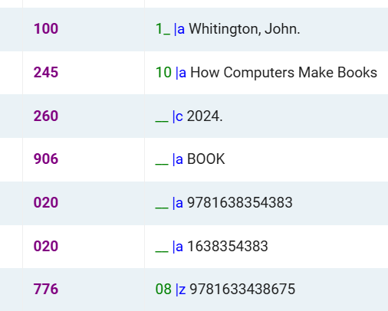
CDI XML Feed
Convert to add more metadata
9780470020456
9780470844922
0470844922

Slide 7
Keeping Metadata Current

Slide 8



Fast and Accurate
Delivering Content Quicker
Automating creation of new collections
26 providers with the Manifest (16 days average)
9 fully automated provider (1 day average)
Daily updates of 99% of the collections in CZ
Alma direct initiative
Changes reflected within one day
New Collections requests
Transparency of new collection requests
CERV community prioritization

Slide 9



Creating New Collection – Statistics and Plans
Software Development
Idea Exchange
Fully automated new collections creation
573
Ideas posted
since January 2024
Upcoming: Pre-Release Indication
Adding Provider Collection ID and Name
NERS
Adding 5 OA
Non-English
providers
Make an Impact
5,200
Collections created by provider request since January 2024 (66%)
49%
Collections created in 2024 with no activations

Slide 10
Supporting Open Access Metadata

Slide 11




The Challenge of Open Access Metadata
Links
Management
False OA
Indicators
Trustworthy Sources
Local
maintenance
Open Access links can be incorrect or broken.
Records may say “Open Access” but lead to paywalled content.
Partnering with content providers and aggregators for OA content.
Fixing, adding and removing Open Access resources locally.

Slide 12




Open Access by the Numbers
Scale, Quality and Impact
165 Full Text Collections in the Knowledgebases
113 of which have high quality Bib rank
61,000 activations across all institutions and products
546M Open Access records in CDI
10% increase in the last 12 months
27 Open Access Ideas completed from Idea Exchange in the last 12 months
Seamless management of Open Access – Open, Accurate and Easy

Slide 13
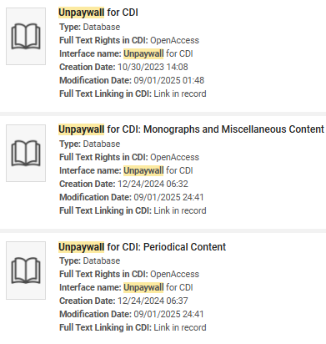
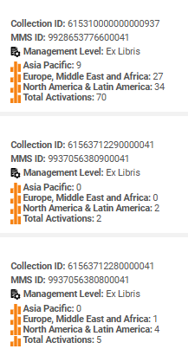
Let’s Talk about Unpaywall
Refreshing and updating the CDI package twice a week
Adding two additional collections for books and journals
Discussion with the Content Working Group
86% of the cases report false Open Access indication and linking issues
80% of the cases report single record issues
Average time of case resolution is 22 days
New Link Checker to remove paywalled and broken links

Slide 14



Looking Forward
Case Resolution
Unpaywall and Ex Libris
Independent updates
of metadata
Re-writing the original Unpaywall code
Focusing on
items with DOI

Slide 15



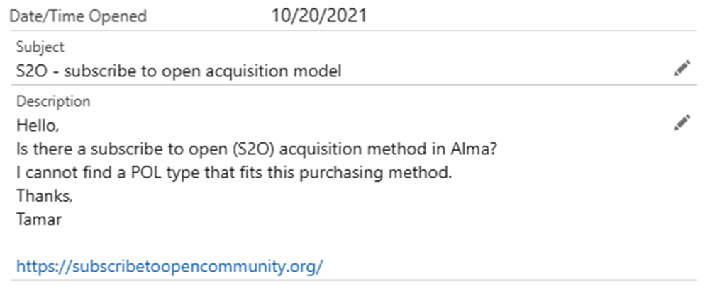
S2O Community of Practice
S2O typology – keeping track of
S2O variants
Supporting the change of metadata in the Knowledgebases and/or CDI
Managing the collection level for subscribers and
non-subscribers

Slide 16
Accessibility Indications
in the Metadata

Slide 17
Accessibility in Bibliographic Records
341 Accessibility content
532 – Accessibility Note
$a – Content access mode (NR)
$b – Textual assistive features (R)
$c – Visual assistive features (R)
$d – Auditory assistive features (R)
$e – Tactile assistive features (R)
$0 – Authority record control number or standard number (R)
$1 – Real World Object URI (R)
$2 – Source (NR)
$3 – Materials specified (NR)
$6 – Linkage (NR)
$8 – Field link and sequence number (R)
$a – Summary of accessibility (NR)
$3 – Materials specified (NR)
$6 – Linkage (NR)
$8 – Field link and sequence number (R)
= 532 \\$acompatible with accessibility standards for most Level A (Priority 1) and AA (Priority 2) success criteria of the Web Content Accessibility Guidelines (WCAG 2.0) developed by the Worldwide Web Consortium (W3C). With the exception that Audio files don’t have transcripts. All the other audio/video-related elements are supported.

Slide 18
What’s Next
Future developments and opportunities

Slide 19






Upcoming Enhancements to Metadata Management
Streamlining Workflows and Maximizing Metadata Value
AI Enrichment for more
Fields
Genres
Providers
Sources (not just full text)
Non-MARC enrichment
More sources for non-MARC enrichment
Automating new collections
Adding more providers for one-day creation of new collections in the Knowledgebases
Authority Correction
Proceeding with SH automatic linking and correction
Adding Names (English)
OER indication in CDI
Adding Document Attribute for OER, visible in facets.
Upcoming collections
Transparency
Planning activation
Reducing Idea Exchange

Slide 20


To
Summarize
Metadata management is constantly improving and evolving
Smooth and efficient workflows for e-resources management
Innovation, transparency and collaboration facilitate
large scale metadata management
A great thank you to the Content Working Group
and CZ Management Group!

Slide 21
Thank You
Tamar Ganor
tamar.ganor@clarivate.com

Slide 22

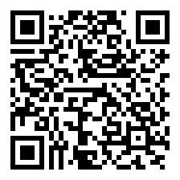


Your voice matters!
Take our 2-min survey now
Help us innovate
Your feedback drives the next generation of valuable solutions
See real impact
The improvements you experience today are direct results of feedback from customers like you
Shape the future
Help us prioritize improvements that will continue to add value to your work

