Slide 1
Advancing Linked Data Adoption and Adaptation in Alma and Primo
Adina Marciano | Product Manager

Slide 2





Agenda
What guides us?
What has been done in the last year?
How to promote adoption?
What does the future hold?
Challenges of the next decade (hybrid)

Slide 3








The Questions That Guide Us
How can we assist in the advancement and adoption of BIBFRAME?
How can we make this user-friendly when it is so technical?
How do we manage the hybrid state of MARC and BIBFRAME side by side?
What does linked data mean for the end user?
How to support innovators and early adopters while thinking of the majority?

Slide 4

What is the End User Looking For?
Consistency enhances user clarity

Slide 5




Linked Data Features H2 2024 ‒ H12025
MARC 21
BIBFRAME
All Formats
For the end user
Linked data enrichment configuration
Supporting local authorities
Sinopia integration
Work Search
Person cards and contributor pages
Names and Subject sections
Linked data navigation
Person: Auto complete, info cards, person page
Supporting additional vocabularies using VIAF

Slide 6



How institutions use BIBFRAME already
Cataloging existing records for learning and comparison
Cataloging special collections
Cataloging local records such as dissertations
Cataloging works with multiple instances
What about you?

Slide 7
Looking Forward
What is planned?

Slide 8
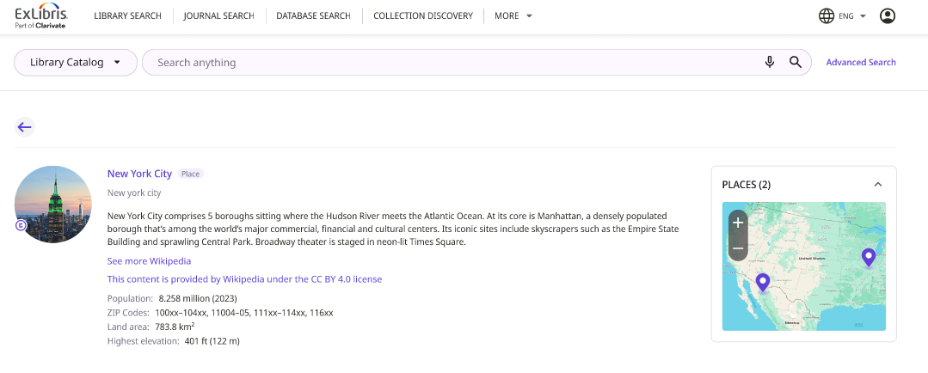
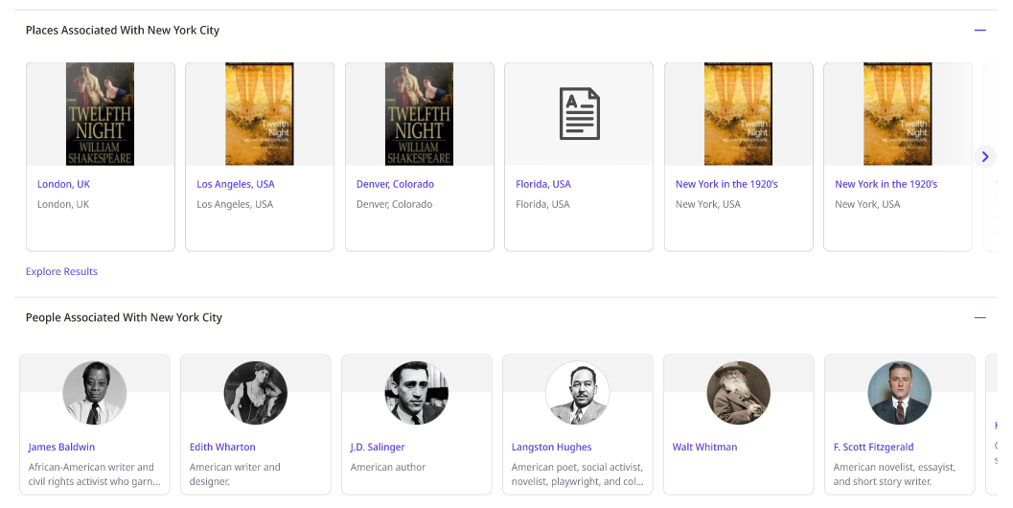
Expanding Linked Data in Discovery
2025 H2
Additional Entities - NDE
Organization
Location
Additional Languages
For all entities
Note: The image is for illustrative purposes only

Slide 9

Linked Open Data Editor (2025‒2026)
Key features
A unified form interface guided by the ontology
Optimal workflow best suited for catalogers
Supporting linked data integrations and lookup services
User-friendly and flexible
Part of the repository Searches
Record and template creation

Slide 10



Sneak Preview
BIBFRAME Form Editor
Still in development
Testing by the linked data focus group
Refining and changing the workflows constantly
Early access planned for Nov 2025

Slide 11
Looking Forward
Future Challenges

Slide 12




Challenges
Of the next decade
Sustainability
Practicality
Hybridity
Adaptability
Stable linked data services
Interoperability
Syncing of systems
Data growth (Wikidata)
New academic formats (RDA)
Adapting to Alma
Usable for non-cataloging librarians
Usable for patrons
Working with AI
For at least a decade
Crosswalks
Linked data displays for all formats
Keeping it simple
Growing usage
New challenges
Working with the community to resolve issues that will arise

Slide 13
Thank You
Adina Marciano
adina.marciano@clarivate.com

Slide 14

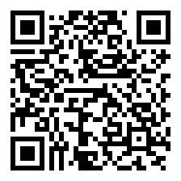
Your voice matters!
Take our 2-min survey now
Help us innovate
Your feedback drives the next generation of valuable solutions
See real impact
The improvements you experience today are direct results of feedback from customers like you
Shape the future
Help us prioritize improvements that will continue to add value to your work

