Slide 1




Linked Open Data SIWG Meeting

Slide 2
Linked Open Data SIWG Meeting
Agenda
Background and status of the SIWG
Cooperation agreement with Ex Libris, activities
Ex Libris view
Communication platforms
Organisation and (s)election of officials
Presentation of use cases

Slide 3
Linked Open Data SIWG Meeting
Background and status of the SIWG

Slide 4
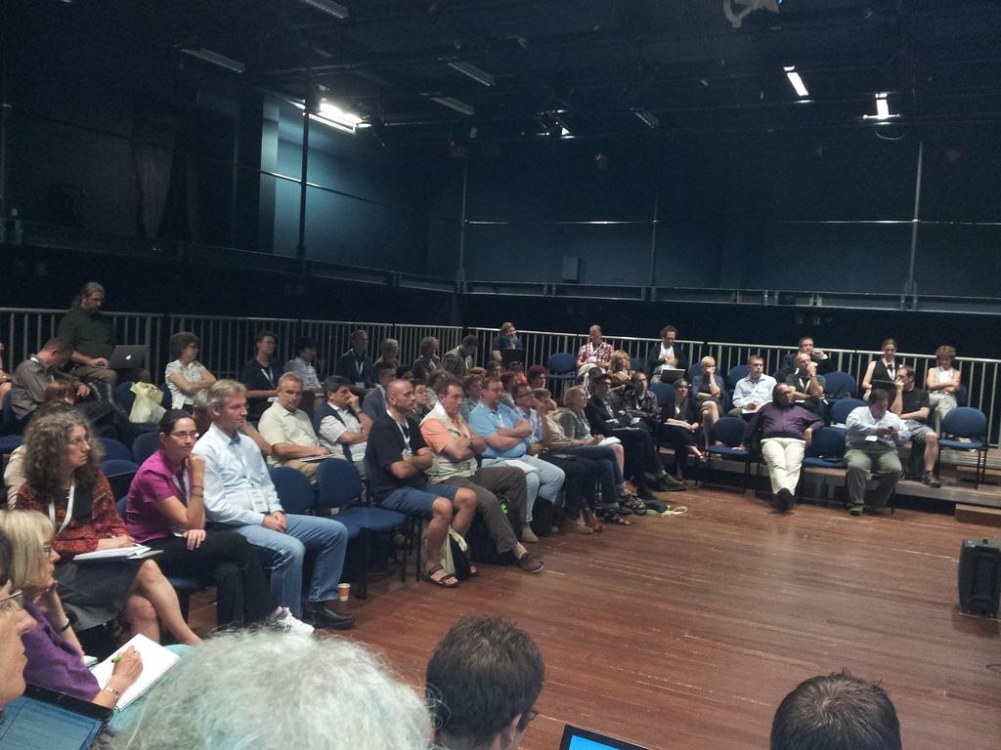

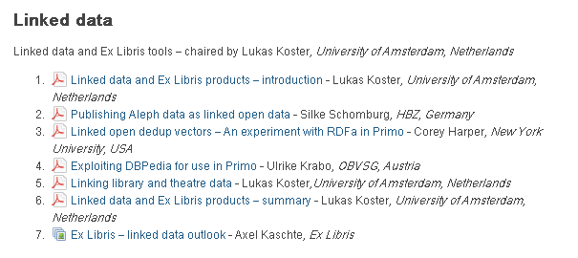
It all started in 2011

Slide 5
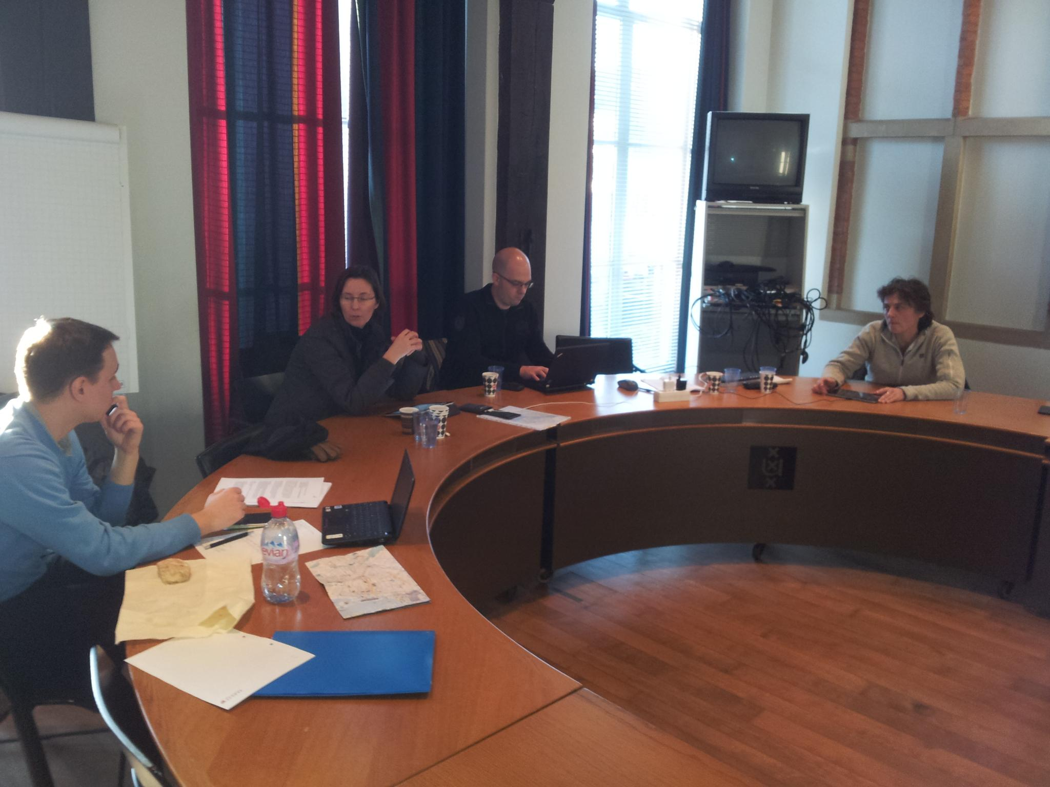
2011-2012 IGeLU LOD SIWG
http://igelu.org/special-interests/lod
Initially 6 people (approx.)
Calls
Meeting in Amsterdam

Slide 6
2011-2012 IGeLU LOD SIWG
Manifesto:
http://igelu.org/special-interests/lod/manifesto
Objectives
Essential linked open data features in all Ex Libris products where appropriate
Means
Collect use cases, scenarios from customers
Discuss and collaborate with Ex Libris

Slide 7

Next episode: IGeLU 2012
Meeting IGeLU LOD SWIG and Ex Libris
Results
Agreement
Next steps

Slide 8
IGeLU LOD SIWG - Starting Point
Document (EL Commons):
Linked Open Data and Ex Libris Products: Visions, Use Cases, Requirements - An open draft
View of LOD SIWG!
http://www.exlibrisgroup.org/display/CrossProduct/Linked+Open+Data+and+Ex+Libris+Products+-+An+open+draft
Introduction
Consumption of LOD
Publication ofd LOD
Architecture
Use cases/Scenarios
Relevance for Ex Libris products

Slide 9
ELUNA 2013
Intention to form a joint
IGeLU/ELUNA LOD SIWG
Approved by IGeLU and ELUNA Steering Committees
Formalising organisational structure
- representation
- (s)elections

Slide 10
Joint IGeLU-ELUNA LOD SIWG
Working relationship with Ex Libris
Sharing and communication platforms

Slide 11

Linked Open Data SIWG Meeting
Cooperation agreement with Ex Libris, activities

Slide 12
Collect and Present of Use Cases
Building on Manifesto and on Vision, Use Case & Requirements Document
Template based on W3C LLD XG
  http://www.w3.org/2005/Incubator/lld/wiki/Use_Case_Template\
  Background, Current Practice, Scenario, Goal, Audience, Limitations, Etc.
Listserv Discussion
Monthly(-ish) WebEx hosted by Ex Libris

Slide 13
Use Case Meetings
July 11, 2013
  Resolve harvested URIs into Primo PNX
  Lukas Koster (U. of Amsterdam)
  http://www.exlibrisgroup.org/display/CrossProduct/July+11%2C+2013
September 30, 2013
  Publishing Mechanisms and Infrastructure
  Pascal Christof, Adrian Pohl (HBZ), Sébastien Nadeau (U. Laval)
October ??, 2013
  You?, or you?, or maybe YOU?

Slide 14
Use Case Categories
Publishing, Consuming, or general infrastructure
Product focus:
Alma
Primo
SFX
Rosetta
“Legacy” products as examples, particularly if generalizable...

Slide 15
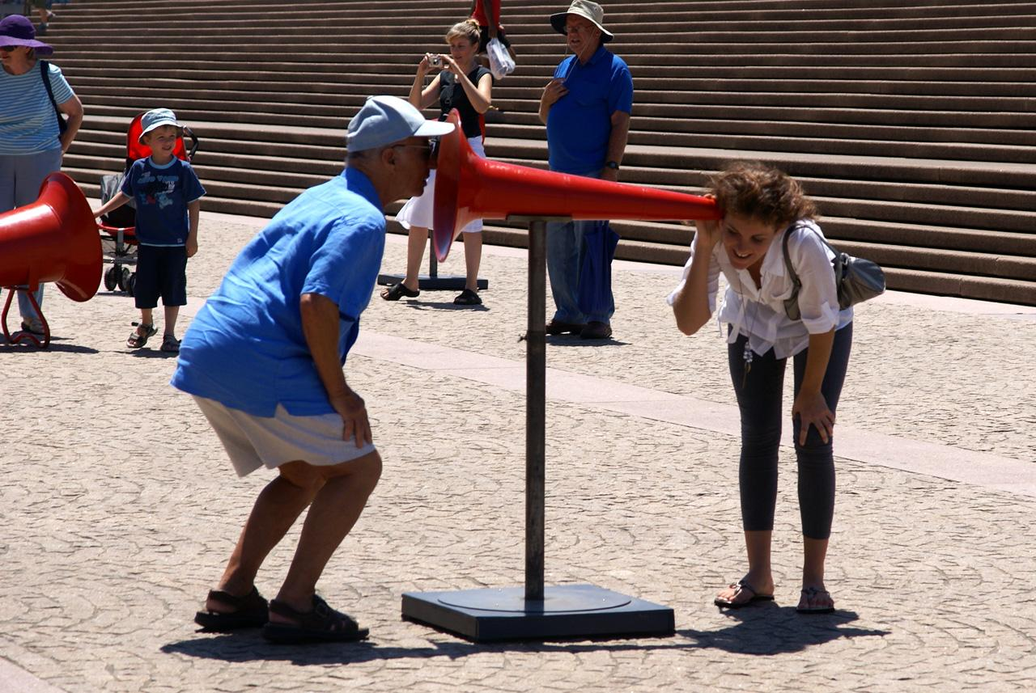

Linked Open Data SIWG Meeting
Communication platforms
http://www.flickr.com/photos/duremi/3200069663

Slide 16





Members only
LOD SIWG
Working
Body
All customers
https://listserv.nd.edu/cgi-bin/wa?A0=IGELU-ELUNA-LOD-SIWG
http://www.exlibrisgroup.org/display/CrossProduct/Linked+Open+Data

Slide 17
Linked Open Data SIWG Meeting
Organisation and (s)election of officials

Slide 18
Members only
LOD SIWG
Working
Body

Slide 19

Call for Coordinator & WB Members
Call for Candidates Sept. 2; Closes Oct. 1
Elections if necessary
http://www.nytimes.com/2012/10/21/sunday-review/candidates-and-the-truth-about-america.html

Slide 20
Linked Open Data SIWG Meeting
Presentation of use cases

