Slide 1
SFX Product Working Group Business Meeting
IGeLU Conference
September 9, 2013
Bas Vat, PWG Coordinator

Slide 2
Agenda
Report on activities 2012-2013
Organization
What we did this year
What is planned for next year
Questions, Comments

Slide 3
SFX Product Working Group (PWG)
Liaison between users and Ex Libris
Discuss member issues
Enhancements processes
Annual conference planning
Newsletter articles
Collaboration with
Ex Libris
IGeLU Steering Committee
National user groups
ELUNA

Slide 4
Working Group Members
Bas Vat, Coordinator (Leiden University Libraries, Netherlands)
Matthias Kratzer, Deputy Coordinator (Bavarian Library Network, Germany)
Inga Overkamp, Enhancements (Max Planck Digital Library, Germany)
Anna Pienimäki, communications, conference planning (National Library, Finland)

Slide 5
Working Group Members
Michelangelo Viana, software enhancements and NERS (Pontifical Catholic University of Rio Grande do Sul PUCRS, Brazil)
Jo Flanders, Vendor relations (St Cloud University, USA)
Holly Thomason, KB enhancements, KBAB liaison (Stanford University, USA)
Mark Dehmlow, SC liaison (University of Notre Dame, USA)

Slide 6
Goodbye...
Thank you very much Inga

Slide 7
Communication
ELUNA
(Maribeth Manoff, Rich Wenger)
SFX Product Manager
(Yisrael Kuchar, Christine Stohn)
Future of SFX
Enhancements process
Quality of CKB updates and service packs

Slide 8
Communication
User Community
List management shared between ELUNA/IGeLU
Discussion Lists
News in brief
Do you hear from us enough?

Slide 9
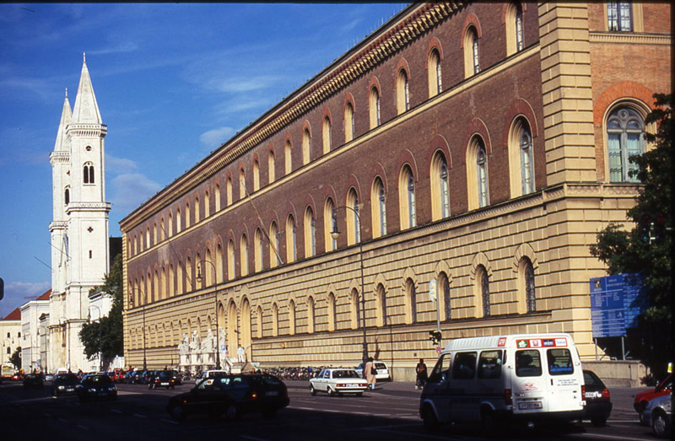
Meeting in March
Bayerische Staatsbibliothek, Munich (thanks to Mathias)
Notes:
Support – regularity, announcements of kb updates

Slide 10
Meeting in March
Discussed
PWG roles
Enhancement processes
Supporting Ex Libris contact with vendors (form letters)
Vendor Checklist
KBAB
Notes:
Support – regularity, announcements of kb updates

Slide 11
Vendor Checklist

Slide 12
Enhancement Process
CKB enhancements – ongoing
results for the 16th round of voting for SFX CKB enhancements (snapshot taken on Aug. 11, 2013). The following resources were elected:
Top 4 general resources:
ProQuest Dissertations and Theses (New Platform);
Wiley's Current Protocols (Series Level);
Open Library;
AIAA Meeting Papers
Regional resources:
Germany: Research Professional
USA: ASCE E-Books

Slide 13
Enhancement Process
Software enhancements
Mobile version of SFX menu (roadmap)
Accessibility
ServicePack 4.5.2, August SFX 4 Revision (20133500) update, includes an accessibility enhancement to the SFX UIs to provide a better user experience when used with screen readers.
The changes are in compliance with WCAG Priority 1 (specifically A and in some cases AA) and Section 508. More details will be available in the release notes.
The enhancement applies to the SFX menus (simplified and advanced), multi-object menu, DirectLink banner, CitationLinker, AZ List and eBook search.

Slide 14
2013 - 2014
Continuing Enhancements
Conference Planning
Form Letters
Periodic News
KBAB !

Slide 15
Agenda
Report on activities 2012-2013
Organization
What we did this year
What we will do next year
Questions, Comments

Slide 16
Questions and Requests
basvat@library.leidenuniv.nl
Things you have questions about
Things you would like us to work on

Slide 17
Q&A
What is the purpose of withdrawn items in the SFX KB? As of KB revision 20133000 we see several items of STATUS = "WITHDRAWN" in the global SFX Knowledge Base: - 249 targets (6.3% of 3,951) - 271 target services (6.2% of 4,357) - 18,192 objects (0.62% of 2,897,995) - 507,270 object portfolios (8.0% of 6,339,624) What exactly is the purpose of keeping withdrawn items in the global KB?

Slide 18
Q&A
MySQL or MariaDB? After the acquisition of MySQL by Oracle will Ex Libris stick to the database technology that has powered SFX for more than a decade or will we see a migration to MariaDB in one of the upcoming revision updates?

Slide 19
Q&A
Support for Version 3
Any updates as to when support for SFX3 will end?

Slide 20
Q&A
E-books
When will be available the a-z list for e-books?
And what about the e-books enrichments? : metadata ...

Slide 21
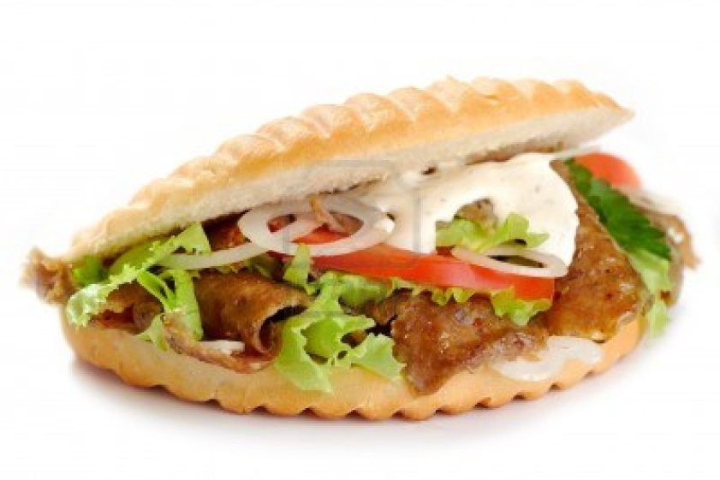
KBAB?
Stands for : Knowledge Base Advisory Board
Discussion started at last year’s conference in Zurich

Slide 22
KB Quality & Policies
Ex Libris agreed to share detailed information on currently implemented policies and processes to assure first class quality of the data stored in the SFX KnowledgeBase.
The SFX KnowledgeBase Advisory Board will review the policies and processes together with Ex Libris, and may either endorse the current policies and processes on behalf of the user community or make suggestions for possible improvements.

Slide 23
KB Quality & Policies
In the long run the board is supposed to
Create its own ideas for new KB policies and/or processes and propose them to Ex Libris;
Receive, review, and forward to Ex Libris any such ideas submitted from the SFX user community;
Provide feedback and advice on intended extensions or changes of KB policies and/or processes on according requests from Ex Libris.

Slide 24
Experiment
New for us all
Take things as they come
Get the community involved
Benefit for Ex Libris and customers

Slide 25
Volunteers
Joint initiative with Eluna (and Ex Libris
Call for volunteers placed via listserv on July 8
Several respondents, 7 people selected

Slide 26
Igelu volunteers
Yosef Branse Haifa University, Israel
François Renaville Université de Liège, Belgium
Mark Needleman Florida Virtual Campus, USA
Holly Thomason acting as liaison for PWG

Slide 27
Eluna volunteers
Ann Ercelawn Vanderbilt University
Erika Banski University of Alberta
Xiaotian Chen Bradley University
Stephanie Aken Kentucky University

Slide 28
Next steps
Gather use cases from past experiences
Information form Ex Libris on current practices
Initiative from volunteers needed
Regular contact, mail conference calls
Get started.....

Slide 29
Ideas???

