Slide 1
Discovery, Services and Integrations with Alma and Primo APIs
Presenter: Jenny Quilliam
Developers: Mark Baldock, Ben Dalwood

Slide 2
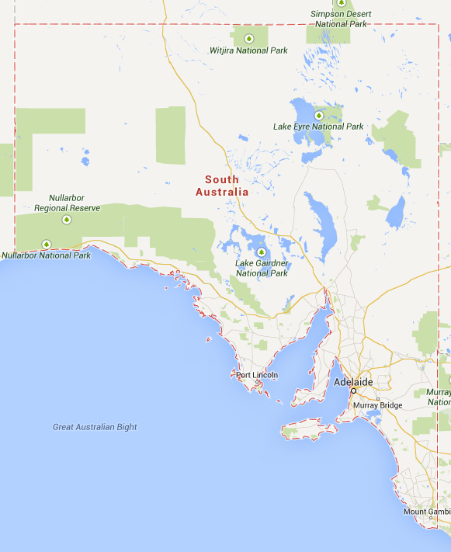
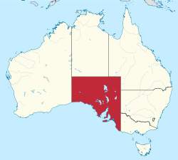
South Australia’s largest University
Over 400 degree programs across a wide range of subjects
4 Faculties across 5 locations
ERA 2012 reported 86% of our assessed research was rated world-class or above
33,000 students / 8,700 international students, 3,500 outside Australia
Whyalla
ADELAIDE
Mt. Gambier
Notes:
The University of South Australia is a globally-focused, locally-engaged institution established on the dual principles of equity and excellence.
With more than 33,000 students, the university is South Australia’s largest and was the youngest Australian institution to be named in the top 50 of 2013 The Times Higher Education’s Top 100 global universities aged under 50.
We offer more than 400 degree programs across a wide range of subjects including business, law, education, arts and social sciences, health sciences, information technology, engineering and the environment.
We are based across five locations with four in metropolitan Adelaide.
The Australian Excellence in Research Assessment evaluation of 2012 reported that 86% of our assessed research was rated world-class or above.
We have around 33,000 students including 8,700 international students – of whom 3,500 are studying outside Australia. Many of our students study in external mode

Slide 3
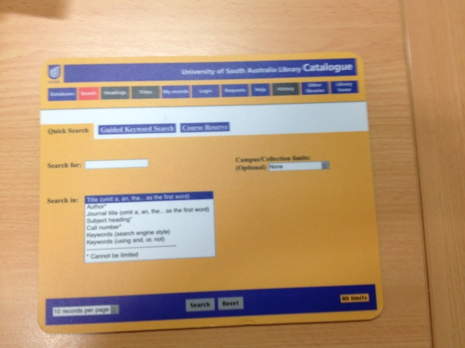
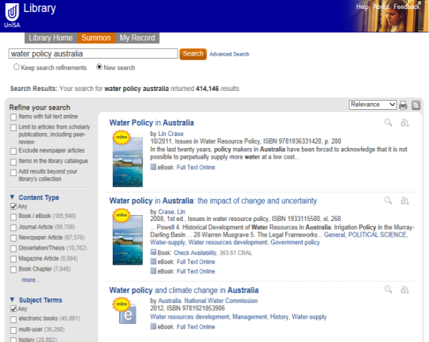
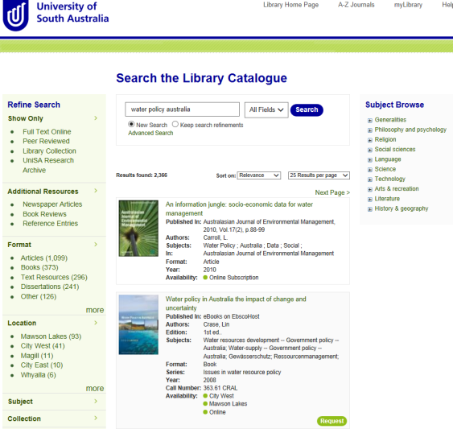
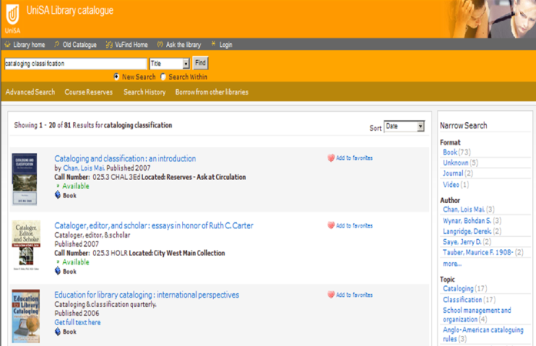
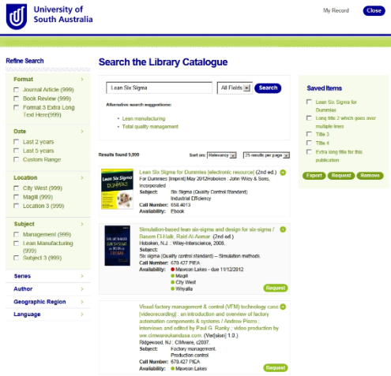
2002 - WebVoyage
2009 - Summon
2014 – Primo / Alma
2008- VuFind
2012- Summon / Voyager
Notes:
Catalogue Timeline
In 2002, when we implemented Voyager, we set up the standard ‘classic’ WebVoyage interface. This was used with minor modifications for several years.
In 2008, VuFInd was installed as the primary catalogue interface. At the time, this offered more flexibility with faceting,
In 2009, The University of South Australia has become the first academic institution outside the US to adopt the new Summon discovery service, enabling
students and faculty to search the entire library collection in its various formats, using one library-branded search box.
In 2011, we had a brief unhappy experience using AquaBrowser as the catalogue as we wanted to create a unified Voyager-Summon search experience.
In 2012, we took the decision to develop our own discovery interface ….. Initially this sat over Voyager and Summon. We also trialled Primo in late 2012, and in early 2013 as our Alma implementation commenced, we signed up with Primo also. As well as the Alma-Primo integration consideration, we were also anxious to have visibility over the publishing of content to the discovery services – this is something that was lacking with publishing Voyager content to Summon – as no reports of publishing outcomes were available and indeed from time to time, we experienced significant and unexplained lags in publishing schedules.
Through 2013, as we implemented Alma
Between 2009 and 2012

Slide 4
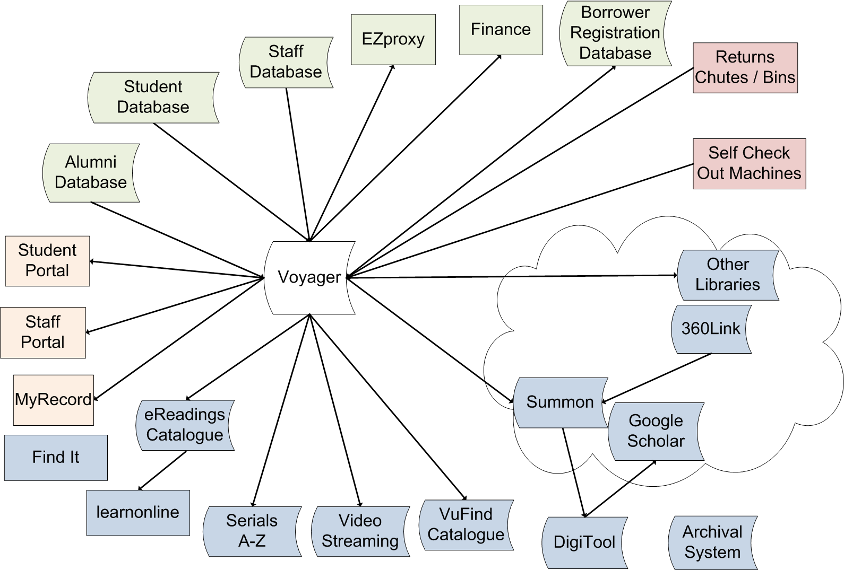
Library Systems (2012)
Notes:
Any library system is heavily integrated into its institution environment - both from a data input and publishing perspective.
Major issues:
Major outages for upgrades
Migrated workflows
Data loads and process concealed
Limitations on data normalisation
Multiple catalogues
By 2012, amassed a range of applications, interfaces and dependencies with Voyager (not all are listed here – some embarrassing moments with AquaBrowser etc).
We had……
Blue – discovery services / repositories
Pink – fulfilment
Orange – borrowing information
Green – administrative
Understanding Alma was on our technology roadmap the Library embarked on a journey to decouple our dependency on our vendor’s software to reduce impact to our patrons as we switched between products.

Slide 5
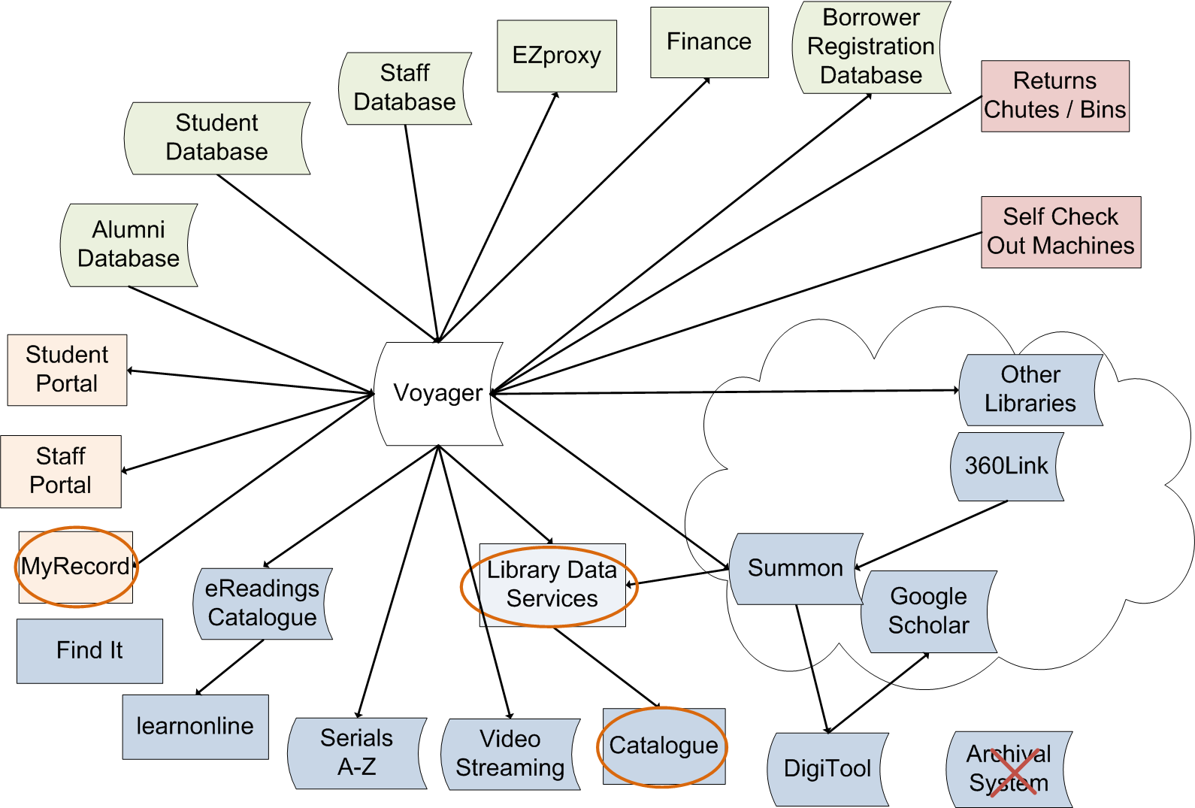
Library Systems (beg. 2013) →Voyager / Summon
Notes:
Prior to our implementation of Alma and Primo, the University of South Australia Library had previously developed a front end (the Library Catalogue) to Summon using their APIs (and Voyager APIs for item availability) and planned to use Primo / Alma in the same way. We had originally decided to develop our own front end based on a user review of the functionality and user interfaces available by discovery services on the market.
To build this front end, staff developed a middleware data layer abstracting Summon and Voyager data – understanding that the Library would be migrating to Alma / Primo in 2013. This data layer was redeveloped to use the Primo and Alma APIs and some minor styling adjustments were needed to complete the migration.
Abstracted our interfaces with Voyager and Summon into our own middleware API – the Library Data Services Interface.
Built a new Catalogue interface in front of our APIs.
And integrated and rebranded our patron borrowing information as myLibrary
We also migrated a locally developed Archival System previousy used for the Bob Hawke Prime Ministerial Archive to DigiTool.

Slide 6
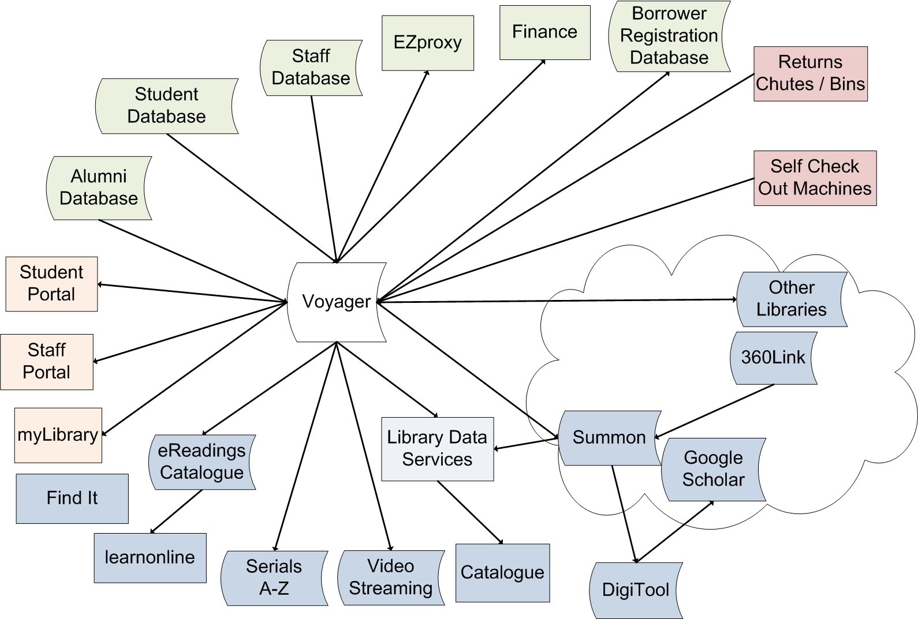
Library Systems (2013) – Voyager / Summon
Notes:
By first teaching period in 2013 we had successfully replaced VuFind and Summon into a single unified interface.

Slide 7
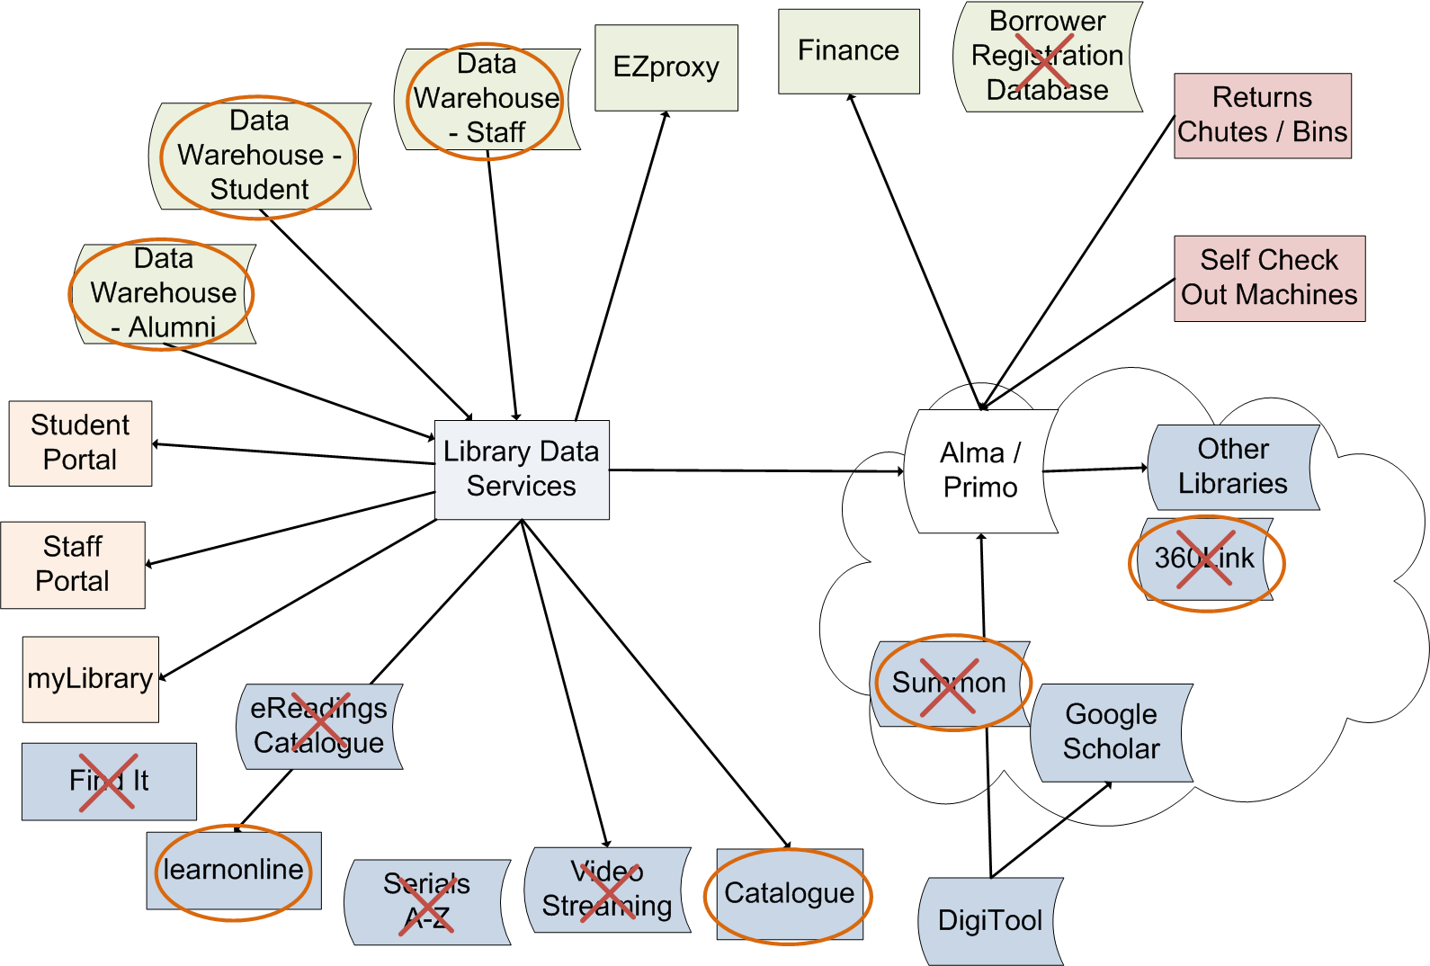
Library Systems (late 2013) →Alma / Primo
Notes:
By 2014, we had successfully removed all of our duplicated data / all those data storage boxes.
Maintaining the same catalogue interface, we replaced Summon with Primo as our discovery index.
In addition, the myLibrary service displaying a user’s current loans, hold requests, demerits and fees previously utilising Voyager’s APIs required redevelopment for Alma’s APIs. Initially the create hold request API was missing from Alma’s web services; and this API was developed by Ex Libris late 2013.
Replaced 360Link with the integrated Uresolver
In doing so, replaced our separate Find It service with a catalogue integrated Open URL resolver
Integrated our Journals A-Z into the Catalogue
Decommissioned our stand alone eReadings Catalogue
We now have a catalogue with embedded video streaming rather than having duplicated metadata elsewhere
And finally sourcing all patron data from our more robust, centralised Data Warehouse rather than disparate systems (e.g. CSV feeds)

Slide 8
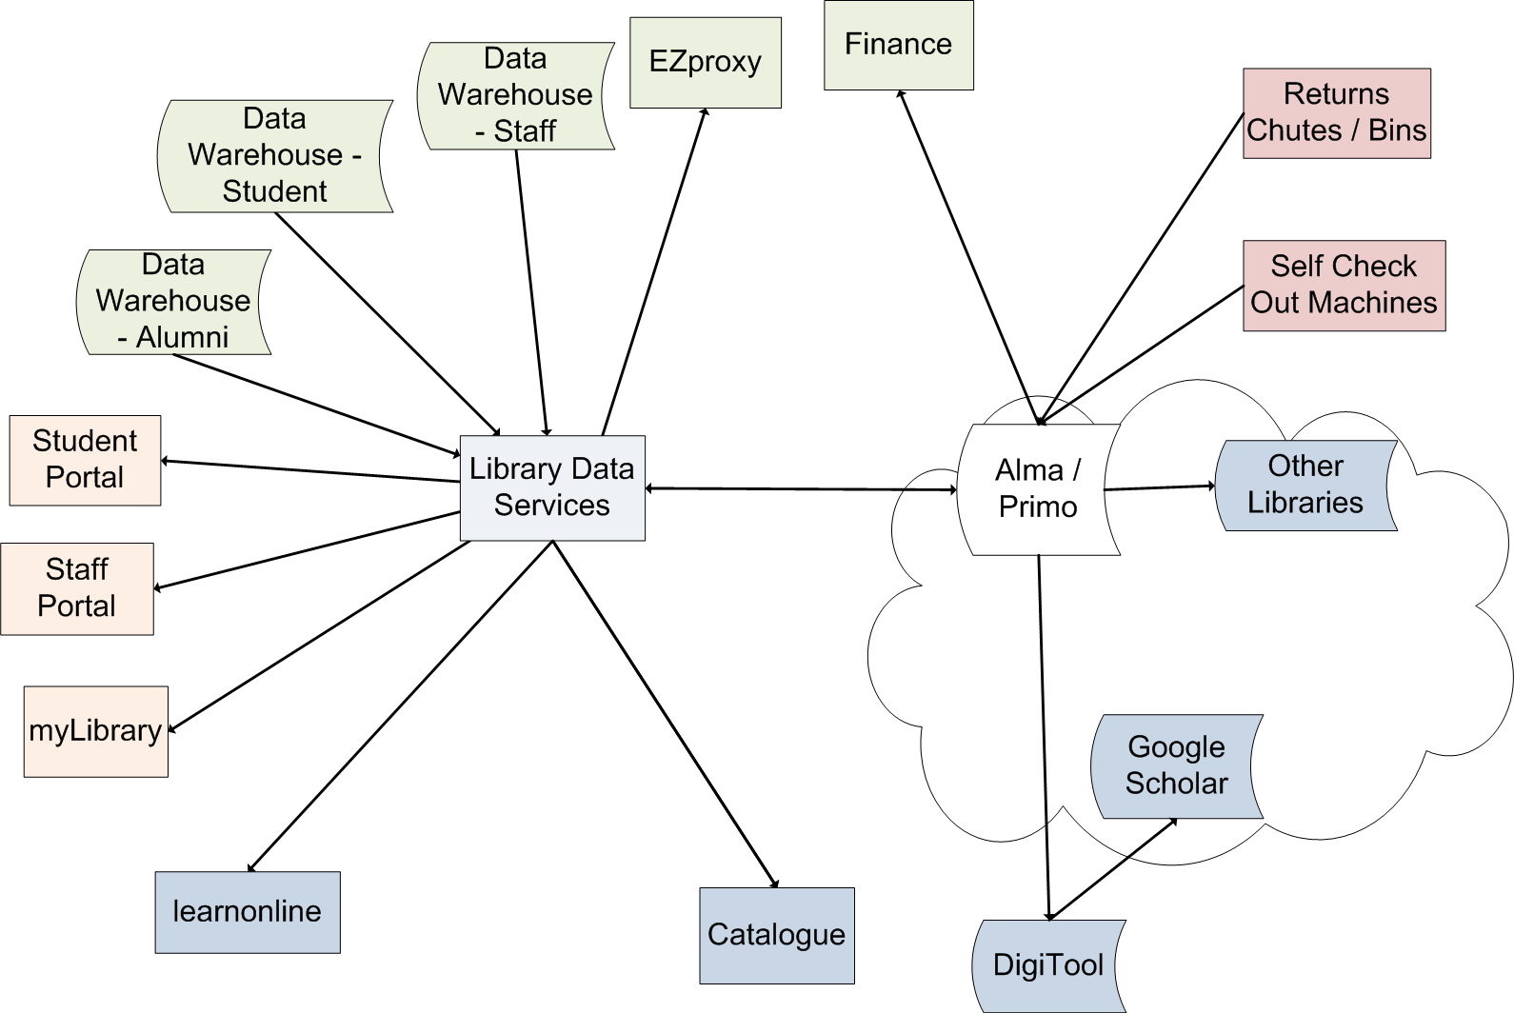
Library Systems (2014) – Alma / Primo
Notes:
Other than our corporate HR and student systems, and our DigiTool repository, we no longer have data duplicated, stored separately from source systems and out of sync.

Slide 9
 | APIs | Library API Abstraction | Catalogue | My Library | Staff / Student Portals | LearnOnline (Moodle)
Alma SOAP | getUserLoans | patron |  | ü | ü
 | getUserCash
 | *getUserDetails
 | *getUserRequests
 | *cancelUserRequests
 | createCourse | course |  |  |  | ü
 | updateCourse
 | *retrieveHoldingsI-Information | holdings |  | ü
 | *getAnalyticsResults-AsXml
Alma REST | users | patron |  | ü
 | bibs | availability | ü
Primo X-Service | Brief Search | courseReadings, patron, availability | ü | ü | ü | ü
UResolver | OpenUrl | availability
Syndetics | Book Jackets |  | ü
 | TOC |  | ü
Notes:
Asterisked API calls are being reworked to be REST calls
Alma SOAP / Alma REST / Primo / Uresolver is abstracted into our own Library Data Services, this has allowed us to be vendor agnostic and allowed us to switch between Voyager to Alma, Primo to Summon with little impact on our front end. Our catalogue, patron services and learning management system then source data from our data services layer.

Slide 10
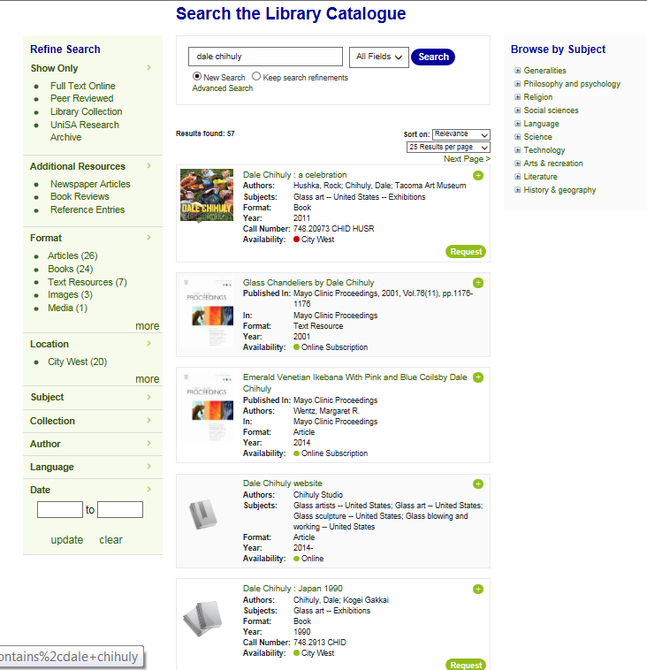
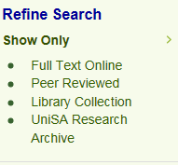
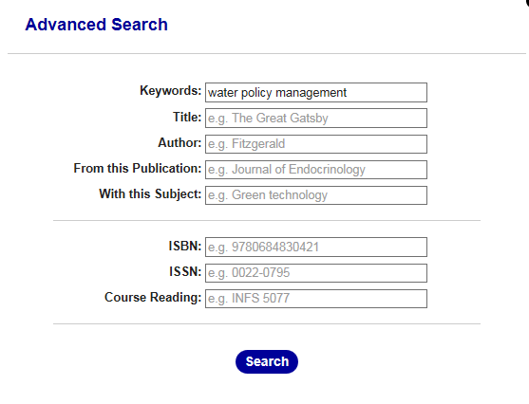
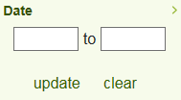
Catalogue search
Notes:
Results for an
Faceting:
Full text online = Primo’s Full text online
Peer Reviewed = Primo’s Peer reveiwed journals
Library Collection = physical collection + subscribed online resources
UniSA Research Archive = limit to Digitool results
Additional Resources = Expand my results (filtered)
Format = Resource type
Location – restricts to physical items by campus / library
Search results can be limited by user defined publication date range
Search Features:
Default is all fields search – though users can limit a simple search to Title, Author or Subject without accessing the Advanced search function
New Search / Keep Search refinements enables users to select whether to keep current facets in place when doing a new search
Advanced Search options: keywords, title, author, source publication e.g. journal titles, subject terms, ISBN, ISSN or Course reading i.e. Series. Search terms are sticky.
Results sort order – as for Primo Native.
Number of search results displayed – by default is set to 25, though users can also select either 10, 50 or 100 results per page

Slide 11
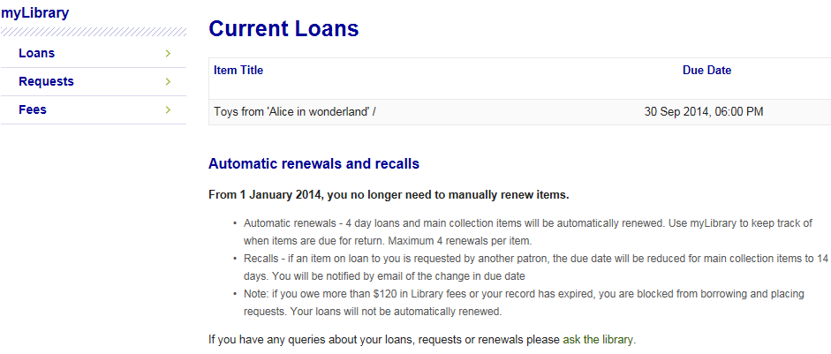
MyLibrary

Slide 12
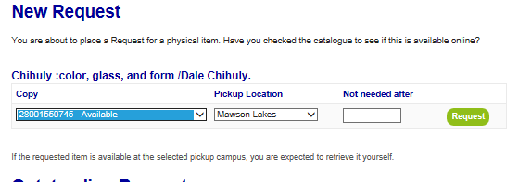
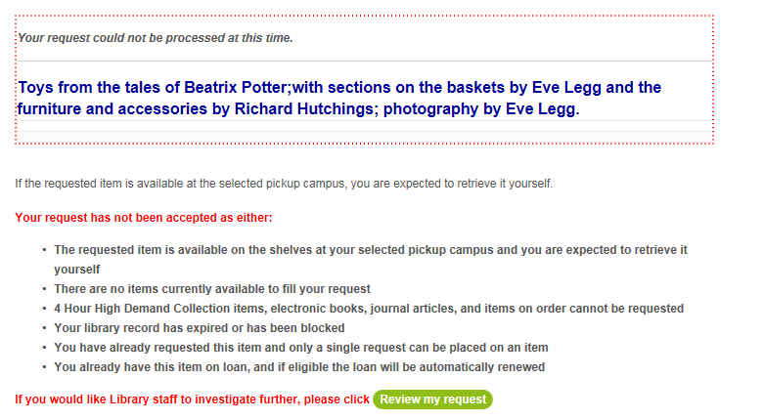
Requesting

Slide 13
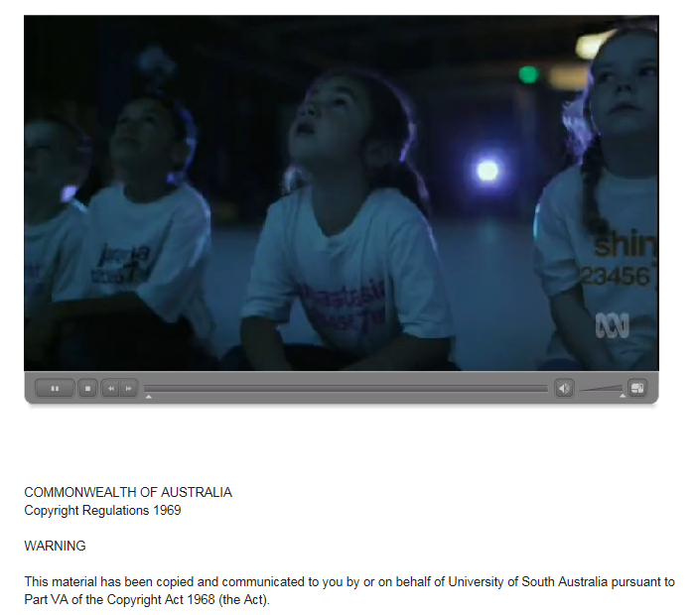
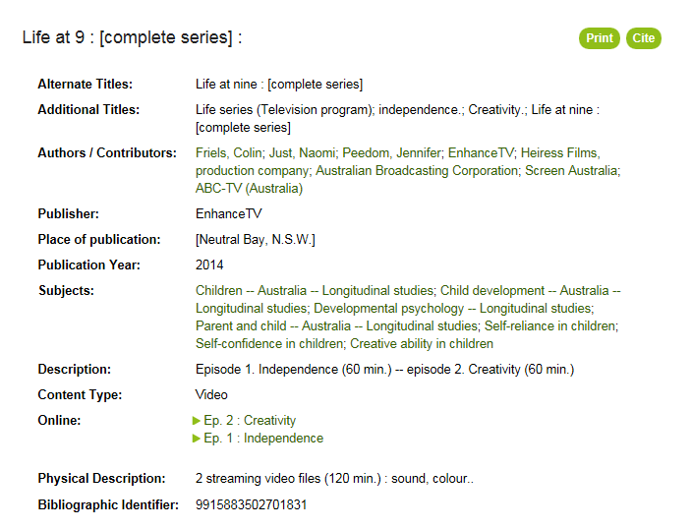
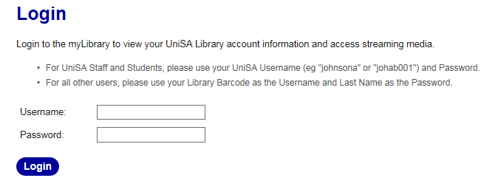
Video Streaming within Catalogue
Notes:
In Australia, there are provisions within the Copyright Act that allow educational institutions to copy from television and radio, provided payment is made to the copyright owners. Typically what we do is to purchase previously broadcast television programs as MP4 files and then stream these for students and staff access. With the increased numbers of streamed videos now hosted by the Library, we have reviewed the technologies and processes being used to deliver streamed videos. Within Alma, electronic portfolios are created and activated for streaming videos.
A number of issues were identified including:
Videos were delivered in a separate browser window and the Copyright and bibliographic information was not persistent; some security concerns as it was possible to discover the resolved URL; significant post-processing of files plus, most importantly, streams were not mobile friendly.
The alternate player which is being developed and trialled opens the video directly from the catalogue interface (in the same browser window) – similar to embedded video. Users will logon via myLibrary rather than being directed to the regular EZproxy authentication in a separate browser window.
We use "Flash Media Server” to stream .flv and .mp4 media using the Real Time Messaging Protocol (RTMP). The RTMP stream is read by a custom .swf Flash Video Player (FLVPlayback) that is embedded within the detailed record page.
The links to each video stream, determined by the portfolio URL, are translated into the RTMP stream address internally for security reasons.
The popup Copyright notice is displayed persistently on all streams. Player controls enable the usual Pause, Volume and Full screen mode features.
We are also pursuing whether we can directly embed streaming videos linked to courses into the LearnOnline Moodle learning management system.
The new process also means that technical services staff create an order in Alma; load MP4 files from the vendor to a secure webserver; create the metadata and electronic portfolio records, and generate the linking URL. The syntax for the linking URL in the portfolio record is quite simple – the final segment being the filename of the streaming video.

Slide 14
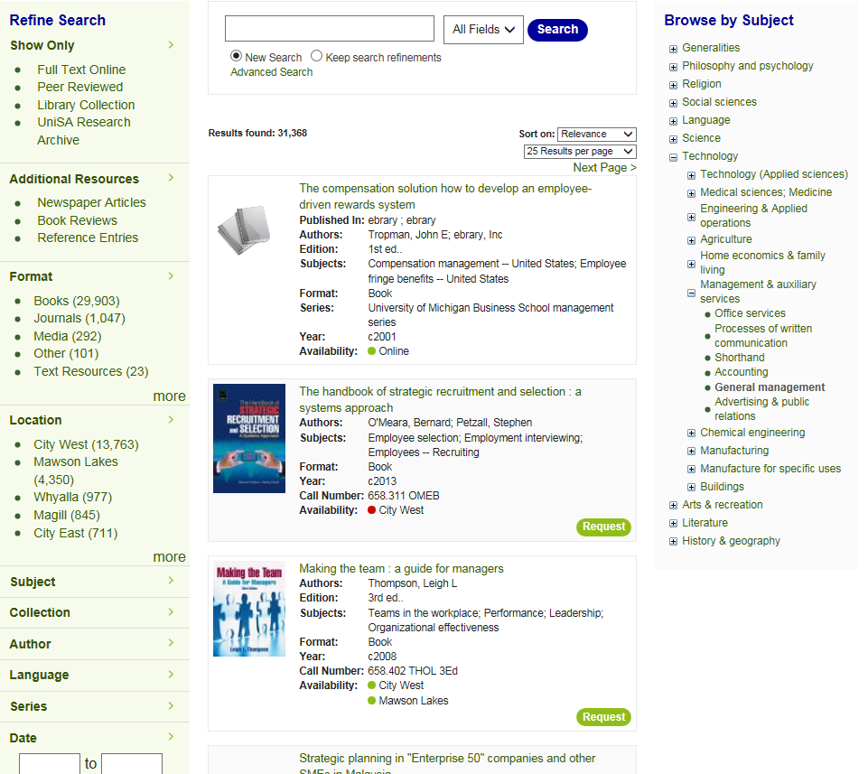
Catalogue Browse by subject
Notes:
Based on the Dewey classification information contained in either the holdings call number (physical) or the 082 field for electronic titles.
Custom fields in Primo for the hundreds, tens, and the thousands have been mapped. Once the user has accessed the Dewey class number, a display of online and physical titles corresponding to the call number is displayed. The usual facets can then be used to limit and further refine the results.

Slide 15
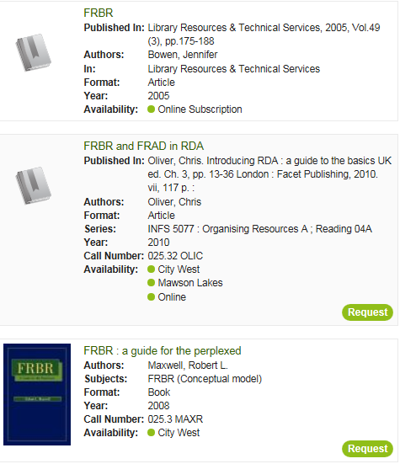
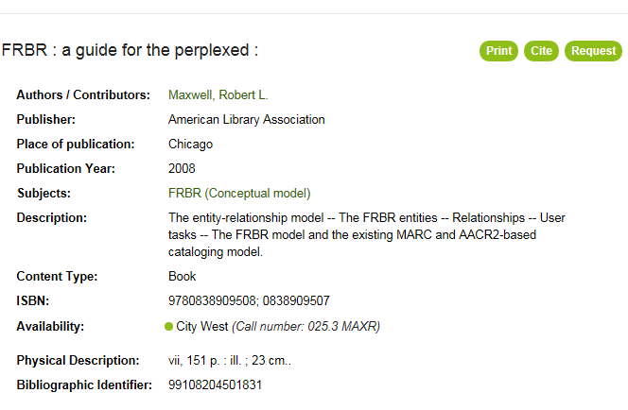
Cite
Notes:
The Cite function generates either a UniSA Harvard or APA style citation. The Results screen includes 2 results which are journal articles and a book result. From the detailed record screen, there are options to Cite, Print the record plus a Request option for physical items. Clicking on the Cite button, the citation is generated – the elements depending on the format of the item. From the Cite screen, citations can be exported to both RefWorks and EndNote. References are not guaranteed to be accurate so a disclaimer is shown.

Slide 16
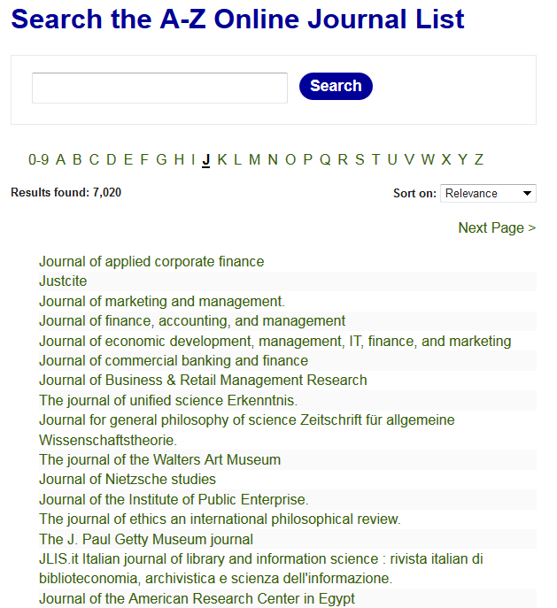
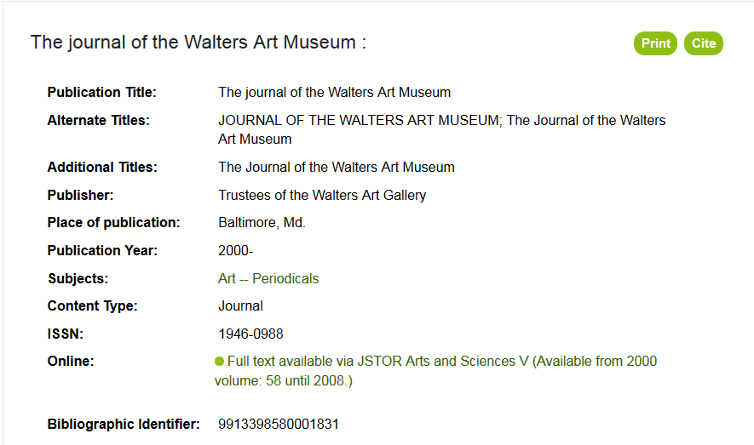
Journals A-Z
Notes:
The Journals A-Z is similar to the out of the box Primo A-Z. The Primo x-services brief search is used together with the undocumented A-Z scope and the undocumented A-Z facet. The hyperlink from the journals list screen opens the detailed catalogue record view.

Slide 17
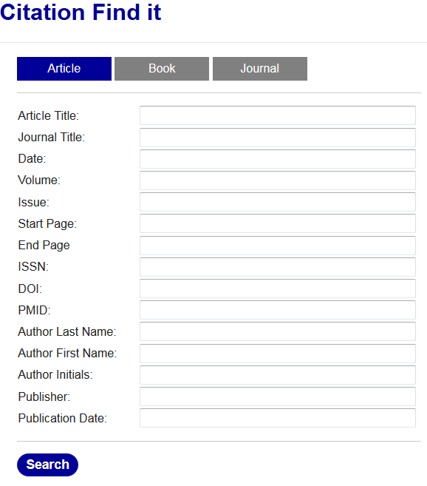
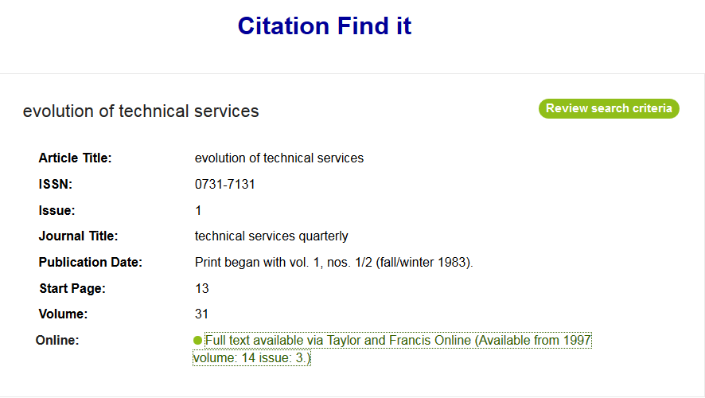
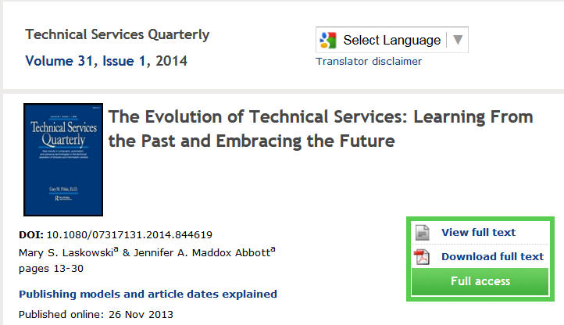
Citation linker – manual entry
Notes:
Citation FindIT uses Uresolver’s OpenURL service. Users are able to review their search criteria directly from the results page – for both successful and failed links

Slide 18
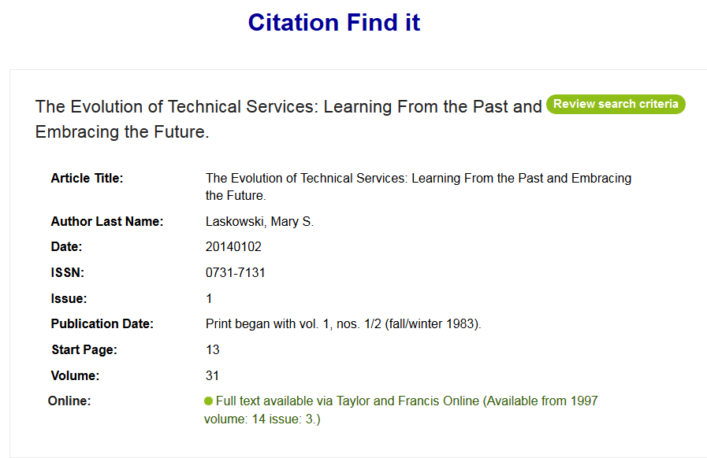
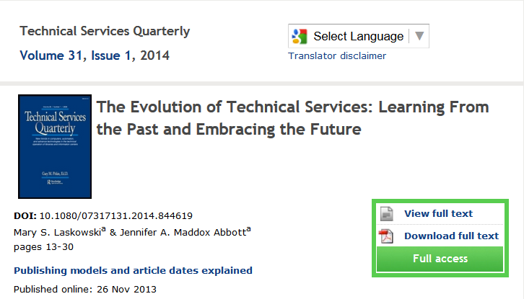
Citation linker – from A&I db / GoogleScholar

Slide 19
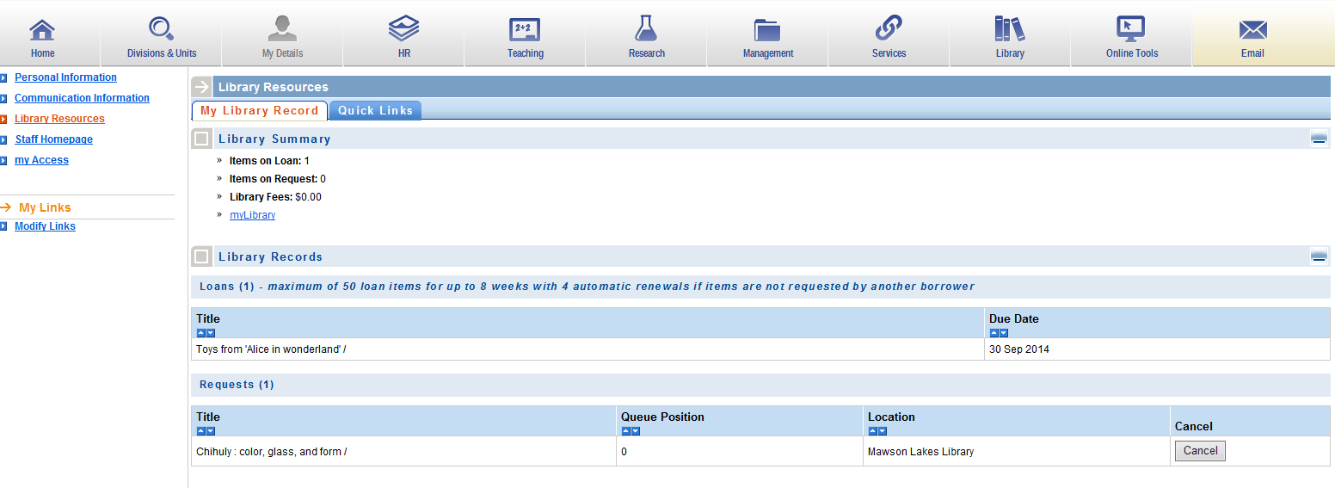
Library Content in Staff portal
Notes:
The University has corporately managed staff and student portals which each have a Library section allowing our staff and students to display patron information / renew loans / cancel hold requests, search and view records and place hold requests. This is a screenshot from the staff portal – the getuserdetails APIs are in use here.

Slide 20
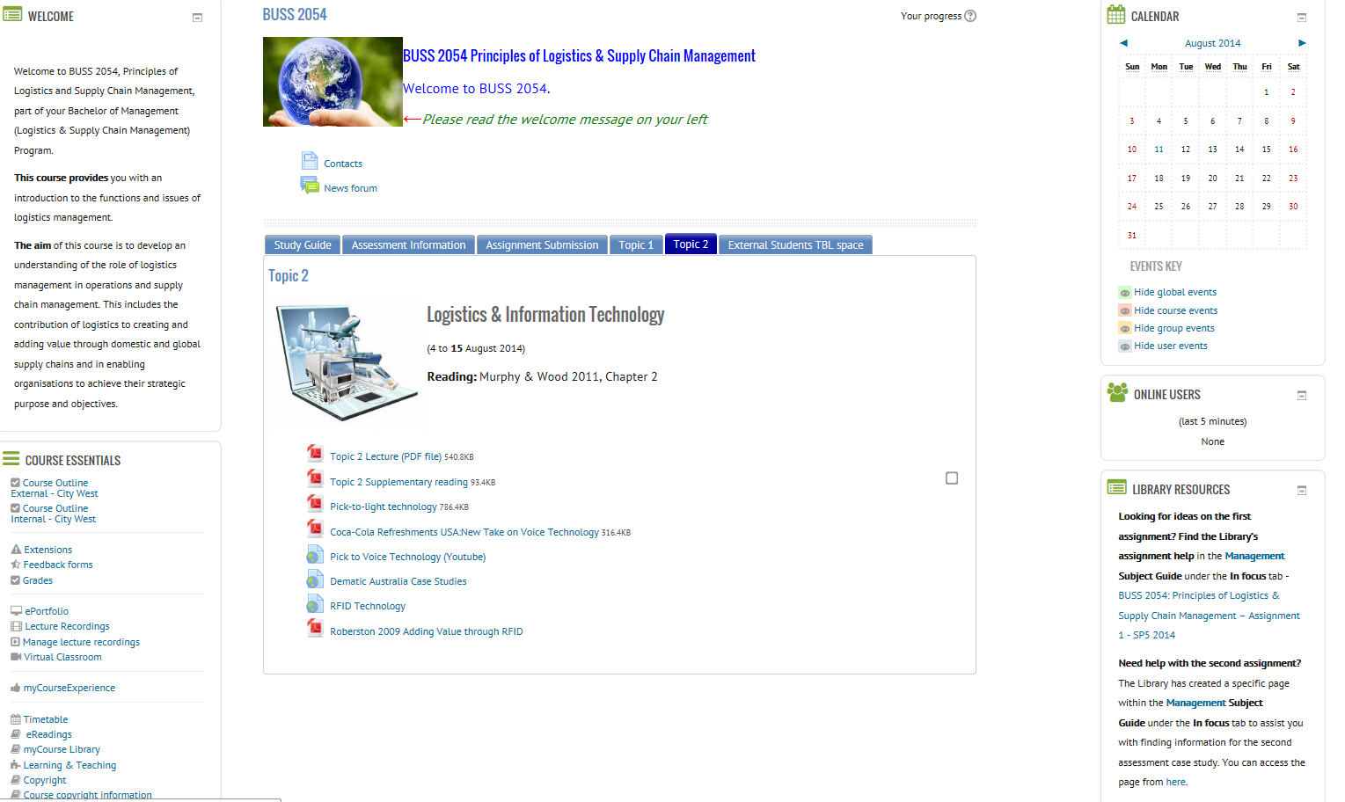
Library Content in Moodle (LearnOnline)
Authored links
Default links
Notes:
The University of South Australia has used the Moodle learning management system since 2009. Ereadings for courses were previously managed in Voyager and have been migrated to Alma. Ereadings have been made available on course pages since then. Originally we generated a web page of links based on a back-end SQL query into Voyager. With Alma / Primo, a much slicker integration has been achieved.
Starting with the overarching objective of integrating library content into LearnOnline by providing a unified interface in a way that contributes a superior student experience, the aims of the integration were to:
Simplify discovery of eReadings content for a given course.
Highlight eReadings availability for a given course.
Improve exposure of Library related support material related to a given course.
Ensure existing eReadings content is available throughout the upgrades.
LearnOnline displays two default library content links in the Course Essentials block - the “eReadings” and the “MyCourse Library” links in the Course Essentials block.
In this particular course, the Lecturer has also include a number of other library links:
There are links to Assignment Helps – these are created by Academic Librarians and either the request is made by the Course Coordinator OR when the library has received many requests for assistance with a particular assignment, the divisional team contacts the CC and then creates a particular assignment help.

Slide 21
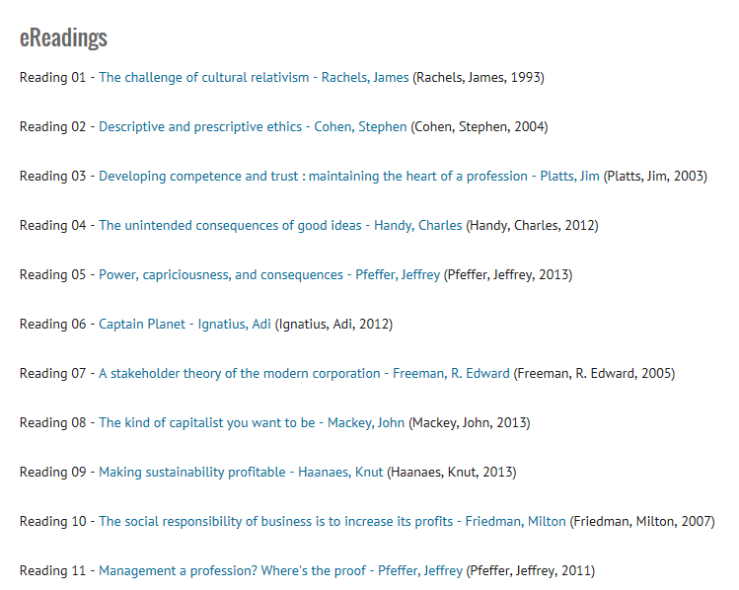
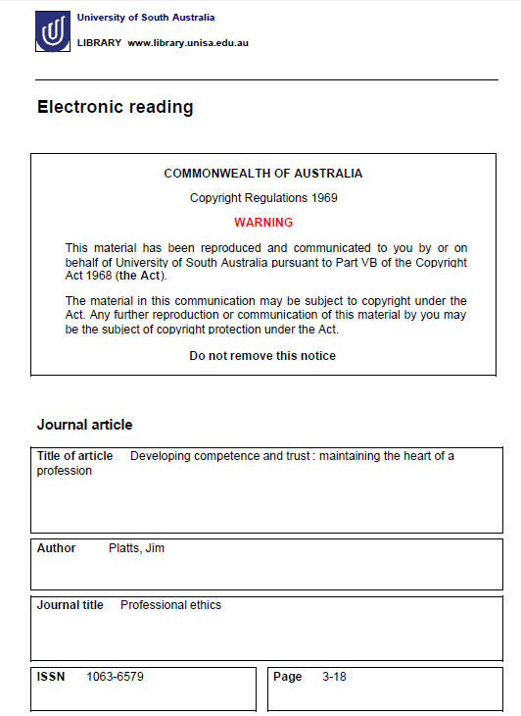
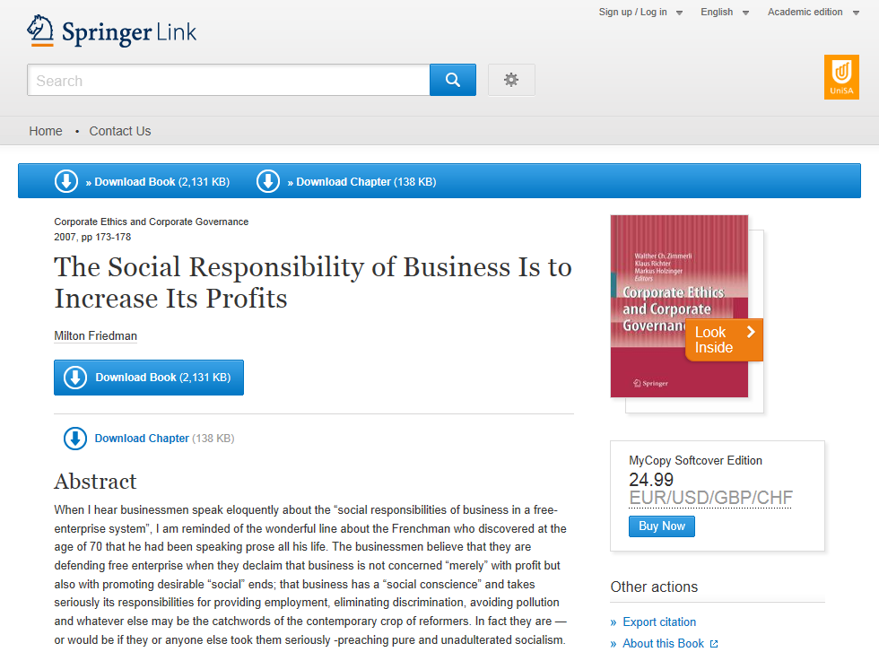
eReadings
Notes:
Working in collaboration with Learning & teaching systems, the library developed an ereadings webservice to
Expose eReadings search results based on course code via web service (title, reading number, author, pub year)
Links from search results are autoredirected to full text via Alma’s Open URL resolver software
Developed Moodle plug-in to read the output from the ereadings webservice
Final display is sorted by reading number if available; otherwise in title order.
Within a learnonline course site, the interface displays an eReadings link in the Course Essentials block if the course coordinator does not manually disable the link and the Library web service (/CourseReadings) identifies eReadings are available for the course.
The eReadings link (1) will direct a user to an eReadings learnonline page (2), in the current browser window, displaying data from a catalogue search result. eReadings are then listed with high level metadata. The title of the eReading links to authenticate through EZproxy (3) and view the full text eReading document (4). The eReadings are to be in ascending order of reading number and title.
Two examples:
The first is for a digitized ereading and authentication to access the reading is required – whether on or off campus. Once a student has authenticated, any subsequent ereadings accessed open directly..
The second example is for a linked ereading, and if the student is on campus, the link is direct and no authentication is required.

Slide 22
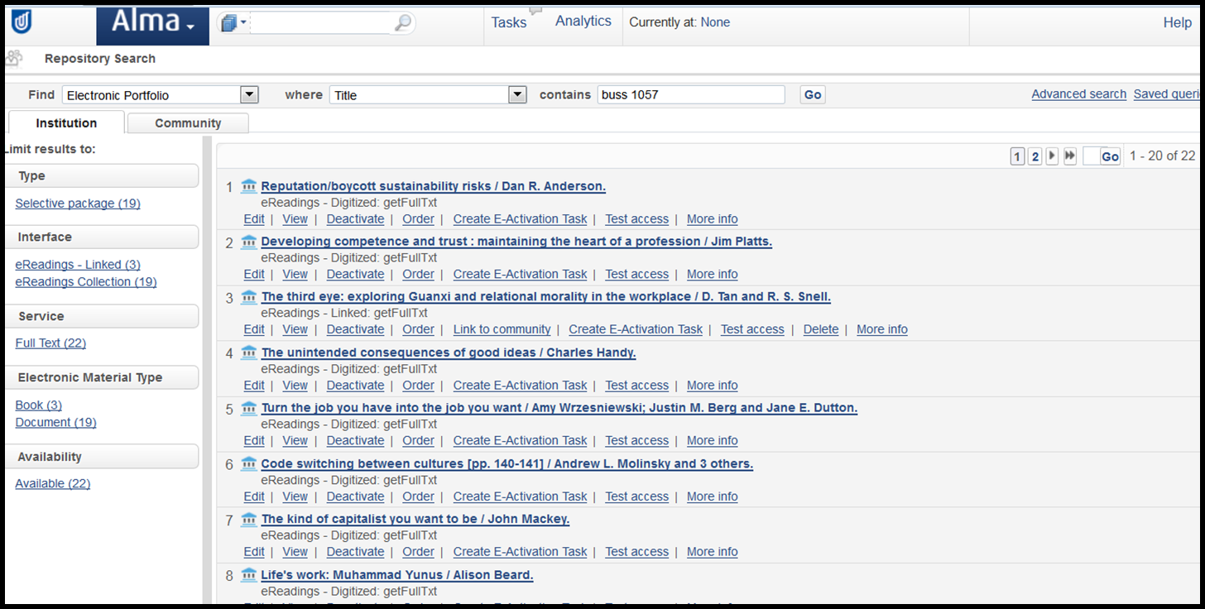
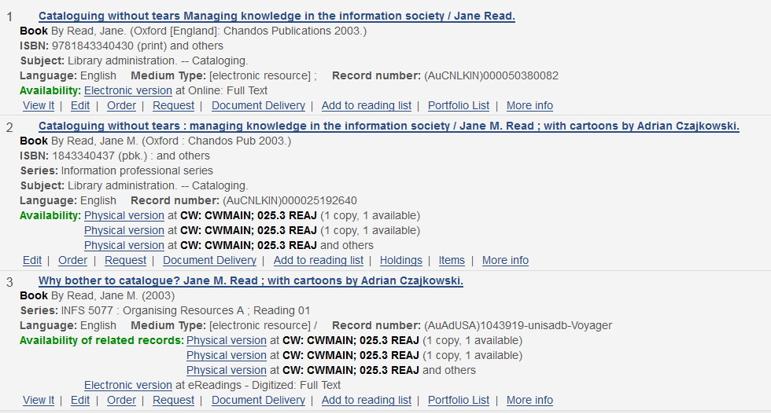
eReadings in Alma
eBook
Print
eReading
Notes:
The Library through the Digital Resource Service (DRS) is responsible for making available all course electronic readings. Currently we manage around 28,000 ereadings. The Library must ensure that all ereadings are compliant with Australian Copyright requirements and that metadata required for the triennial Copyright Agency Limited (CAL) audited is captured and recorded.
Links to ereadings are via electronic portfolio – and local collections for both digitized and linked ereadings have been setup. Digitized readings are stored in a dark Fedora repository – and there is an simple file ingest process where the filename is the MMSID, and the portfolio link syntax also references the MMSID.
Alma’s related works function links the various manifestations of a title together. In the situation, where a lecturer has requested a chapter of a book to made available as an eReading, staff are quickly able to confirm whether such a ereading will comply with copyright law. In this example, an Alma inventory search shows that we have this title both as an ebook and a physical book, and that a chapter from the book has already been digitised and made.
There is an ongoing project for library staff to replace digitized ereadings with links.

Slide 23
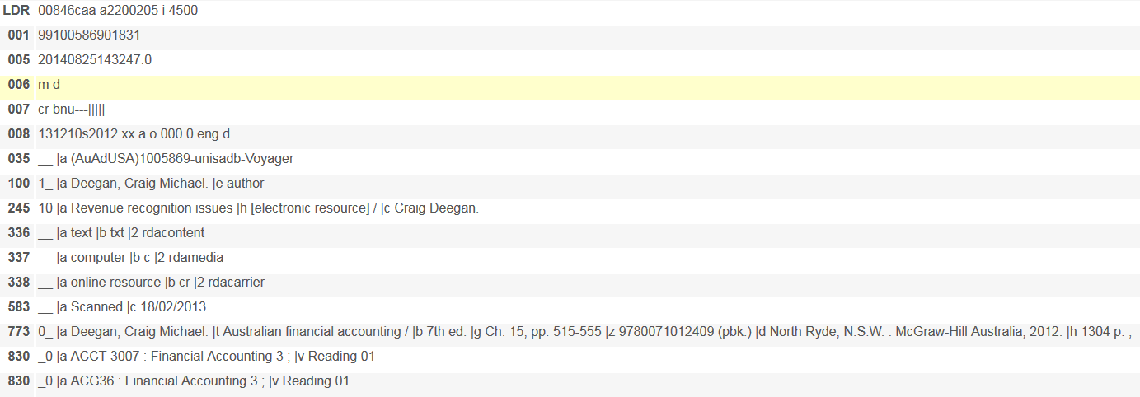
Metadata for a digitized eReading
Notes:
Here is an example of the metadata in a record for a digitized ereading
This reading is used by 2 courses, hence a double series 830 field – noting that the reading number can vary by course.
The 773 field serves two purposes: the 773 field contains information about the “parent title”; that is, the item from which this reading is taken. Firstly, it enables the related works functionality in Alma and secondly and most importantly, it includes the information (title, author, ISBN, publication and description details and chapter information). The 583 field is used to track the Communication date that we are required to report to the Copyright Agency Limited for the triennial survey.
Each metadata record has an accompanying portfolio record which includes the linking details.

Slide 24
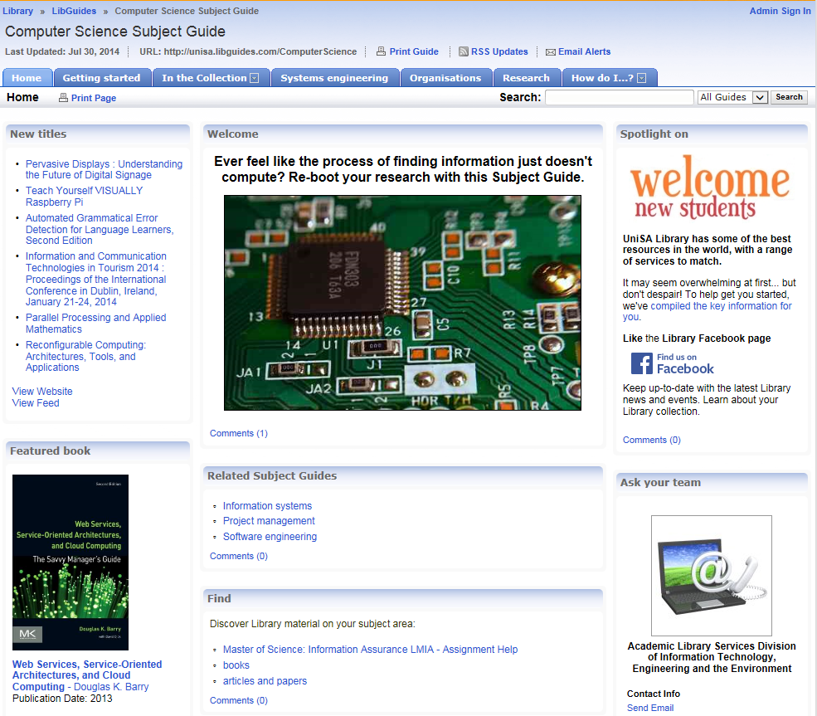
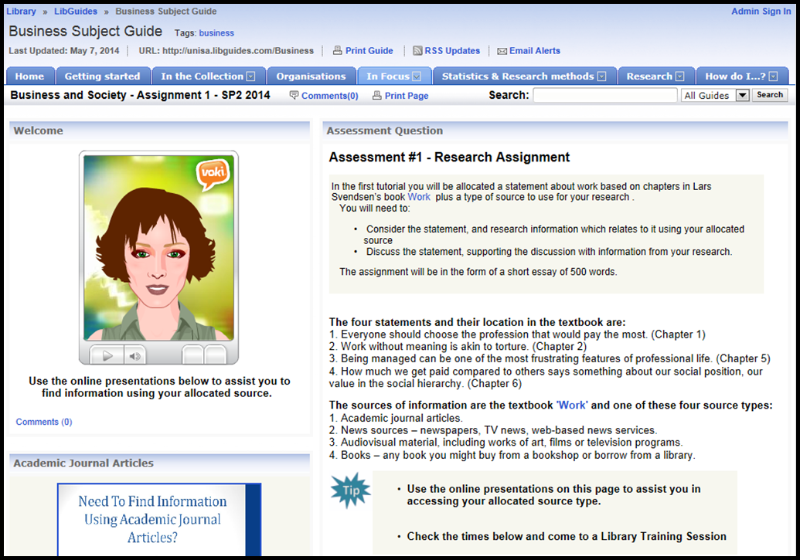
LibGuides integration into Moodle
Notes:
The ‘MyCourse Library’ link takes students to the relevant Library subject guide for the topic / discipline. The subject guides have embedded metadata to enable the link. For some courses, there may be two or more library subject guides. Where there is just a single relevant subject guide, the ‘MyCourse Library’
Link to a Library Subject Guide for your discipline to explore the "Getting Started" page. There you will find links to a range of resources, including videos, websites and workshops that will help develop your information research skills.
Each Subject Guide provides a launch pad to authoritative, reliable resources and information on a specific topic. These guides are pathways to assist you in beginning research.
A “Textbook” block sources live holdings / availability, thumbnails, and link to the Library catalogue to improve discoverability and access to resources.

Slide 25
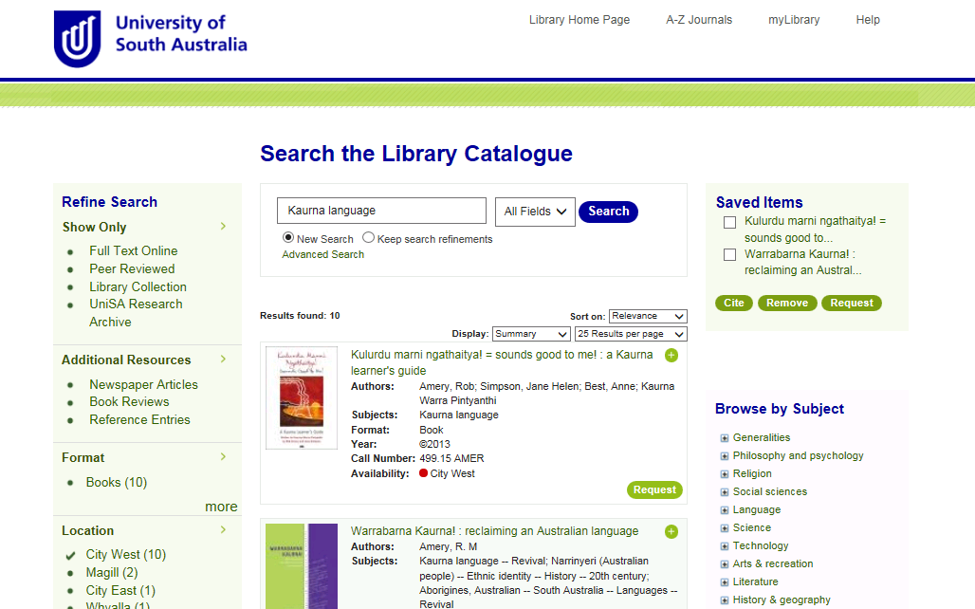
Saved Items
Notes:
Saved Items functionality – users can save a set of results for later action – citations, requesting

Slide 26
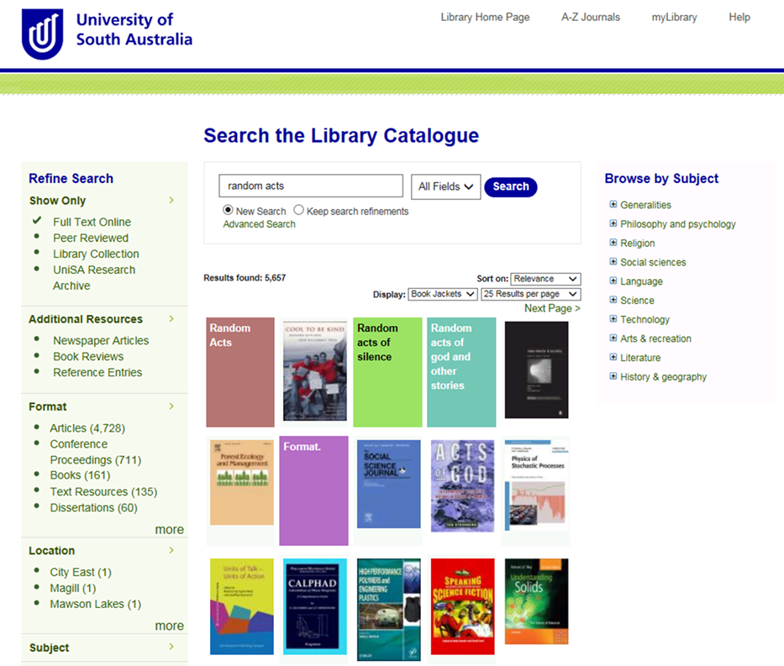
Results display as book jackets

Slide 27
To Do List
Transition Alma APIs from REST to SOAP
Saved Items functionality rollout
Databases A-Z listing (based on Alma Collections) Digitool → Alma Digital
Resource sharing with Libraries Australia
Single Sign On
Alumni-specific catalogue
Notes:
By the end of the 2014, we hope to:
remove DigiTool as a separate discovery service
have Google Scholar harvesting repository content directly from Alma
have an Alumni specific catalogue filtering a subset of Primo Central content
reduce the dependency on EZproxy for all of our local resources
Provide single sign on between the staff / student portals, learnonline our moodle learning management system, myLibrary (our patron service), and all local resources (repository, ereadings, streaming video).
Integrate ILL requests into an Alma resource sharing workflow, and borrower information systems.
2015:
Single sign on for all Library services / EZproxy (or its replacement)
Integrate all DigiTool metadata into Alma
Saved searches into myLibrary

Slide 28
Presenter
Jenny Quilliam
Manager, Information Resources & Technology
jenny.quilliam@unisa.edu.au
Developers
Mark Baldock
IT & Web Services Coordinator
mark.baldock@unisa.edu.au
Ben Dalwood
Web Developer
ben.dalwood@unisa.edu.au
Notes:
Development of these interfaces and services has meant that whilst the underlying software has changed, the look and functionality of the catalogue and integrations with the portals and the learning management system has been maintained. We are actively working on further improvements and services to the catalogue and to the best of our knowledge, we are the only library extensively integrating with both Alma and Primo’s web services.

